Slide 1
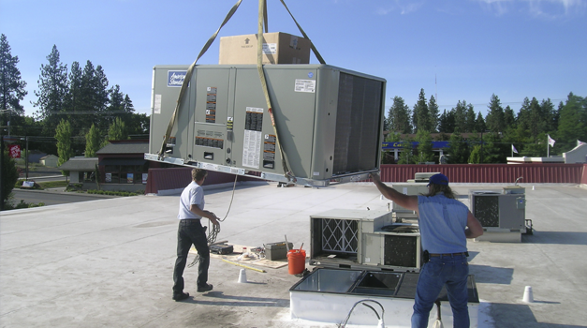
Mechanical Systems

Slide 2
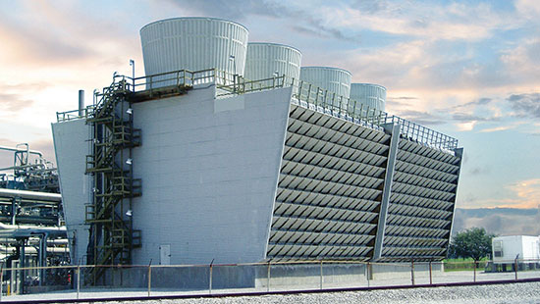
HVAC Fundamentals
HVAC Systems
Purpose
Heating, Ventilating, and Air Conditioning (HVAC) systems are designed to provide and control:
Temperature (heat intensity)
Enthalpy (heat quantity in the air)
Humidity (relative, dew point)
Pressure (atmospheric, building pressurization)
Air Motion (mechanical, fans, diffusers)
Ventilation (air freshness, oxygen content)
Air Quality (pollution, contaminant, odors)

Slide 3
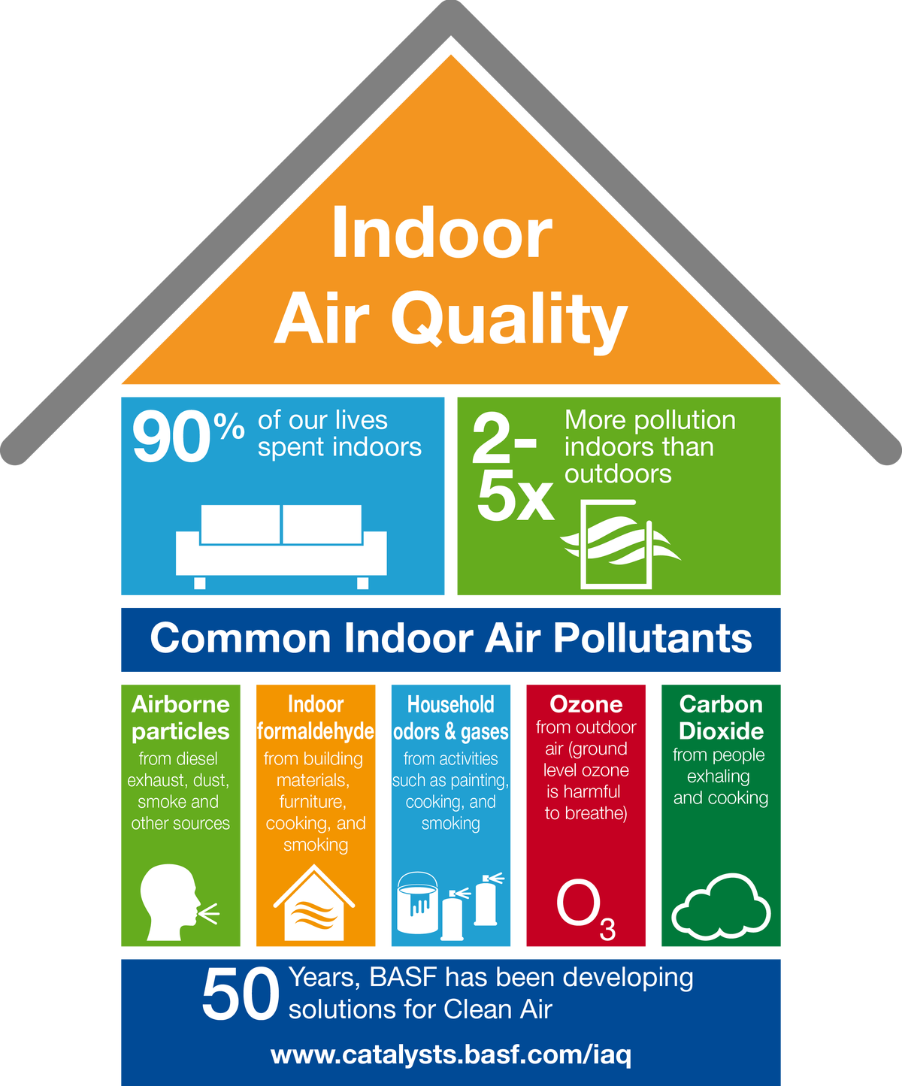
HVAC Fundamentals
Indoor Air Quality (IAQ)

Slide 4
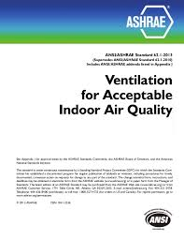
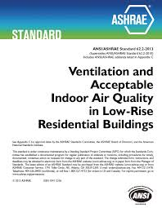
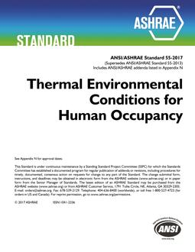
HVAC Fundamentals
American Society of Heating, Refrigeration, and Air Conditioning Engineers (ASHRAE)

Slide 5
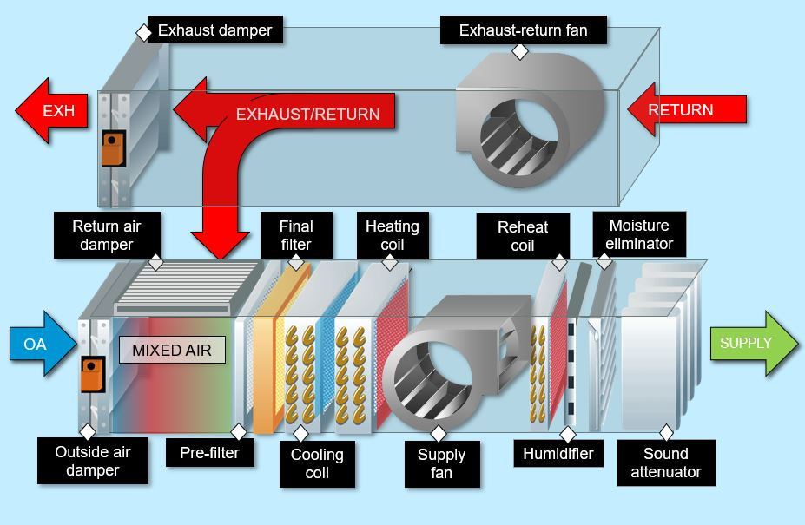
HVAC Fundamentals
Design

Slide 6
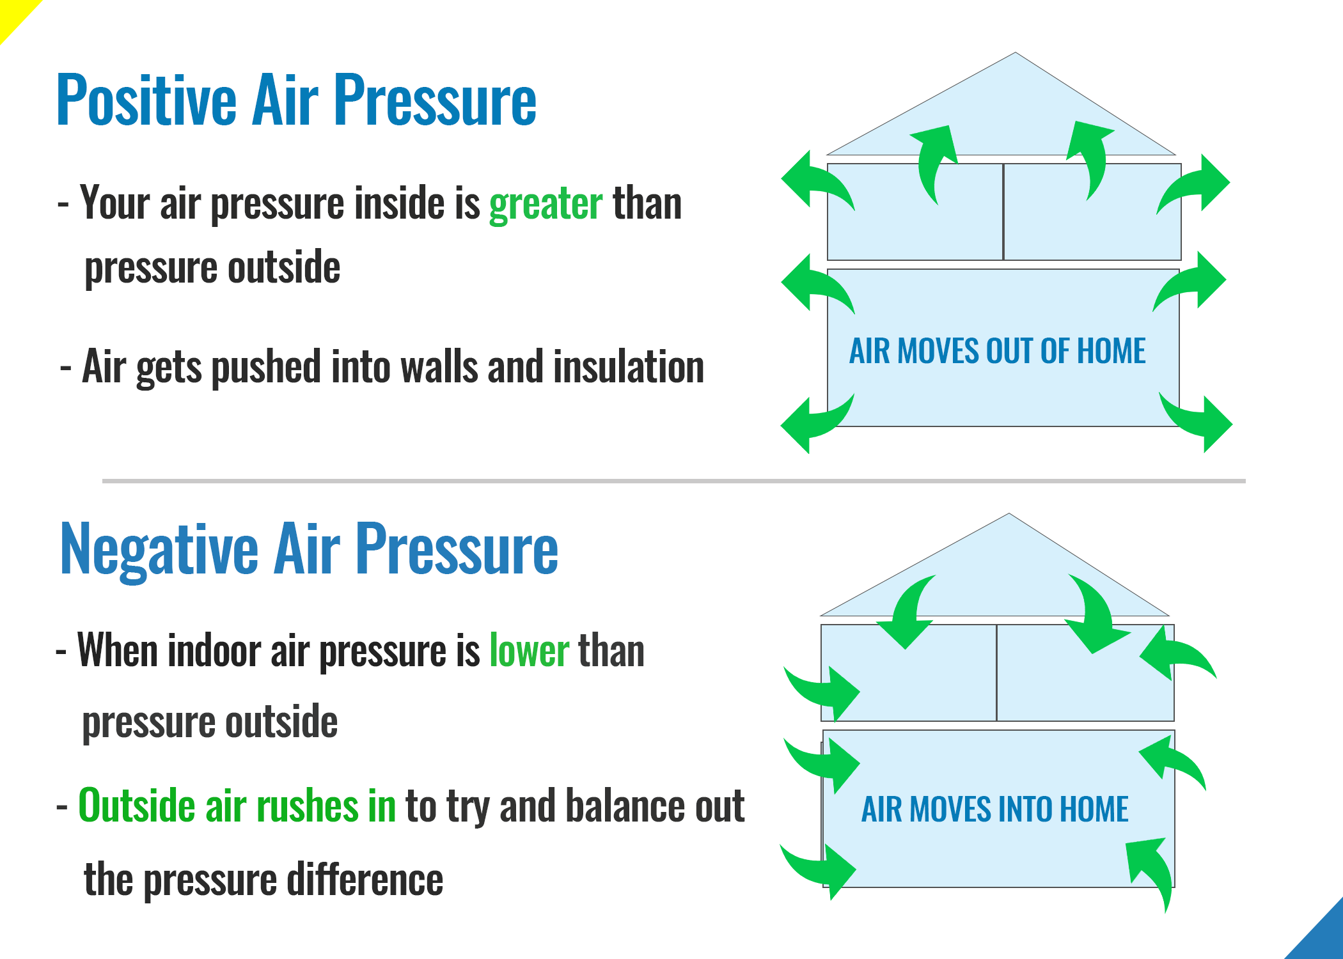
HVAC Fundamentals
Building Pressurization

Slide 7
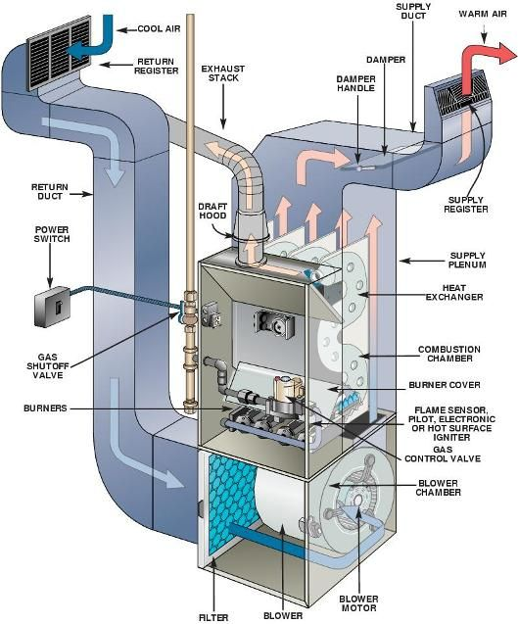
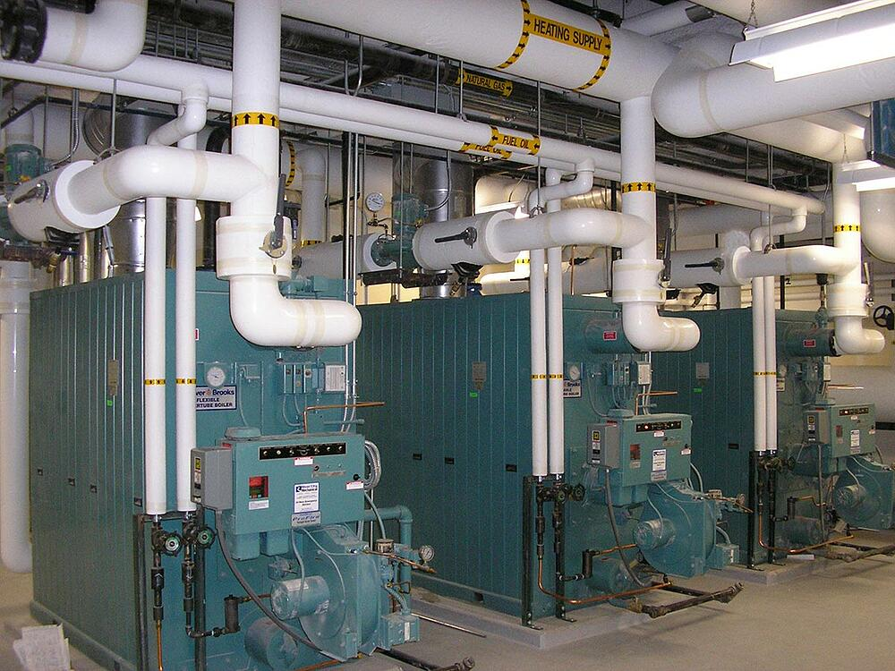
HVAC Fundamentals
HVAC Components
Heating

Slide 8
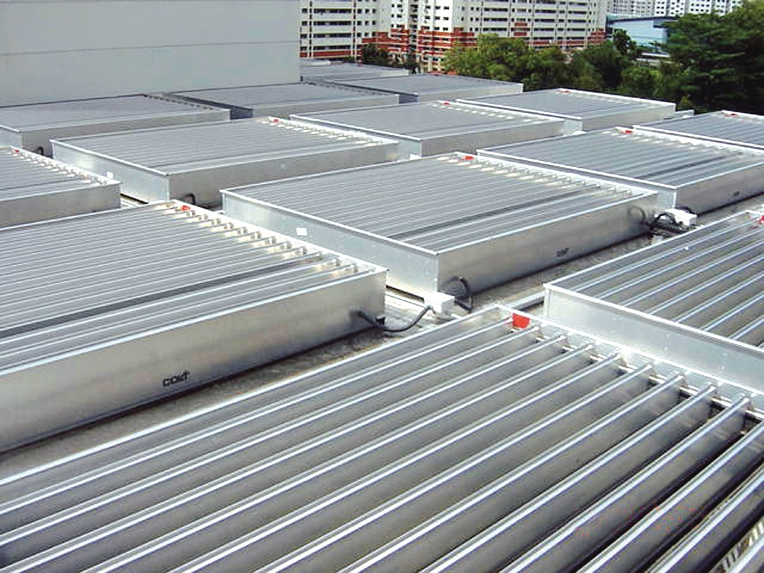
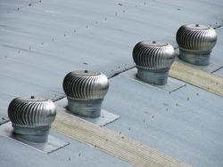
HVAC Fundamentals
HVAC Components
Ventilation
Natural Ventilation (Passive)

Slide 9
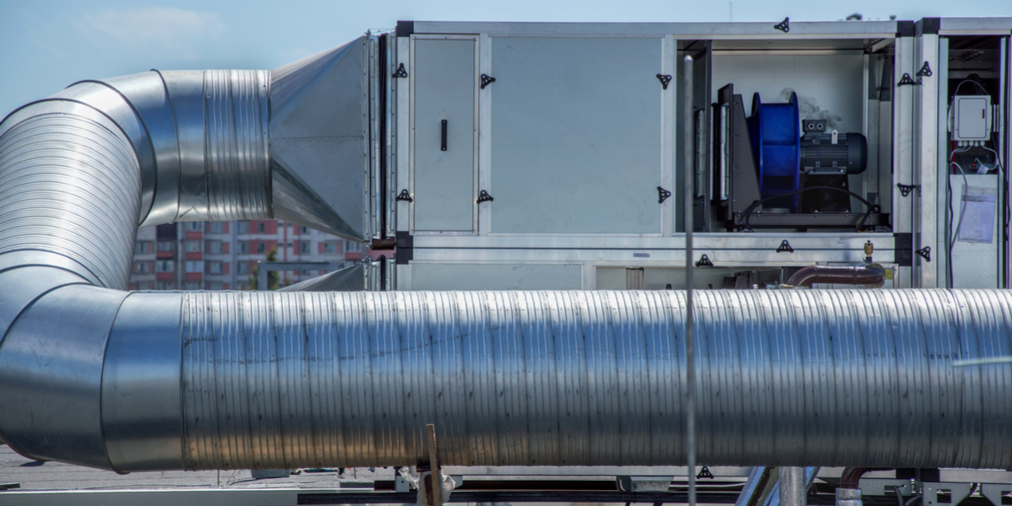
HVAC Fundamentals
HVAC Components
Ventilation
Mechanical Ventilation (Active)

Slide 10
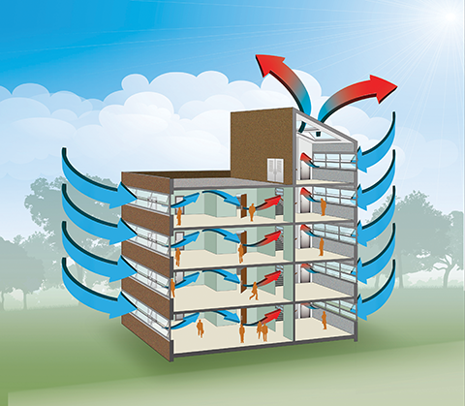
HVAC Fundamentals
HVAC Components
Ventilation
EPA - IAQ
https://www.epa.gov/indoor-air-quality-iaq
https://www.calacademy.org/efficient-building-design

Slide 11
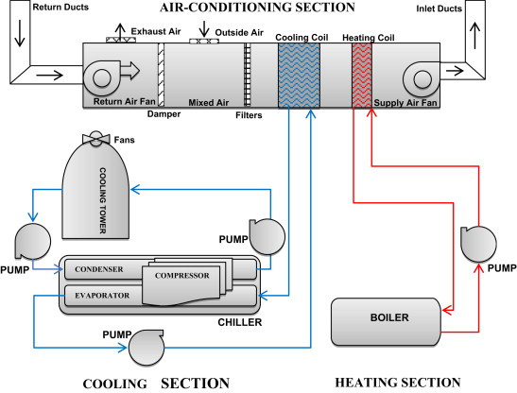
HVAC Fundamentals
HVAC Components
Air Conditioning

Slide 12
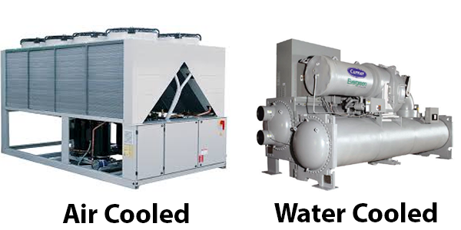
HVAC Fundamentals
HVAC Components
Air Conditioning

Slide 13
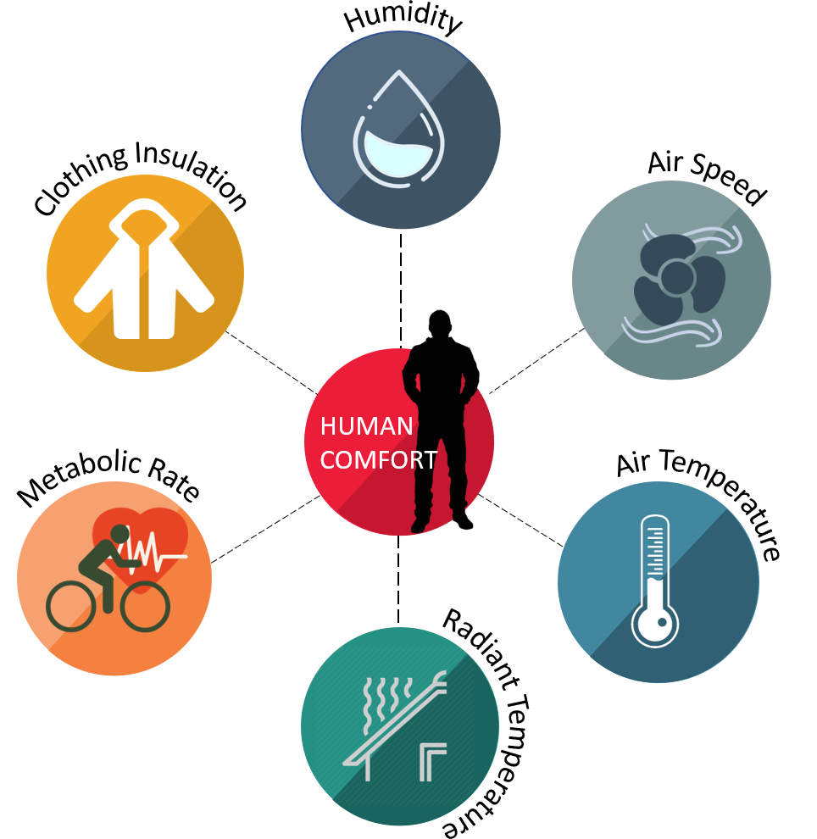
HVAC Fundamentals
HVAC Components
Air Conditioning

Slide 14
HVAC Fundamentals
Basics of Energy

Slide 15
HVAC Fundamentals
Thermal (Heat) Energy
Energy of any object with a temperature above absolute zero, due to the kinetic energy of its molecules.
For a given quantity of material, the higher its temperature, the more thermal energy it has.
Heat is not something an object has, but rather the energy that it absorbs or gives up.

Slide 16
HVAC Fundamentals
Units of Heat
Calorie (cal) One calorie (1 cal) is the quantity of heat required to raise the temperature of 1 g of water 1 ⁰C 10 calories of heat with raise the temperature of 10 g of water by 10 ⁰C One kilocalorie (1 kcal) is the quantity of heat required to raise the temperature of 1 kg of water 1 ⁰C | British Thermal Unit (Btu) One British Thermal Unit (1 Btu) is the quantity of heat required to raise the temperature of 1 lb of water 1 ⁰F 10 Btu will raise the temperature of 10 lb of water by 10 ⁰F The British Thermal Unit (Btu) is widely used in the HVAC industry. It is an outdated unit. When working with the Btu, the pound unit is actually a unit of mass, not weight. | SI Unit of Heat Joule - the SI unit of work or energy, equal to the work done by a force of one newton when its point of application moves one meter in the direction of action of the force.

Slide 17
HVAC Fundamentals
Heat Formula
Heat flows from the point of higher temperature to one of lower temperature.
The heat content, Q, is given by the equation:
Q = M x C x ΔT
Where
Q = heat absorbed (or released) (Btu)
M = mass (lb)
C = heat capacity (often called “specific heat”) (Btu/lb ⁰F)
ΔT = temperature increase or decrease, ⁰F

Slide 18
HVAC Fundamentals
Example 1.
A 12 ft X 20 ft concrete patio is 6 in thick. If the slab is warmed by the sun to 90ºF during the day and cools to 45ºF overnight, how much heat is stored and released by the floor on a daily basis?

Slide 19
HVAC Fundamentals
Example 1.
A 12 ft X 20 ft concrete patio is 6 in thick. If the slab is warmed by the sun to 90ºF during the day and cools to 45ºF overnight, how much heat is stored and released by the floor on a daily basis?
Solution.
For Concrete, C = 0.21 Btu/lb°F (specific heat)
ρ = 144 lb/ft³ (density)
W = ρ v (M)
Heat Storage
Q = M x C x ∆T
Q = (12 ft x 20 ft x 6 in x 1 ft/12 in ) x 144 lb/ft³ x 0.21 Btu/lb°F x (90°F - 45°F)
Q = 120 ft³ x 144 lb/ft³ x 0.21 Btu/lb°F x 45°F
Q = 163,296 Btu

Slide 20
HVAC Fundamentals
Heat Capacity
The heat capacity of a substance is the heat required to raise the temperature a unit degree.
Density and Heat Capacity for many common materials are listed in the table below.
Material Density (lb/ft³) ρ Heat Capacity (Btu/lb°F) C
Water 62.4 1.0
Wood 45 0.57
Foam Insulation 2.5 0.34
Air 0.075 0.24
Concrete 144 0.21
Steel 489 0.12
Aluminum 169 0.215

Slide 21
HVAC Fundamentals
Example 2.
How much heat (Btus) will be stored in a 100-ft² concrete wall 8-in thick if it is warmed from 55ºF to 85ºF by exposure to sunlight?

Slide 22
HVAC Fundamentals
Example 2.
How much heat (Btus) will be stored in a 100-ft² concrete wall 8-in thick if it is warmed from 55ºF to 85ºF by exposure to sunlight?
Solution.
Heat Storage
Q = M x C x ∆T
Q = (100 ft² x 8 in x 1 ft/12 in) x 144 lb/ft³ x 0.21 Btu/lb°F x (85°F - 55°F)
Q = (67 ft³ x 144 lb/ft³) x 0.21 Btu/lb°F x 30°F
Q = 60,480 Btu

Slide 23
HVAC Fundamentals
Example 3.
2 kg of Aluminum (AL) is heated from 20ºC to 100ºC. The specific heat of AL is 0.91 kJ/kg ºC and the heat required can be calculated as:

Slide 24
HVAC Fundamentals
Example 3.
2 kg of Aluminum (AL) is heated from 20ºC to 100ºC. The specific heat of AL is 0.91 kJ/kg ºC and the heat required can be calculated as:
Solution.
Q = M x C x ∆T = 2 kg x 0.91 kJ/kg ºC x (100ºC - 20ºC) = 145.6 kJ
How many Btu’s? rapidtables.com 138 Btu

Slide 25
HVAC Fundamentals
Example 4.
One litre of water is heated from 0ºC to boiling (100ºC). Specific heat of water is 4.19 kJ/kg ºC and the heat required can be calculated as:

Slide 26
HVAC Fundamentals
Example 4.
One litre of water is heated from 0ºC to boiling (100ºC). Specific heat of water is 4.19 kJ/kg ºC and the heat required can be calculated as:
Solution.
Q = M x C x ∆T = (1 litre x 1 kg/litre) x (4.19 kJ/kg ºC) x (100ºC - 0ºC) = 419 kJ
How many Btu’s? rapidtables.com 397 Btu

Slide 27
HVAC Fundamentals
Example 4.
Convert from SI to US
Q = 419 kJ = 419,000 J 1 J = 0.000948 Btu
1000 J = 1 kJ = 0.948 Btu
Q = 419 kJ x 0.948 Btu / kJ = 397 Btu

Slide 28
HVAC Fundamentals
Example 4.
Using US Units
1 litre = ? lb Can’t Compare!
A litre is a unit of Volume
A lb is a unit of Weight
1 litre weighs 1 kg
There are 2.20462 lb /1 kg
Q = M x C x ∆T = 2.20462 lb x 1 Btu/lb °F x (212°F - 32°F) = 397 Btu

Slide 29
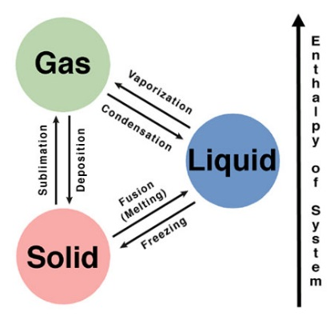
HVAC Fundamentals
Sensible and Latent Heat
Sensible Heat
Causes a change in temperature of substance when heat is added or removed. Can be measured by a thermometer.
Latent Heat
Causes a change of state in the substance when heat is added or removed. Changing a solid to a liquid or a liquid to a gas while the temperature remains constant.

Slide 30
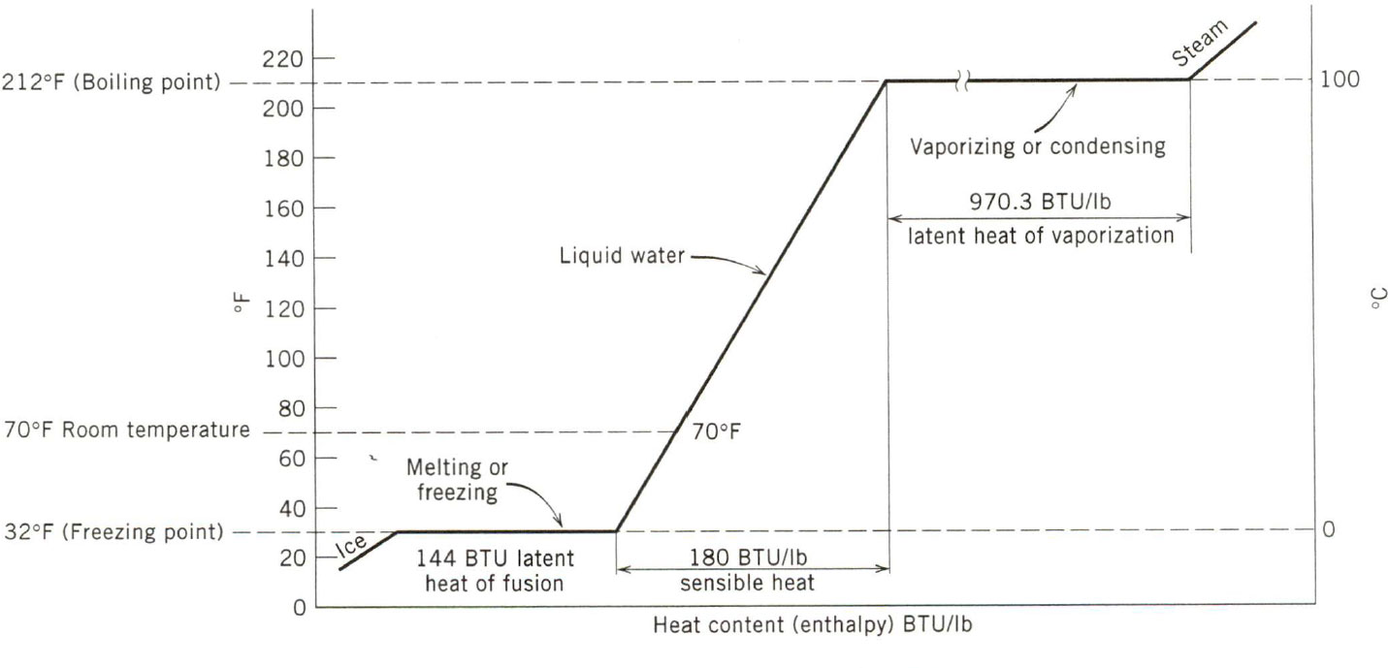
HVAC Fundamentals

Slide 31
HVAC Fundamentals
Example 5.
How much heat must be added to a 1 lb of water at room temperature (70⁰F) to bring it to the boiling point?

Slide 32
HVAC Fundamentals
Example 5.
How much heat must be added to a 1 lb of water at room temperature (70⁰F) to bring it to the boiling point?
Solution.
Q = M x C x ∆T
Q = 1 lb x 1 Btu/lb°F x (212°F - 70°F) = 142 Btu

Slide 33
HVAC Fundamentals
Example 6.
A block of ice, 1 ft³ in volume, is taken from a freezer where it was stored at 20°F (-6.7 °C) .
How many BTU of heat will be required to convert the ice to water at 60°F?

Slide 34
HVAC Fundamentals
Example 6.
A block of ice, 1 ft³ in volume, is taken from a freezer where it was stored at 20°F (-6.7 °C) .
How many BTU of heat will be required to convert the ice to water at 60°F?
Solution.
Weight of the ice: M = 1 ft³ x 62.41 lb/ft³ = 62.41 lb
Sensible Heat needed to raise the temperature from 20°F to 32°F
Q = 62.41 LB X 1 Btu/lb°F x (32°F - 20°F) = 748.92 Btu
Latent Heat is involved since there is a phase change from solid (ice) to liquid (water)
Q = 62.41 lb x 144 Btu/lb = 8,987.04 Btu
Sensible Heat is needed to raise the temperature from melted @32 °F to 60 °F
Q = 62.41 lb x 1 Btu/lb°F x (60°F - 32°F) = 1,747.48 Btu
Total Heat (Enthalpy) = Latent Heat + Sensible Heat
= 748.92Btu + 8,987.04 Btu + 1,747.48 Btu = 11,483 Btu

Slide 35
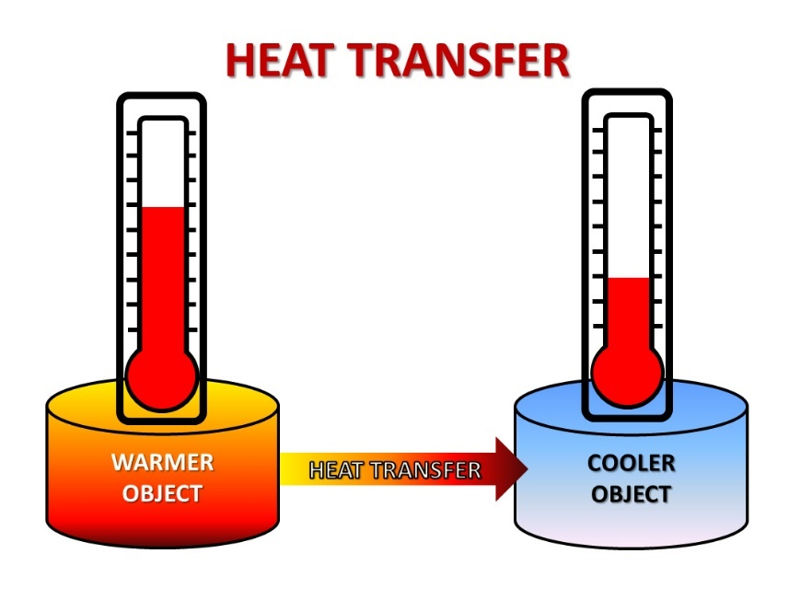
HVAC Fundamentals
Heat Transfer: Conduction, Convection, Radiation

Slide 36
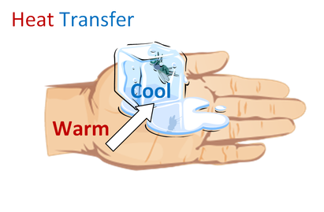
HVAC Fundamentals
Conduction
Transfer of heat between substances that are in direct contact with each other. The better the conductor, the more rapidly heat will be transferred.
Examples:
A cold cast iron skillet is placed onto a stovetop. When the stove is turned on, the skillet becomes very hot due to the conduction of heat from the burner to the skillet.
A cube of ice placed in your hand.

Slide 37
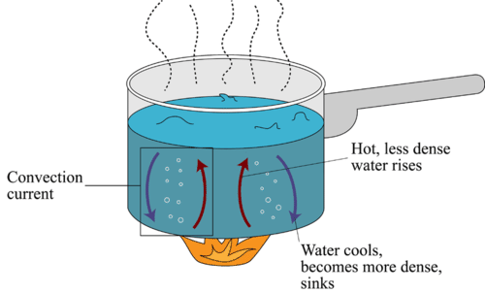
HVAC Fundamentals
Convection
Thermal energy is transferred from hot places to cold places by convection. Convection occurs when warmer areas of a liquid or gas rise to cooler areas in the liquid or gas. Cooler liquid or gas then takes the place of the warmer areas which have risen higher. This results in a continuous circulation pattern.
Example:
Boiling water - The heat passes from the burner into the pot, heating the water at the bottom. Then, this hot water rises and cooler water moves down to replace it, causing a circular motion.

Slide 38
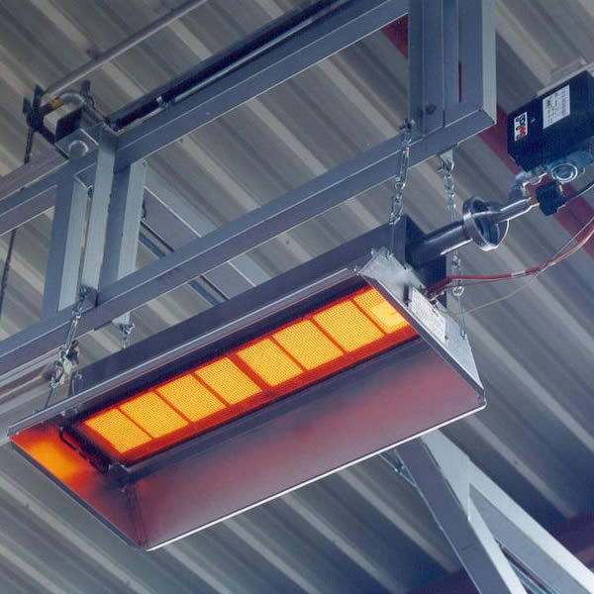
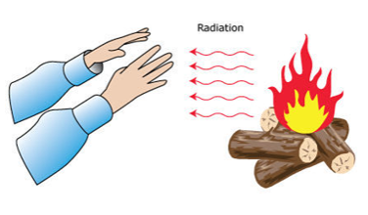
HVAC Fundamentals
Radiation
Transfer of heat through space from a mass at a higher temperature to a mass at a lower temperature via electromagnetic waves.
Examples:
Sun warms your body
Heat from a fire
Mean radiant temperature (MRT) is a measure of the average temperature of the surfaces that surround a point, with which it will exchange thermal radiation.

Slide 39
HVAC Fundamentals
Power
The rate of energy flow is “power”.
The unit of power for thermal energy is in Btus per hour, abbreviated Btuh (BTUH)
This unit is used in quantifying the amount of heating gained or lost by a structure (load) and the amount of heating or cooling capacity required by equipment to offset the heat or load.

Slide 40
HVAC Fundamentals
Power
For all forms of energy, the following equation will apply, but units will depend on the energy

Slide 41
HVAC Fundamentals
Example 7.
A 50 ft² x 6 in. concrete slab is in full sun all day and absorbed 72,000 Btu of heat energy. If the absorbed heat is released during the night between 11:00 pm and 5:00 am, what is the average capacity of the slab over this period to assist in heating the building?

Slide 42
HVAC Fundamentals
Example 7.
A 50 ft² x 6 in. concrete slab is in full sun all day and absorbed 72,000 Btu of heat energy. If the absorbed heat is released during the night between 11:00 pm and 5:00 am, what is the average capacity of the slab over this period to assist in heating the building?
Solution.
Power = Energy / Time
= 72,000 Btu / 6 hr
= 12,000 Btu/hr = 12,000 Btuh

