Slide 1
HVAC System Basics
CMGT235 Mechanical and Electrical Systems
Notes:
Another everyday form of building energy use is the provision of hot water.
Water-heating energy efficiency depends upon water-heating equipment, delivery, and operational controls.
Energy codes provide criteria for such issues as insulating circulating hot water systems, service water heating equipment performance efficiencies in commercial applications, heat traps, controls and pool heaters.

Slide 2
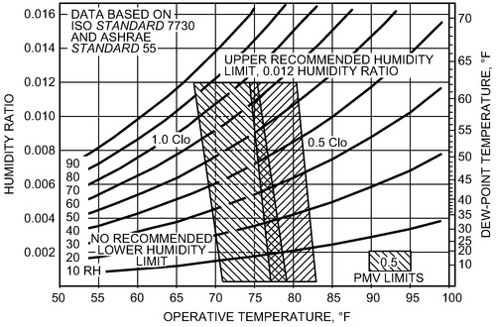
Basic Purpose of HVAC
Air-Conditioning for thermal and humidity comfort
CMGT235 Mechanical and Electrical Systems
Notes:
Another everyday form of building energy use is the provision of hot water.
Water-heating energy efficiency depends upon water-heating equipment, delivery, and operational controls.
Energy codes provide criteria for such issues as insulating circulating hot water systems, service water heating equipment performance efficiencies in commercial applications, heat traps, controls and pool heaters.

Slide 3
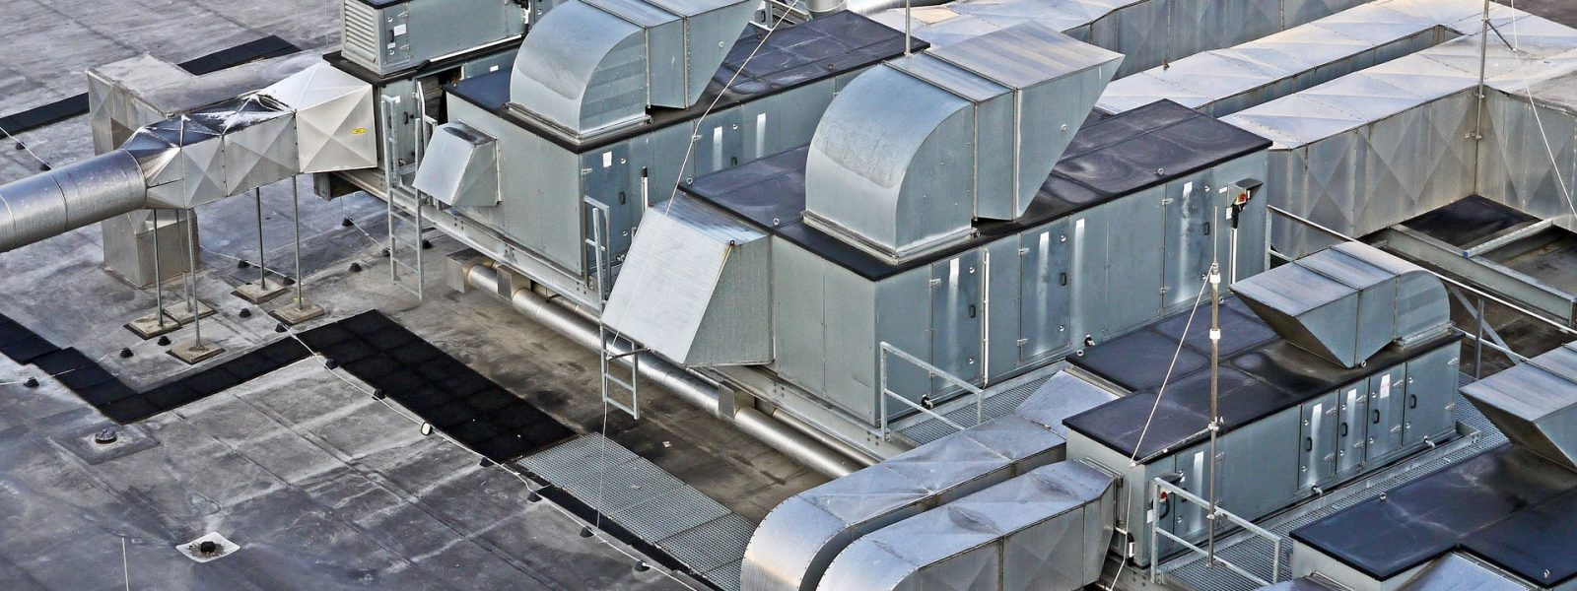
Basic Purpose of HVAC
Ventilation
Introduction of required outside air
CMGT235 Mechanical and Electrical Systems
Notes:
Another everyday form of building energy use is the provision of hot water.
Water-heating energy efficiency depends upon water-heating equipment, delivery, and operational controls.
Energy codes provide criteria for such issues as insulating circulating hot water systems, service water heating equipment performance efficiencies in commercial applications, heat traps, controls and pool heaters.

Slide 4
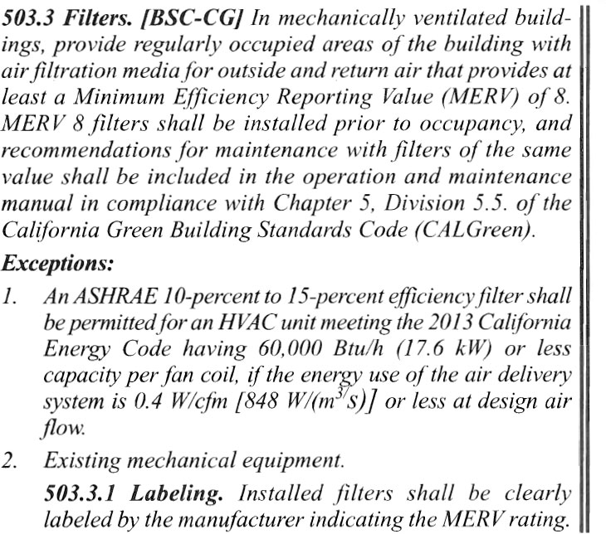
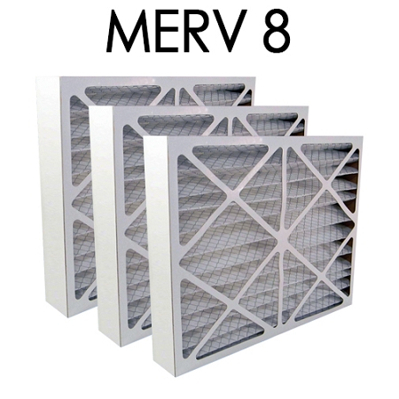
Basic Purpose of HVAC
Ventilation
Filtration
ASHRAE 52.2
CMGT235 Mechanical and Electrical Systems
Notes:
Another everyday form of building energy use is the provision of hot water.
Water-heating energy efficiency depends upon water-heating equipment, delivery, and operational controls.
Energy codes provide criteria for such issues as insulating circulating hot water systems, service water heating equipment performance efficiencies in commercial applications, heat traps, controls and pool heaters.

Slide 5
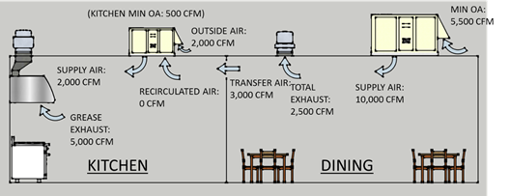
Basic Purpose of HVAC
Ventilation
Exhaust of undesirable air (toilet, kitchen, lab exhaust)
CMGT235 Mechanical and Electrical Systems
Notes:
Another everyday form of building energy use is the provision of hot water.
Water-heating energy efficiency depends upon water-heating equipment, delivery, and operational controls.
Energy codes provide criteria for such issues as insulating circulating hot water systems, service water heating equipment performance efficiencies in commercial applications, heat traps, controls and pool heaters.

Slide 6
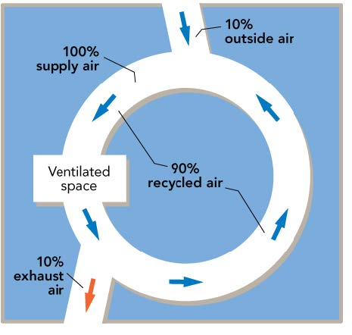
Basic Purpose of HVAC
Ventilation
Air movement in space
CMGT235 Mechanical and Electrical Systems
Notes:
Another everyday form of building energy use is the provision of hot water.
Water-heating energy efficiency depends upon water-heating equipment, delivery, and operational controls.
Energy codes provide criteria for such issues as insulating circulating hot water systems, service water heating equipment performance efficiencies in commercial applications, heat traps, controls and pool heaters.

Slide 7
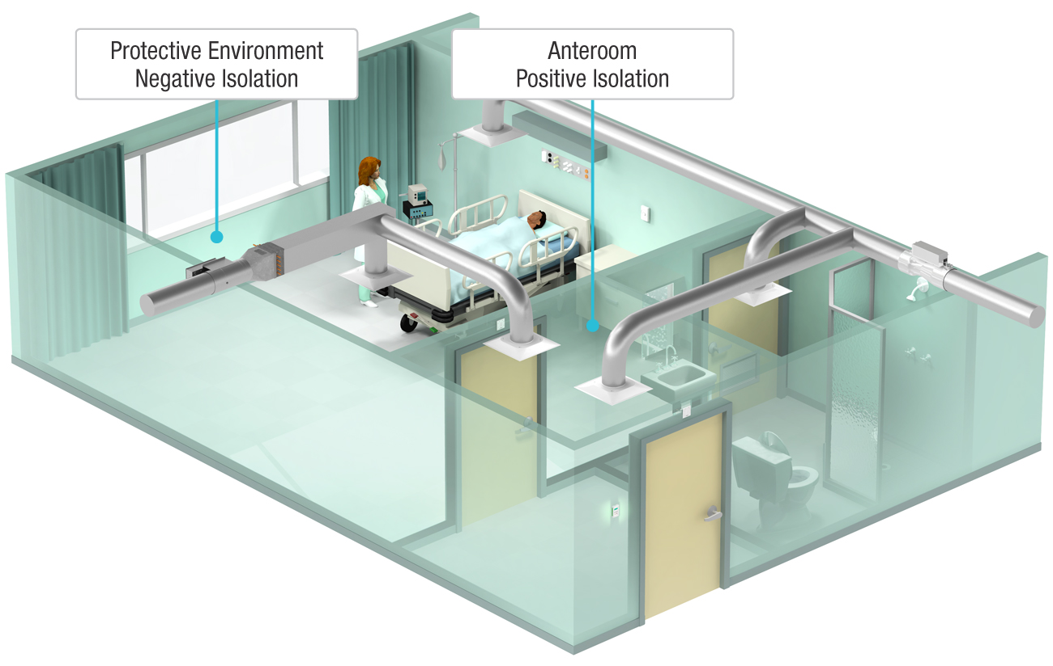
Basic Purpose of HVAC
Space pressurization
Control infiltration
Makeup of exhausted air
CMGT235 Mechanical and Electrical Systems
Notes:
Another everyday form of building energy use is the provision of hot water.
Water-heating energy efficiency depends upon water-heating equipment, delivery, and operational controls.
Energy codes provide criteria for such issues as insulating circulating hot water systems, service water heating equipment performance efficiencies in commercial applications, heat traps, controls and pool heaters.

Slide 8
Heat Gain vs Heat Loss
Heat Gains
Solar thru windows / walls
Summer transfer / infiltration
Internal
Electric use, Lighting & Equipment
Body Heat
Heat Loss
Air Leaks (infiltration)
Transfer
Walls
Roofs
Floor
Windows
CMGT235 Mechanical and Electrical Systems
Notes:
Another everyday form of building energy use is the provision of hot water.
Water-heating energy efficiency depends upon water-heating equipment, delivery, and operational controls.
Energy codes provide criteria for such issues as insulating circulating hot water systems, service water heating equipment performance efficiencies in commercial applications, heat traps, controls and pool heaters.

Slide 9
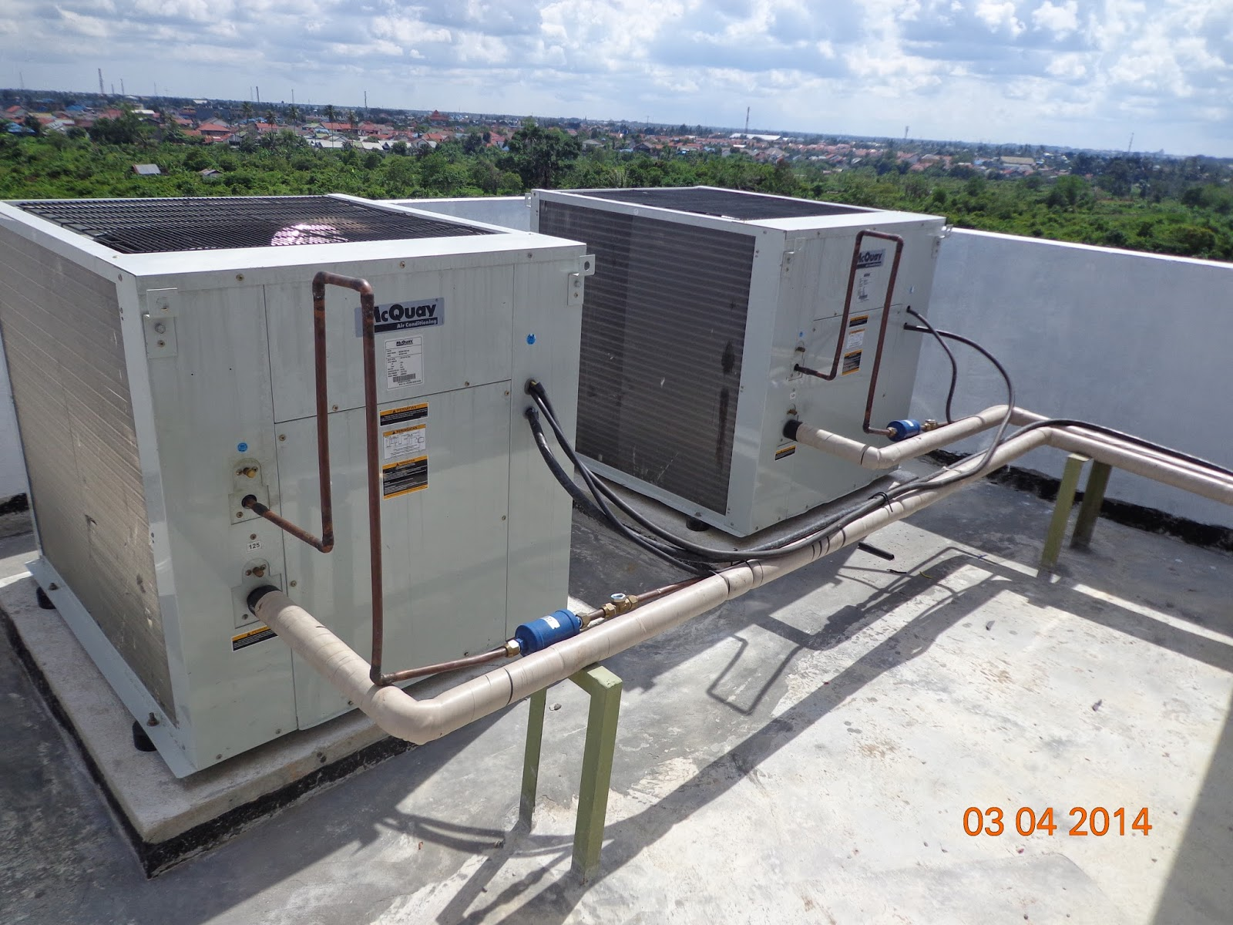
Heat Gain vs Heat Loss
CMGT235 Mechanical and Electrical Systems
Notes:
Another everyday form of building energy use is the provision of hot water.
Water-heating energy efficiency depends upon water-heating equipment, delivery, and operational controls.
Energy codes provide criteria for such issues as insulating circulating hot water systems, service water heating equipment performance efficiencies in commercial applications, heat traps, controls and pool heaters.

Slide 10
Air Conditioning
Two general types of air conditioning (cooling)
Refrigeration-based: refrigerant cycle moves heat from space (indoors) to another (outdoors)
Refrigerant has a low boiling point, making it ideal for HVAC systems
Like a car AC
Non-refrigerant: evaporative cooling
CMGT235 Mechanical and Electrical Systems
Notes:
Another everyday form of building energy use is the provision of hot water.
Water-heating energy efficiency depends upon water-heating equipment, delivery, and operational controls.
Energy codes provide criteria for such issues as insulating circulating hot water systems, service water heating equipment performance efficiencies in commercial applications, heat traps, controls and pool heaters.

Slide 11
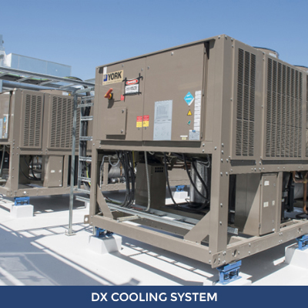
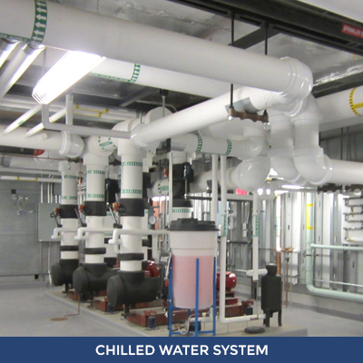
Air Conditioning
Simple vs. Complex
CMGT235 Mechanical and Electrical Systems
Notes:
Another everyday form of building energy use is the provision of hot water.
Water-heating energy efficiency depends upon water-heating equipment, delivery, and operational controls.
Energy codes provide criteria for such issues as insulating circulating hot water systems, service water heating equipment performance efficiencies in commercial applications, heat traps, controls and pool heaters.

Slide 12
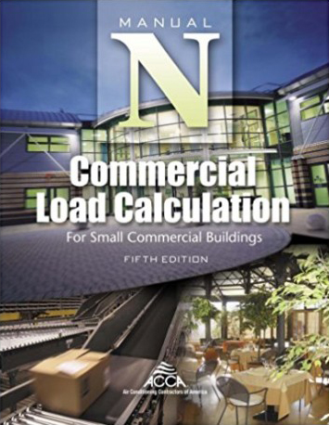
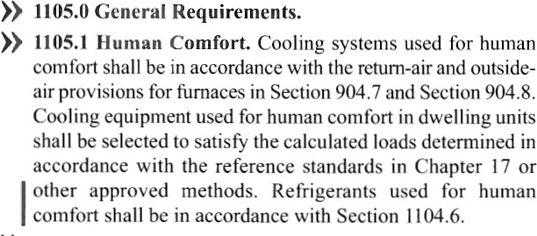
System Capacity Sizing
Verify that cooling and heating capacity sizing (load calculations) have been completed (C403.2.1)
CMGT235 Mechanical and Electrical Systems
Notes:
Another everyday form of building energy use is the provision of hot water.
Water-heating energy efficiency depends upon water-heating equipment, delivery, and operational controls.
Energy codes provide criteria for such issues as insulating circulating hot water systems, service water heating equipment performance efficiencies in commercial applications, heat traps, controls and pool heaters.

Slide 13
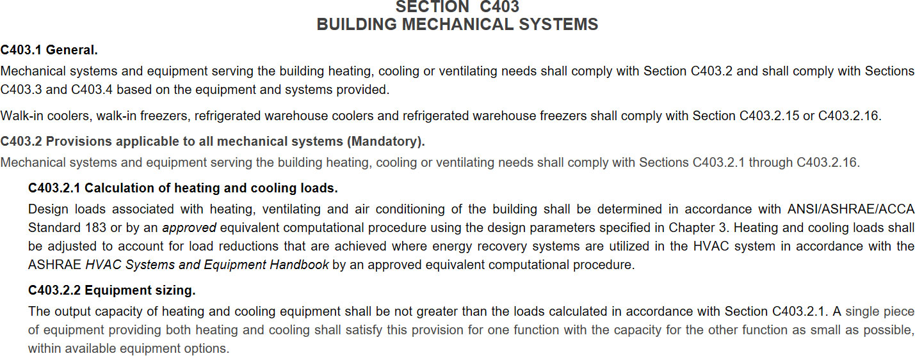
System Capacity Sizing
Verify that equipment is not unreasonable over-sized (C403.2.2)
Why?
CMGT235 Mechanical and Electrical Systems
Notes:
Another everyday form of building energy use is the provision of hot water.
Water-heating energy efficiency depends upon water-heating equipment, delivery, and operational controls.
Energy codes provide criteria for such issues as insulating circulating hot water systems, service water heating equipment performance efficiencies in commercial applications, heat traps, controls and pool heaters.

Slide 14
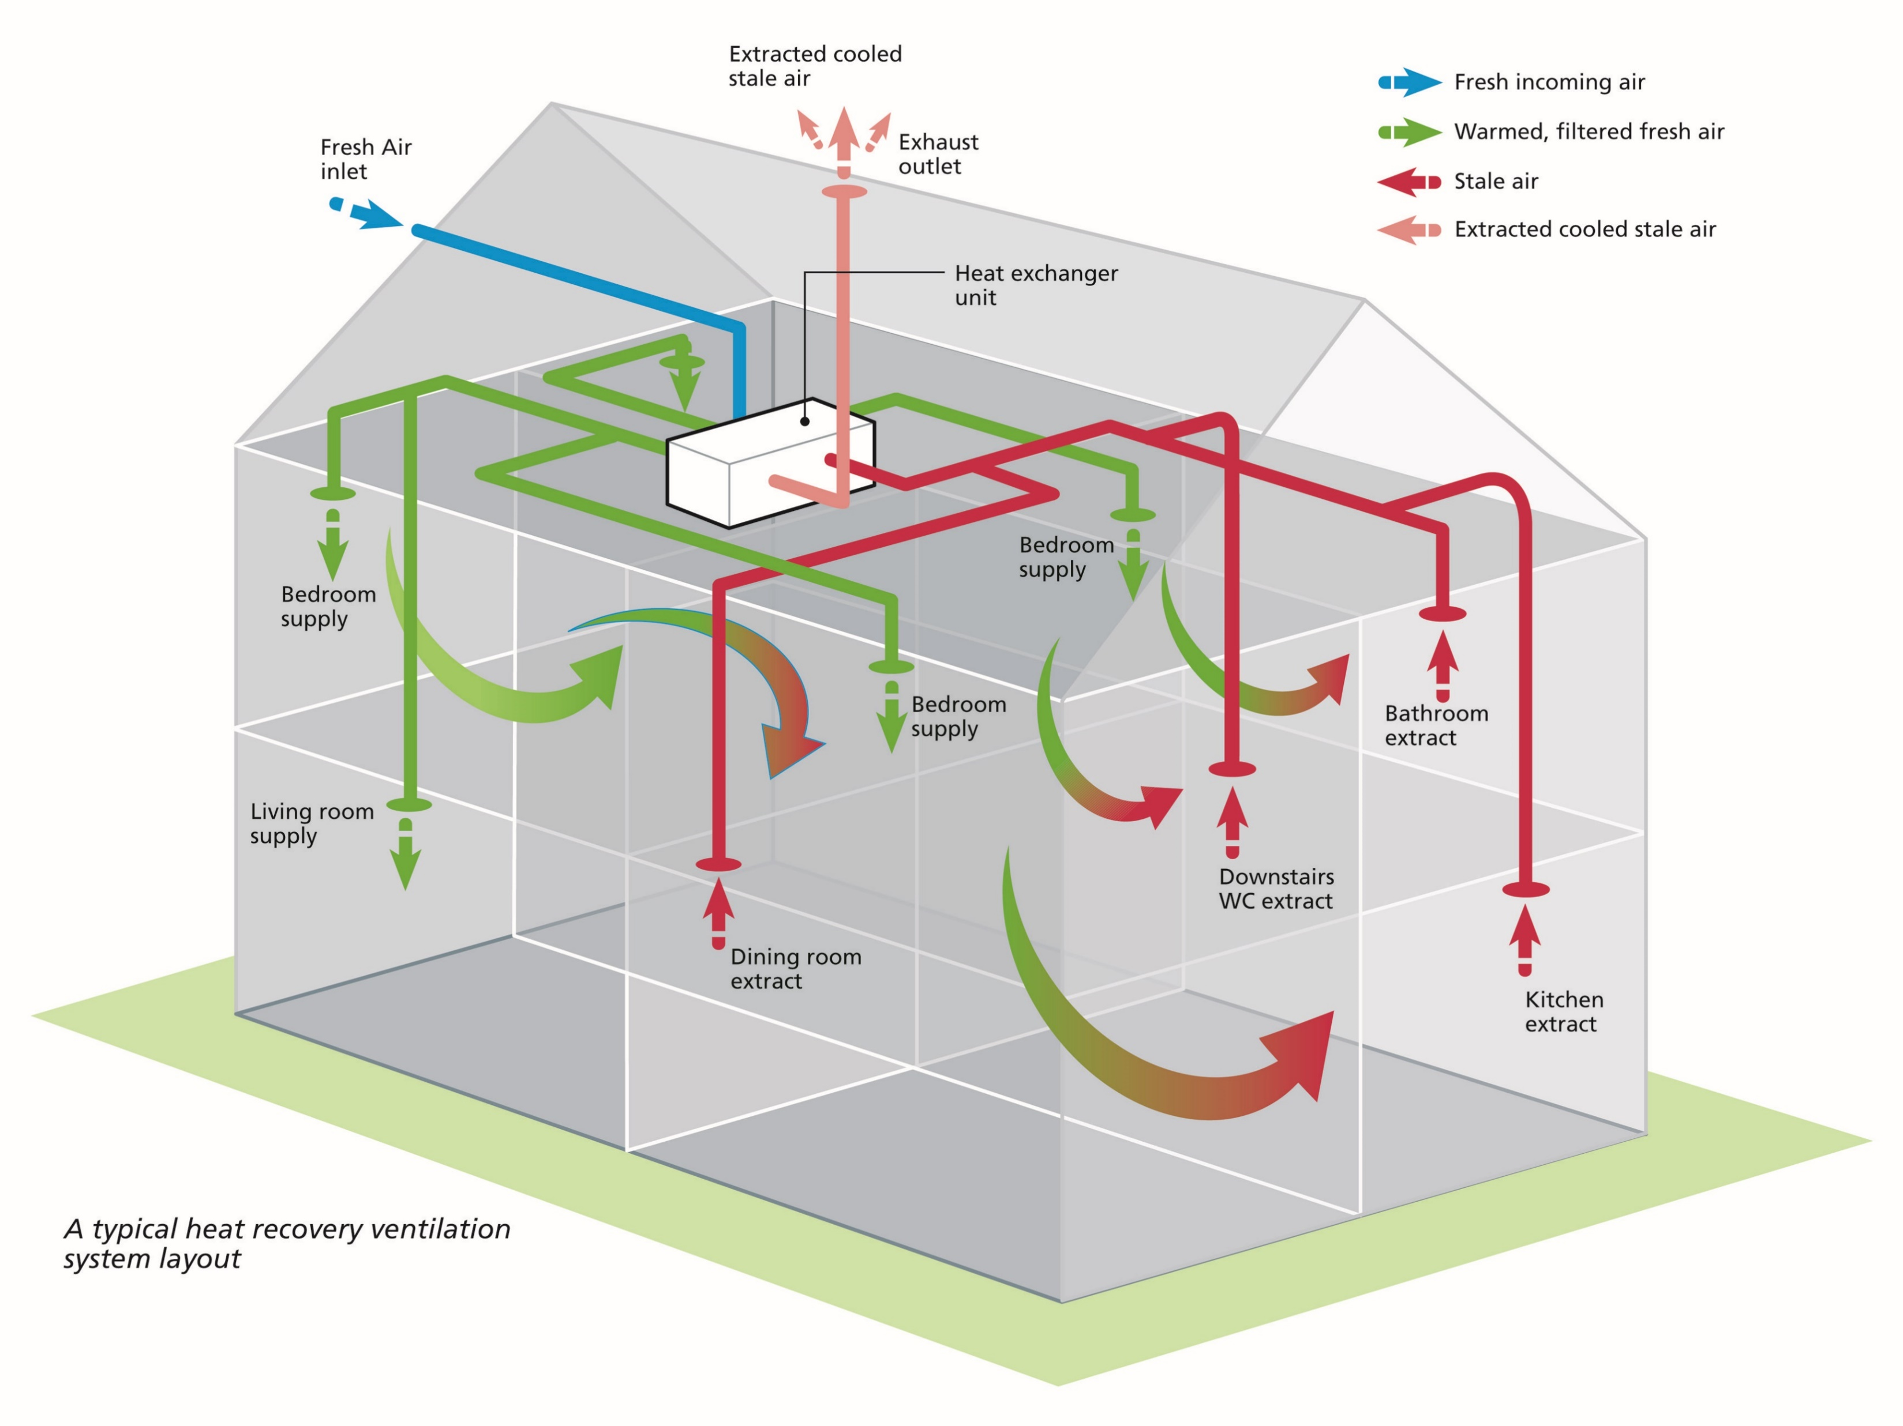
Ventilation
Two types
Mechanical ventilation (Active)
CMGT235 Mechanical and Electrical Systems
Notes:
Another everyday form of building energy use is the provision of hot water.
Water-heating energy efficiency depends upon water-heating equipment, delivery, and operational controls.
Energy codes provide criteria for such issues as insulating circulating hot water systems, service water heating equipment performance efficiencies in commercial applications, heat traps, controls and pool heaters.

Slide 15
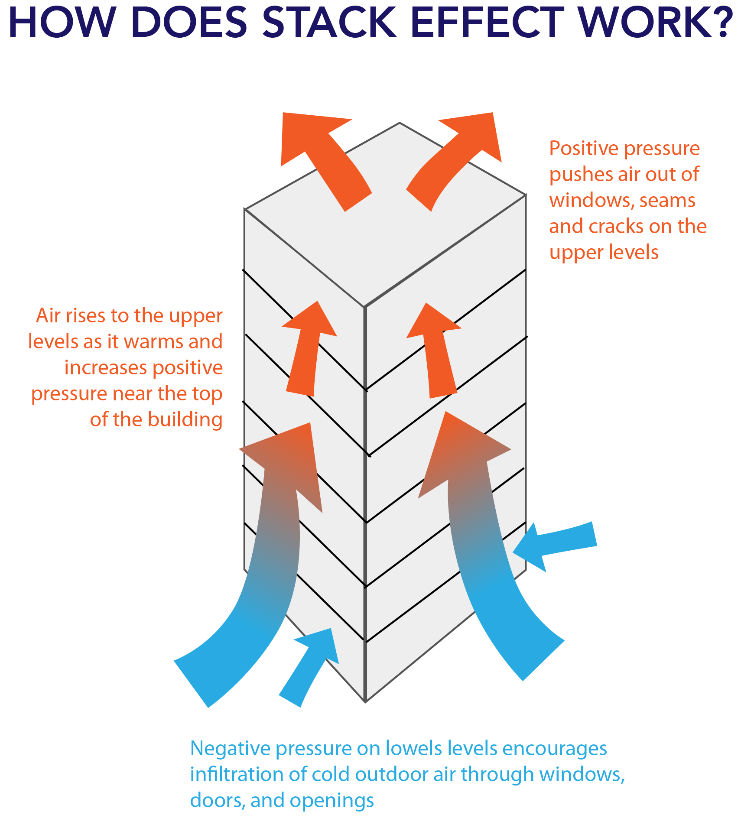
Ventilation
Two types
Natural ventilation (Passive)
CMGT235 Mechanical and Electrical Systems
Notes:
Another everyday form of building energy use is the provision of hot water.
Water-heating energy efficiency depends upon water-heating equipment, delivery, and operational controls.
Energy codes provide criteria for such issues as insulating circulating hot water systems, service water heating equipment performance efficiencies in commercial applications, heat traps, controls and pool heaters.

Slide 16
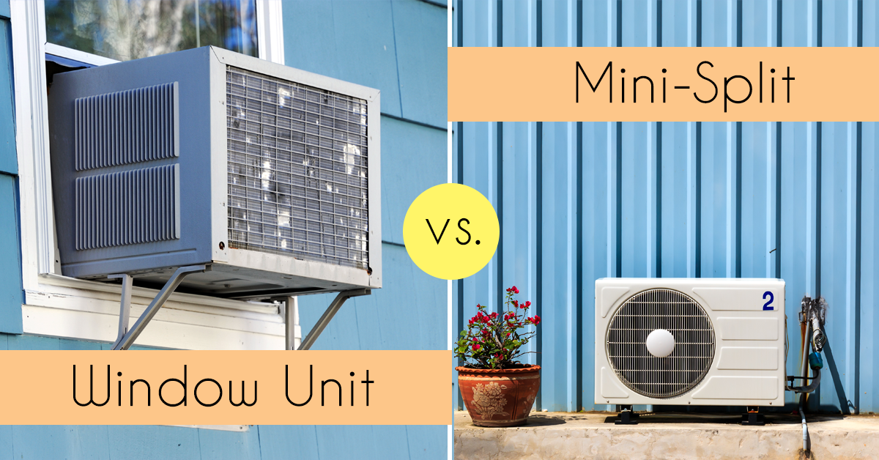
Simple HVAC Systems
Package Units
Thru-wall air conditioner
Package Terminal Air Conditioner (PTAC)
Package Terminal Heat Pump (PTHP)
Unitary
Air conditioner
Furnace
Heat Pumps
Packaged, split, mini-split
Variable refrigerant Flow (VRF)
CMGT235 Mechanical and Electrical Systems
Notes:
Another everyday form of building energy use is the provision of hot water.
Water-heating energy efficiency depends upon water-heating equipment, delivery, and operational controls.
Energy codes provide criteria for such issues as insulating circulating hot water systems, service water heating equipment performance efficiencies in commercial applications, heat traps, controls and pool heaters.

Slide 17
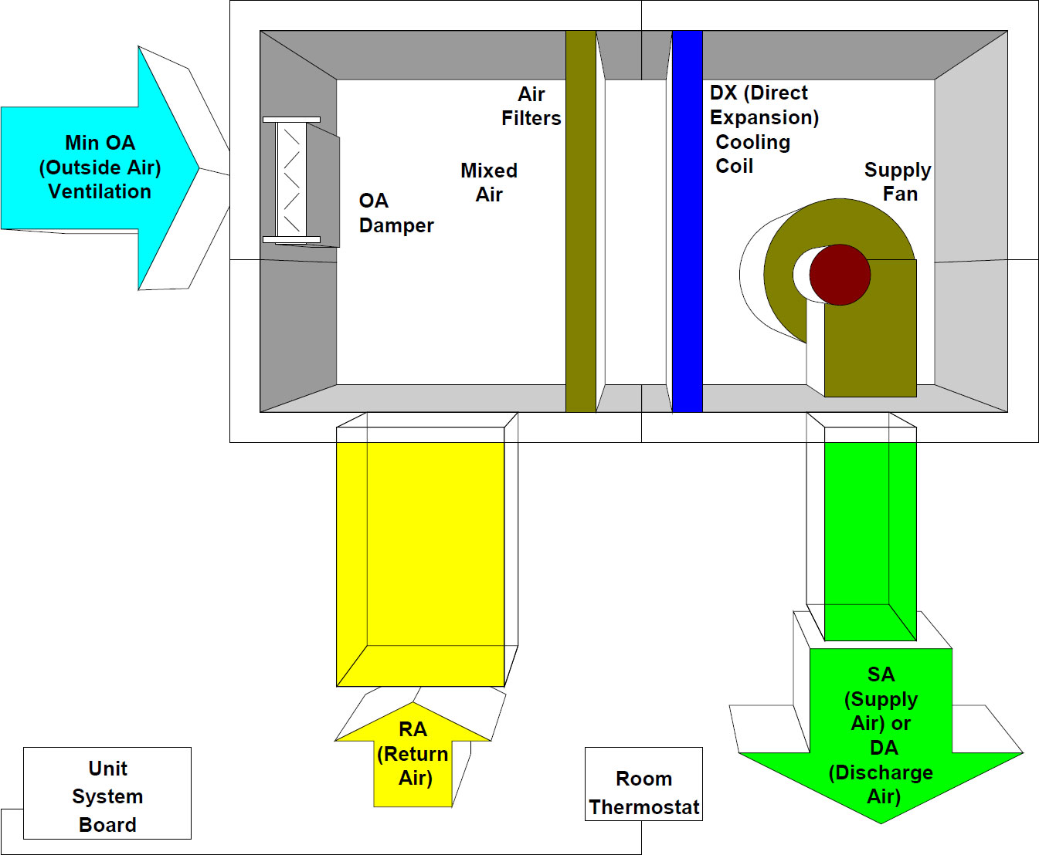
Packaged Rooftop Cooling Unit (RTU)
CMGT235 Mechanical and Electrical Systems
Notes:
Another everyday form of building energy use is the provision of hot water.
Water-heating energy efficiency depends upon water-heating equipment, delivery, and operational controls.
Energy codes provide criteria for such issues as insulating circulating hot water systems, service water heating equipment performance efficiencies in commercial applications, heat traps, controls and pool heaters.

Slide 18
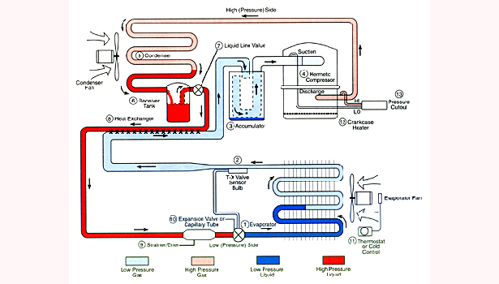
Refrigeration Cycle
CMGT235 Mechanical and Electrical Systems
Notes:
Another everyday form of building energy use is the provision of hot water.
Water-heating energy efficiency depends upon water-heating equipment, delivery, and operational controls.
Energy codes provide criteria for such issues as insulating circulating hot water systems, service water heating equipment performance efficiencies in commercial applications, heat traps, controls and pool heaters.

Slide 19
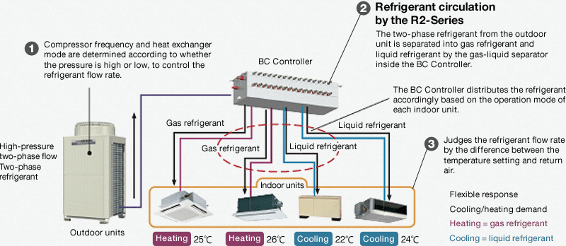
Variable Refrigerant Flow (VRF)
CMGT235 Mechanical and Electrical Systems
Notes:
Another everyday form of building energy use is the provision of hot water.
Water-heating energy efficiency depends upon water-heating equipment, delivery, and operational controls.
Energy codes provide criteria for such issues as insulating circulating hot water systems, service water heating equipment performance efficiencies in commercial applications, heat traps, controls and pool heaters.

Slide 20
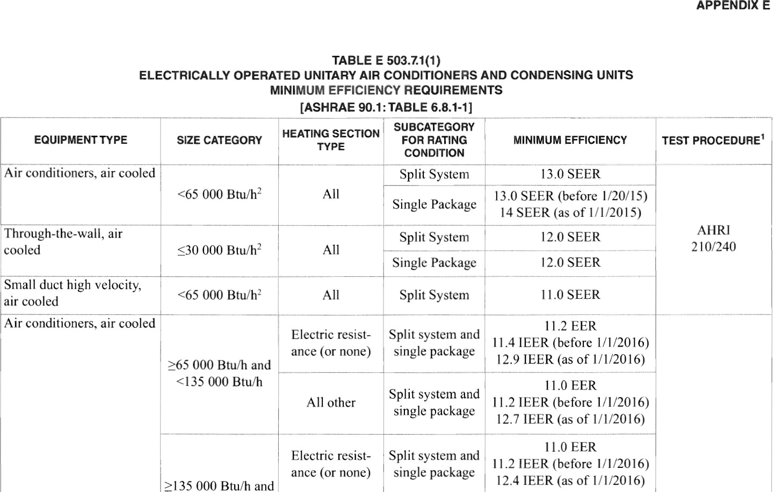
Energy Code
CMGT235 Mechanical and Electrical Systems
Notes:
Another everyday form of building energy use is the provision of hot water.
Water-heating energy efficiency depends upon water-heating equipment, delivery, and operational controls.
Energy codes provide criteria for such issues as insulating circulating hot water systems, service water heating equipment performance efficiencies in commercial applications, heat traps, controls and pool heaters.

Slide 21
Top of the Charts
Most Impactful Basic HVAC Control Measures
Snow and ice melt heater control
Temperature setback scheduling
Full 5-degree thermostat deadband
Economizer controls
Limits on simultaneous heating and cooling (VAV reheat)
VAV ventilation optimization
Supply air temperature & fan static reset controls
Exterior ductwork insulation (C403.2.9)
Fan power limits
Proper equipment sizing
Commissioning
CMGT235 Mechanical and Electrical Systems
Notes:
Another everyday form of building energy use is the provision of hot water.
Water-heating energy efficiency depends upon water-heating equipment, delivery, and operational controls.
Energy codes provide criteria for such issues as insulating circulating hot water systems, service water heating equipment performance efficiencies in commercial applications, heat traps, controls and pool heaters.

Slide 22
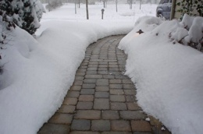
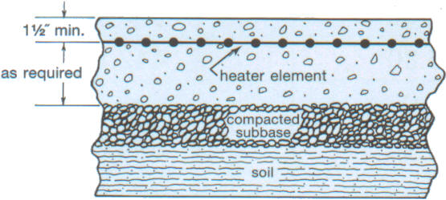
Snow and Ice Melt Heater Control
Snow and ice melt heaters will use a large amount of energy if not properly and automatically controlled
CMGT235 Mechanical and Electrical Systems
Notes:
Another everyday form of building energy use is the provision of hot water.
Water-heating energy efficiency depends upon water-heating equipment, delivery, and operational controls.
Energy codes provide criteria for such issues as insulating circulating hot water systems, service water heating equipment performance efficiencies in commercial applications, heat traps, controls and pool heaters.

Slide 23
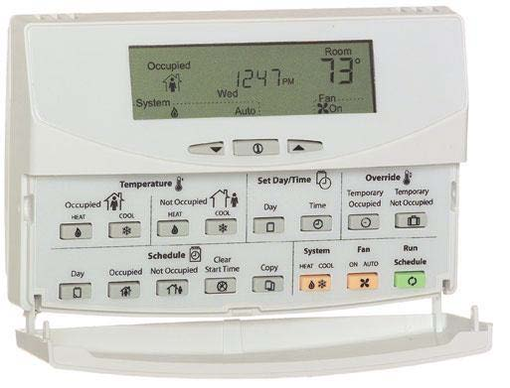
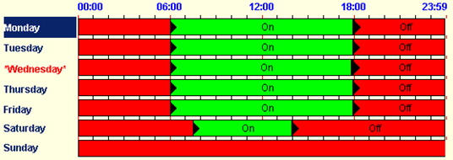
Temperature Setback Scheduling
Simple control systems
Programmable thermostats
Seven different daily schedules/week
Manual override
Occupant sensor is an alternative
DDC (Direct Digital Control) systems
Central scheduling of all units
Optimum start activated
CMGT235 Mechanical and Electrical Systems
Notes:
Another everyday form of building energy use is the provision of hot water.
Water-heating energy efficiency depends upon water-heating equipment, delivery, and operational controls.
Energy codes provide criteria for such issues as insulating circulating hot water systems, service water heating equipment performance efficiencies in commercial applications, heat traps, controls and pool heaters.

Slide 24
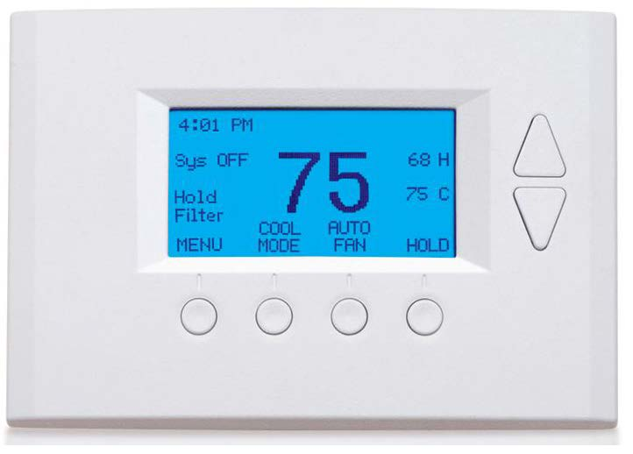
Full 5-degree Thermostat Deadband Economizer Controls
A most significant control feature is temperature deadband
If heating is set at 70°F, then cooling should be ≥ 75°F
Should be the found condition during an inspection
Why?
Simple systems can fight each other in open office areas
VAV systems have excessive reheat if settings are too tight
Energy Star recommended factory default setpoints of:
Heating 70°F
Cooling 78°F
CMGT235 Mechanical and Electrical Systems
Notes:
Another everyday form of building energy use is the provision of hot water.
Water-heating energy efficiency depends upon water-heating equipment, delivery, and operational controls.
Energy codes provide criteria for such issues as insulating circulating hot water systems, service water heating equipment performance efficiencies in commercial applications, heat traps, controls and pool heaters.

Slide 25
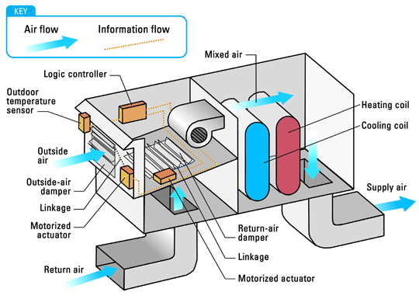
HVAC – Economizers “Free Cooling”
Quantity of Outside Air (OA): Meet Minimum Ventilation Requirement
Economizer Function: Flush out building heat with cool outside air
CMGT235 Mechanical and Electrical Systems
Notes:
Another everyday form of building energy use is the provision of hot water.
Water-heating energy efficiency depends upon water-heating equipment, delivery, and operational controls.
Energy codes provide criteria for such issues as insulating circulating hot water systems, service water heating equipment performance efficiencies in commercial applications, heat traps, controls and pool heaters.

Slide 26
Packaged Rooftop Cooling Unit
CMGT235 Mechanical and Electrical Systems
Notes:
Another everyday form of building energy use is the provision of hot water.
Water-heating energy efficiency depends upon water-heating equipment, delivery, and operational controls.
Energy codes provide criteria for such issues as insulating circulating hot water systems, service water heating equipment performance efficiencies in commercial applications, heat traps, controls and pool heaters.

Slide 27
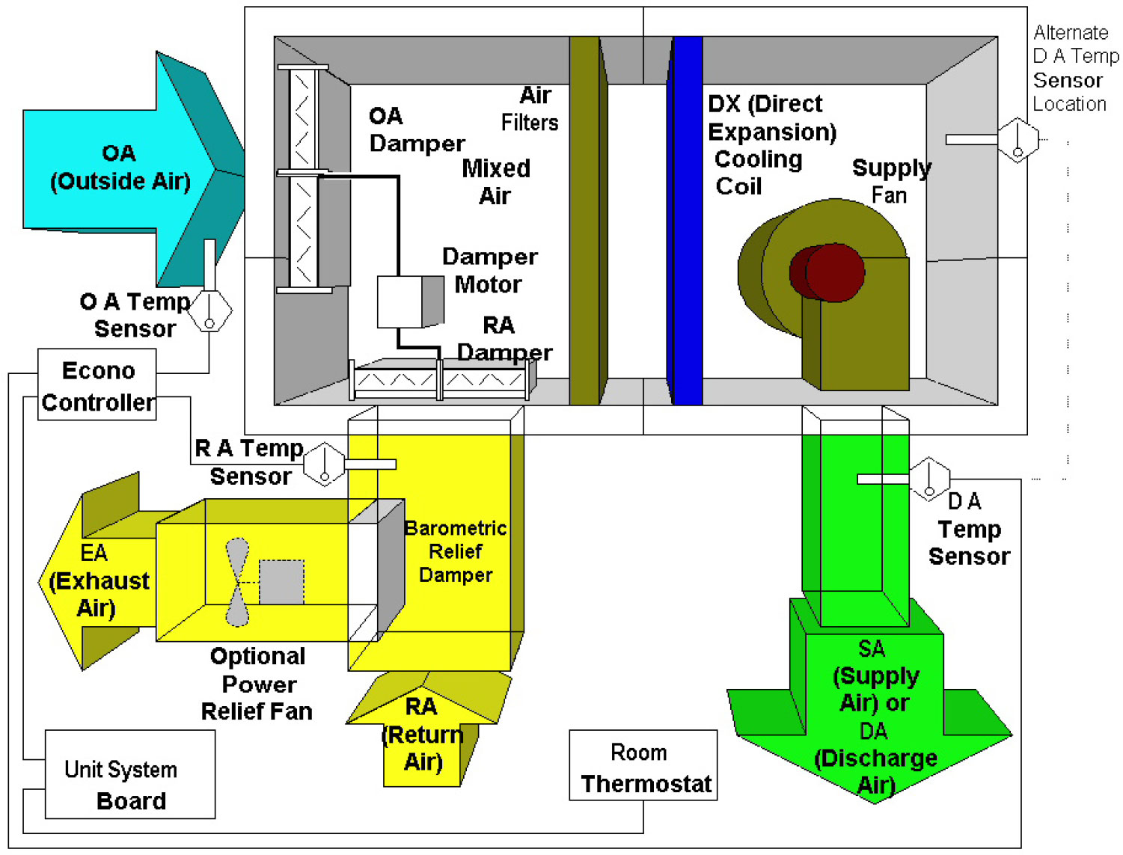
Basic OA Economizer Idea
CMGT235 Mechanical and Electrical Systems
Notes:
Another everyday form of building energy use is the provision of hot water.
Water-heating energy efficiency depends upon water-heating equipment, delivery, and operational controls.
Energy codes provide criteria for such issues as insulating circulating hot water systems, service water heating equipment performance efficiencies in commercial applications, heat traps, controls and pool heaters.

Slide 28
Top of the Charts
Most Impactful Basic HVAC Control Measures
Snow and ice melt heater control
Temperature setback scheduling
Full 5-degree thermostat deadband
Economizer controls
Limits on simultaneous heating and cooling (VAV reheat)
VAV ventilation optimization
Supply air temperature & fan static reset controls
Exterior ductwork insulation (C403.2.9)
Fan power limits
Proper equipment sizing
Commissioning
CMGT235 Mechanical and Electrical Systems
Notes:
Another everyday form of building energy use is the provision of hot water.
Water-heating energy efficiency depends upon water-heating equipment, delivery, and operational controls.
Energy codes provide criteria for such issues as insulating circulating hot water systems, service water heating equipment performance efficiencies in commercial applications, heat traps, controls and pool heaters.

Slide 29
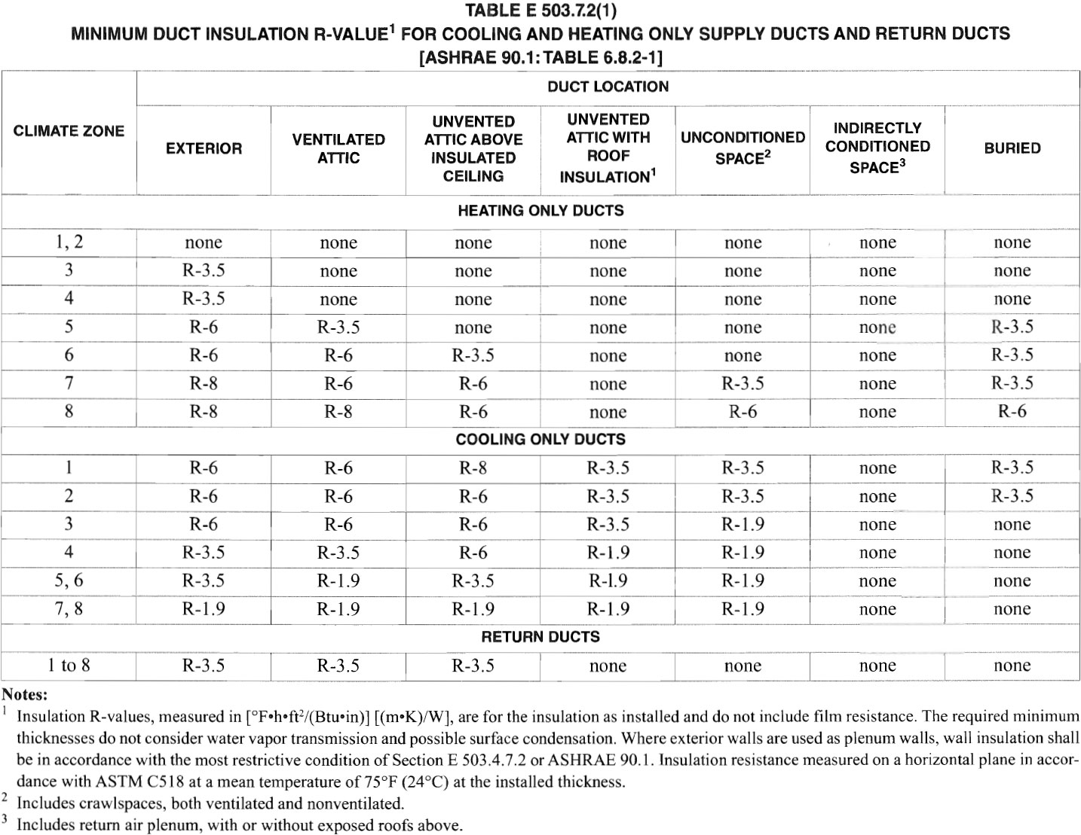
Ductwork in Attics or Outside the Building
CMGT235 Mechanical and Electrical Systems
Notes:
Another everyday form of building energy use is the provision of hot water.
Water-heating energy efficiency depends upon water-heating equipment, delivery, and operational controls.
Energy codes provide criteria for such issues as insulating circulating hot water systems, service water heating equipment performance efficiencies in commercial applications, heat traps, controls and pool heaters.

Slide 30
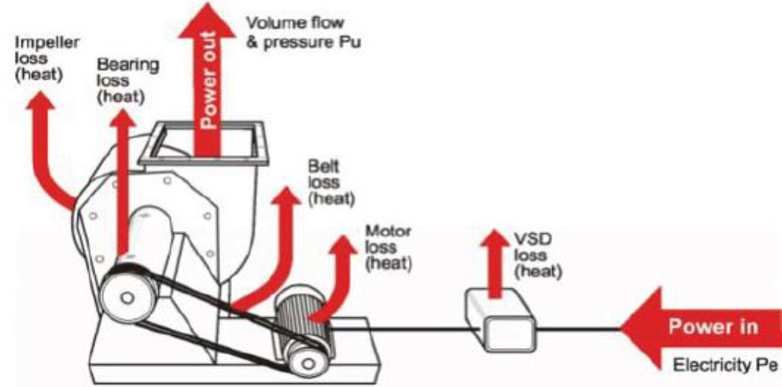
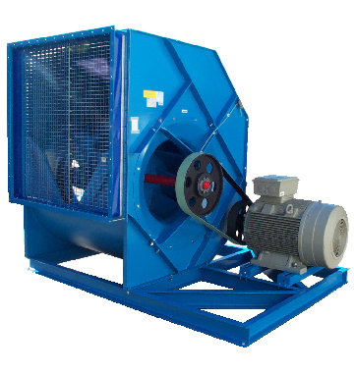
Overall Fan System Efficiency
CMGT235 Mechanical and Electrical Systems
Notes:
Another everyday form of building energy use is the provision of hot water.
Water-heating energy efficiency depends upon water-heating equipment, delivery, and operational controls.
Energy codes provide criteria for such issues as insulating circulating hot water systems, service water heating equipment performance efficiencies in commercial applications, heat traps, controls and pool heaters.

Slide 31
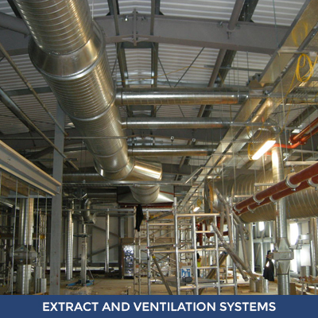
Complex Building Energy Use - HVAC
CMGT235 Mechanical and Electrical Systems
Notes:
Another everyday form of building energy use is the provision of hot water.
Water-heating energy efficiency depends upon water-heating equipment, delivery, and operational controls.
Energy codes provide criteria for such issues as insulating circulating hot water systems, service water heating equipment performance efficiencies in commercial applications, heat traps, controls and pool heaters.

Slide 32
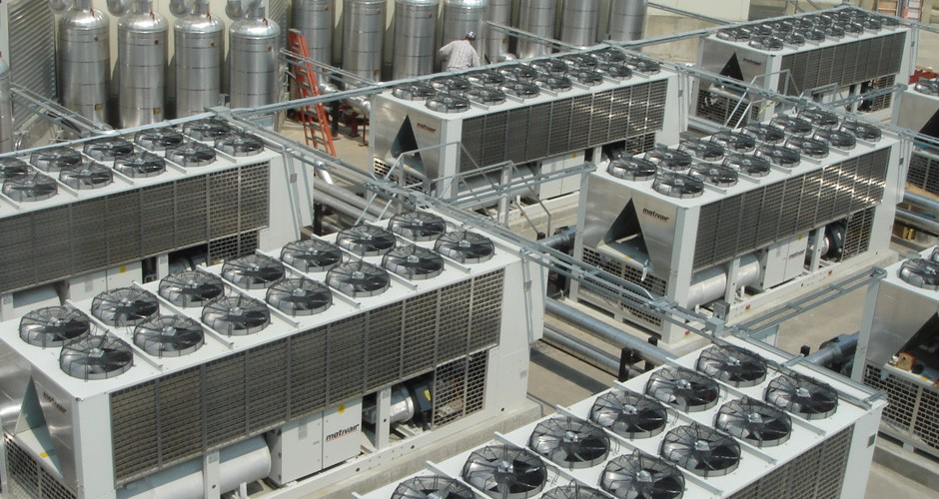
Heating and Cooling
CMGT235 Mechanical and Electrical Systems
Notes:
Another everyday form of building energy use is the provision of hot water.
Water-heating energy efficiency depends upon water-heating equipment, delivery, and operational controls.
Energy codes provide criteria for such issues as insulating circulating hot water systems, service water heating equipment performance efficiencies in commercial applications, heat traps, controls and pool heaters.

Slide 33
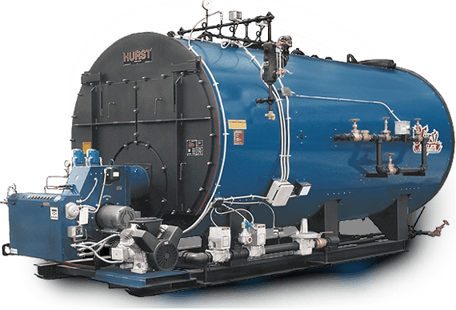
Central Plant: Boilers
CMGT235 Mechanical and Electrical Systems
Notes:
Another everyday form of building energy use is the provision of hot water.
Water-heating energy efficiency depends upon water-heating equipment, delivery, and operational controls.
Energy codes provide criteria for such issues as insulating circulating hot water systems, service water heating equipment performance efficiencies in commercial applications, heat traps, controls and pool heaters.

Slide 34
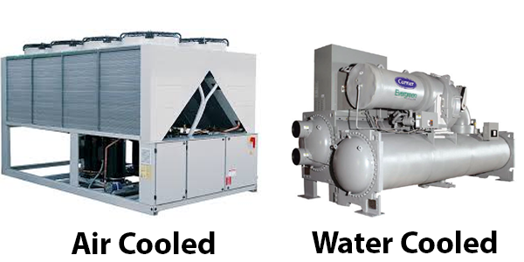
Central Plant: Chillers
CMGT235 Mechanical and Electrical Systems
Notes:
Another everyday form of building energy use is the provision of hot water.
Water-heating energy efficiency depends upon water-heating equipment, delivery, and operational controls.
Energy codes provide criteria for such issues as insulating circulating hot water systems, service water heating equipment performance efficiencies in commercial applications, heat traps, controls and pool heaters.

Slide 35
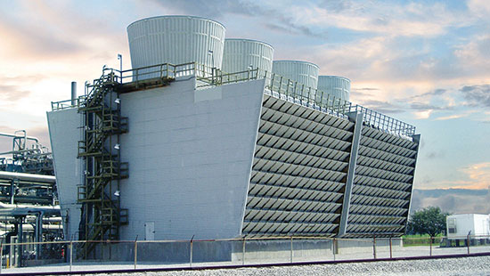
Central Plant: Cooling Tower
CMGT235 Mechanical and Electrical Systems
Notes:
Another everyday form of building energy use is the provision of hot water.
Water-heating energy efficiency depends upon water-heating equipment, delivery, and operational controls.
Energy codes provide criteria for such issues as insulating circulating hot water systems, service water heating equipment performance efficiencies in commercial applications, heat traps, controls and pool heaters.

Slide 36
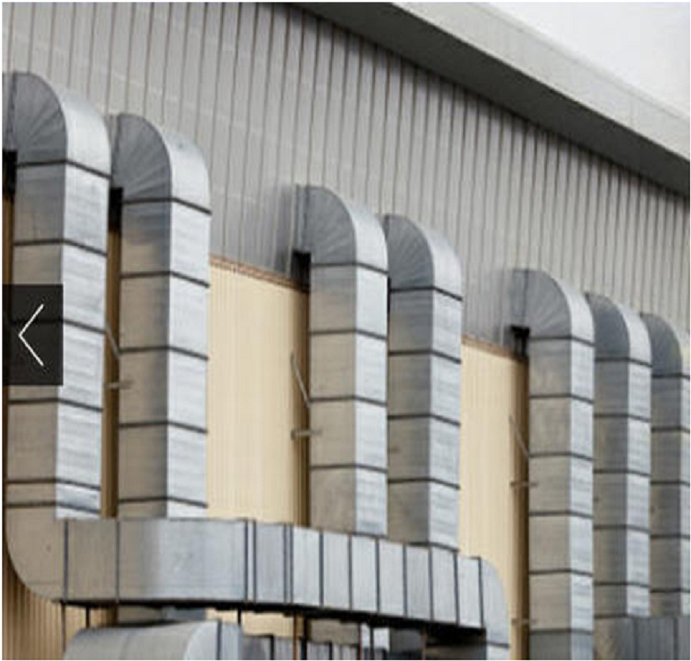
Energy Code Checks
CMGT235 Mechanical and Electrical Systems
Notes:
Another everyday form of building energy use is the provision of hot water.
Water-heating energy efficiency depends upon water-heating equipment, delivery, and operational controls.
Energy codes provide criteria for such issues as insulating circulating hot water systems, service water heating equipment performance efficiencies in commercial applications, heat traps, controls and pool heaters.

Slide 37
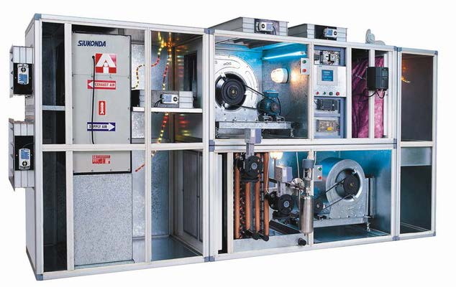
Complex Secondary HVAC Systems
CMGT235 Mechanical and Electrical Systems
Notes:
Another everyday form of building energy use is the provision of hot water.
Water-heating energy efficiency depends upon water-heating equipment, delivery, and operational controls.
Energy codes provide criteria for such issues as insulating circulating hot water systems, service water heating equipment performance efficiencies in commercial applications, heat traps, controls and pool heaters.

Slide 38
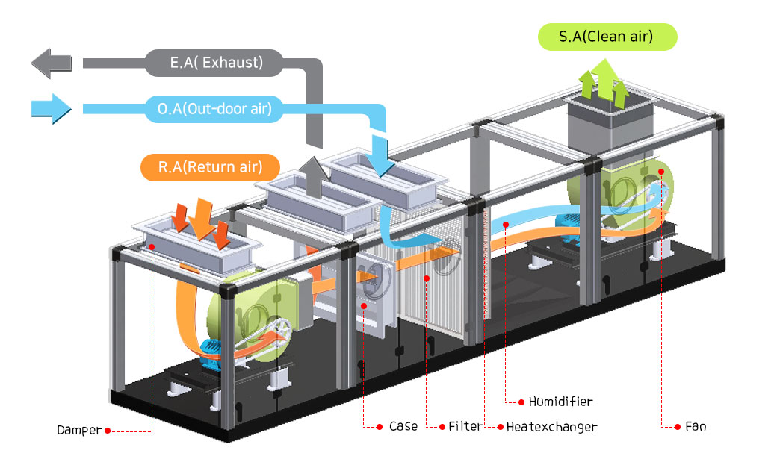
Secondary HVAC System Air Handlers
CMGT235 Mechanical and Electrical Systems
Notes:
Another everyday form of building energy use is the provision of hot water.
Water-heating energy efficiency depends upon water-heating equipment, delivery, and operational controls.
Energy codes provide criteria for such issues as insulating circulating hot water systems, service water heating equipment performance efficiencies in commercial applications, heat traps, controls and pool heaters.

Slide 39
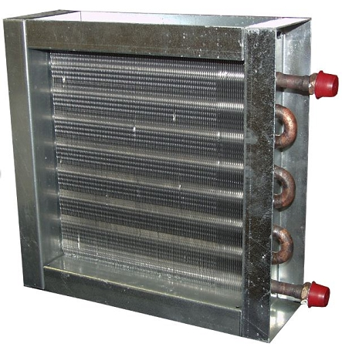
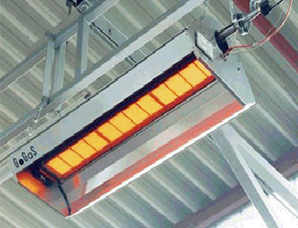
Distribution: Heating Coils, Radiant Heaters
CMGT235 Mechanical and Electrical Systems
Notes:
Another everyday form of building energy use is the provision of hot water.
Water-heating energy efficiency depends upon water-heating equipment, delivery, and operational controls.
Energy codes provide criteria for such issues as insulating circulating hot water systems, service water heating equipment performance efficiencies in commercial applications, heat traps, controls and pool heaters.

Slide 40
VAV Multiple Zone System Concept
CMGT235 Mechanical and Electrical Systems
Notes:
Another everyday form of building energy use is the provision of hot water.
Water-heating energy efficiency depends upon water-heating equipment, delivery, and operational controls.
Energy codes provide criteria for such issues as insulating circulating hot water systems, service water heating equipment performance efficiencies in commercial applications, heat traps, controls and pool heaters.

Slide 41
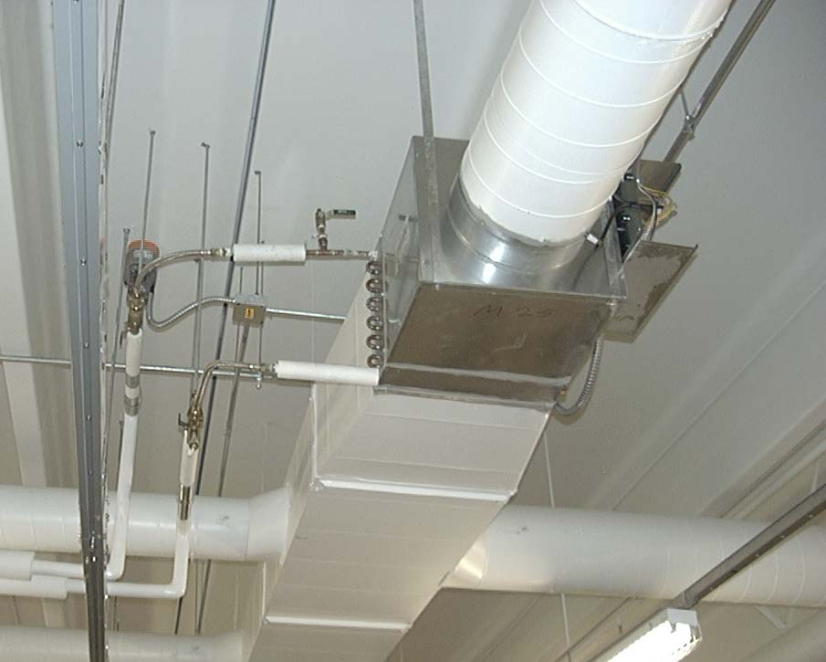
Multiple Zone System Example: VAV Terminal Unit (VAV Box)
CMGT235 Mechanical and Electrical Systems
Notes:
Another everyday form of building energy use is the provision of hot water.
Water-heating energy efficiency depends upon water-heating equipment, delivery, and operational controls.
Energy codes provide criteria for such issues as insulating circulating hot water systems, service water heating equipment performance efficiencies in commercial applications, heat traps, controls and pool heaters.

