Slide 1
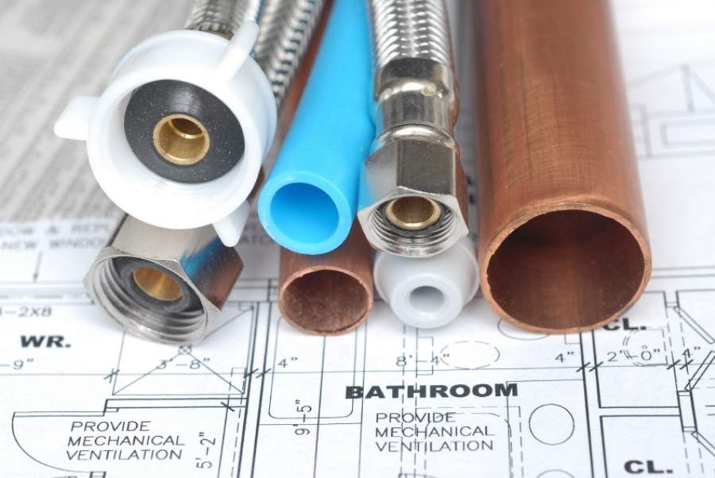
Plumbing Systems
CMGT235 Mechanical and Electrical Systems

Slide 2

Plumbing Material
International Association of Plumbing and Mechanical Officials (IAPMO)
CMGT235 Mechanical and Electrical Systems
2

Slide 3
Plumbing Material
International Association of Plumbing and Mechanical Officials (IAPMO)
The International Association of Plumbing and Mechanical Officials shall be recognized by the building industry and the general public, both at home and abroad, as the world-wide leader in the plumbing and mechanical industry for:
protecting health and safety
supporting sustainability and emerging technology
and delivering code education.
This shall be accomplished through the use of IAPMO codes and related services in cooperation with industry partners. IAPMO shall have recruited, retained, and empowered a diverse membership and staff that makes this possible.
CMGT235 Mechanical and Electrical Systems
3

Slide 4

Plumbing Material
Uniform Plumbing Code (UPC)
The Uniform Plumbing Code provides consumers with safe and sanitary plumbing systems while, at the same time, allowing latitude for innovation and new technologies.
http://epubs.iapmo.org/UPC/mobile/index.html#p=1
CMGT235 Mechanical and Electrical Systems
4

Slide 5

Plumbing Material
http://www.iapmo.org/
CMGT235 Mechanical and Electrical Systems
5

Slide 6

Plumbing Material
2016 California Plumbing Code
http://www.bsc.ca.gov/codes.aspx
Available Online
http://epubs.iapmo.org/2016/CPC/#p=1
CMGT235 Mechanical and Electrical Systems
6

Slide 7
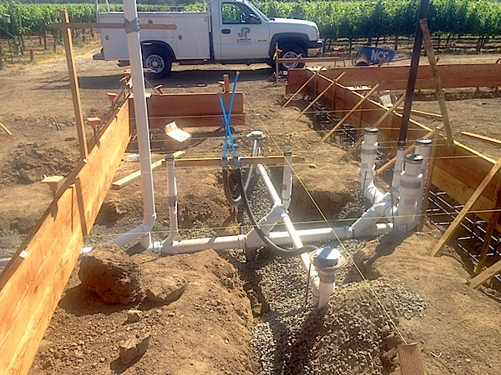
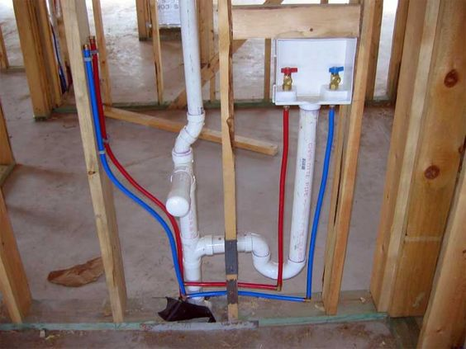
Plumbing Material
BASIC PLUMBING MATERIAL
Pipe – Cylindrical Tubing
Fittings – used to make connections between pipes and equipment
Valves – used to regulate fluid flow
Meters – Used to measure and indicate fluid flow
CMGT235 Mechanical and Electrical Systems
7

Slide 8
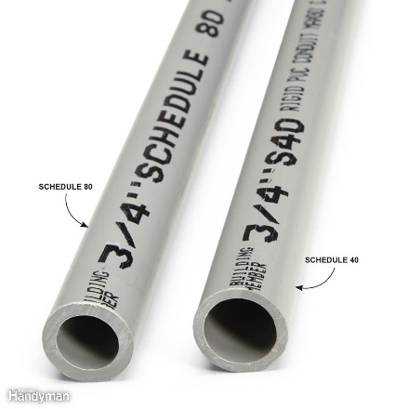
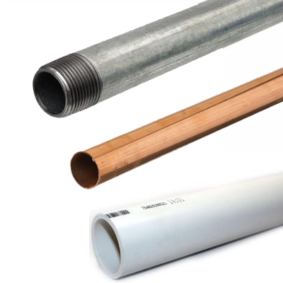
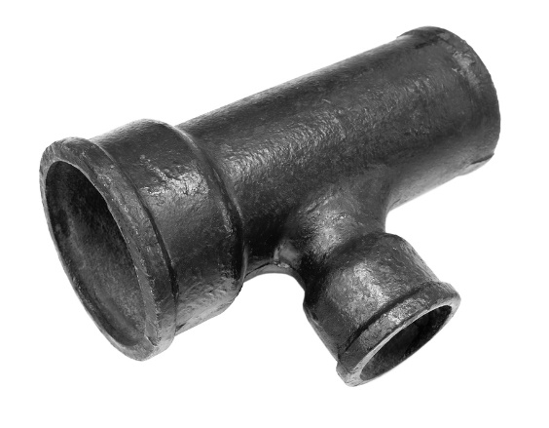
Plumbing Material
Classification of Pipe and Pipe Fitting Materials
Plastic
Copper
Cast Iron Soil Pipe
Steel
Check your plumbing code to determine which materials and products may be used for each application, what product standards apply, and whether there are any special provisions regarding use of the materials.
CMGT235 Mechanical and Electrical Systems
8

Slide 9
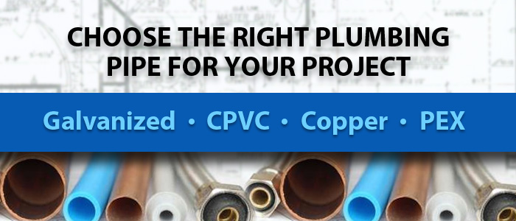
Plumbing Material
CMGT235 Mechanical and Electrical Systems

Slide 10

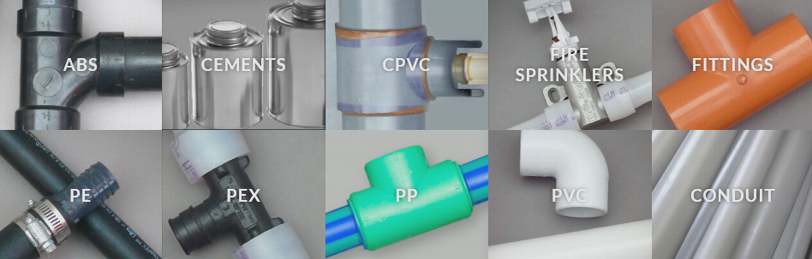
Plumbing Material
PLASTIC PIPE AND FITTINGS
CMGT235 Mechanical and Electrical Systems

Slide 11
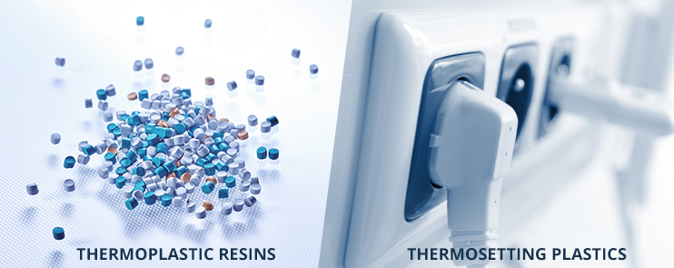
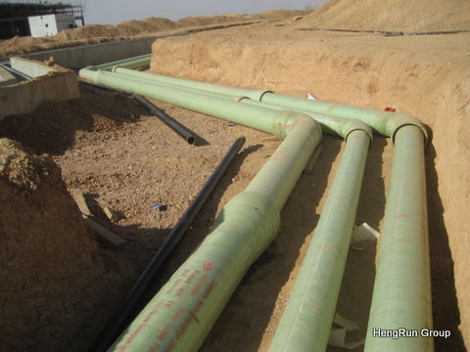
Plumbing Material
PLASTIC PIPE AND FITTINGS
Plastics
Petroleum-based products
Thermosetting resin – cannot be re-melted after it is formed and cured
Thermoplastic resin – can be heated and reformed
CMGT235 Mechanical and Electrical Systems

Slide 12
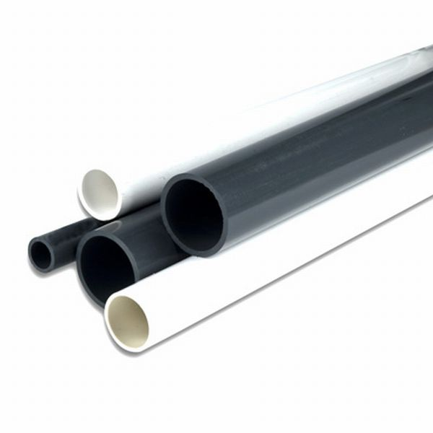
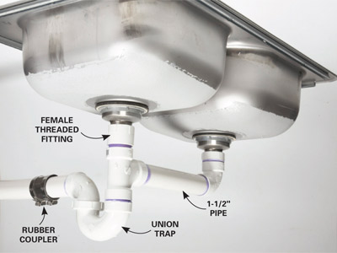
Plumbing Material
Plastic Pipe
Excellent resistance to solvents and corrosives
Resistance to heat and high temperature
Smooth interior walls
Resist bacteria growth
Good flexibility
Do not conduct electricity
CMGT235 Mechanical and Electrical Systems

Slide 13

Plumbing Material
Plastic Piping Used for Plumbing Some Jurisdictions
Acrylonitrile-Butadiene-Styrene (ABS) Polyethylene (PE)
Polyvinyl Chloride (PVC) Polybutylene (PB)
Chlorinated Polyvinyl Chloride (CPVC) Polypropylene (PP)
Cross-Linked Polyethylene (PEX)
Local plumbing code determines what type may be used.
CMGT235 Mechanical and Electrical Systems

Slide 14
Plumbing Material
APPLICATION | Water Distribution | Sewer and Mains | Drain, waste, and Vent | Hot and Cold Water Distribution | Fire Sprinklers | Industrial Process Piping
COLOR | Black, light blue, white, clear, or gray | Green, white, black, or gray | Black, or white | Tan, red, white, blue, silver, or clear | Orange | Dark gray – PVC Light gray - CPVC
PLASTIC PIPING MATERIALS | ABS | ABS | ABS | CPVC | CPVC | PVC
 | PVC | PVC | PVC | PEX | PB | CPVC
 | CPVC |  | PP | PB
 | PEX |  |  | PP
 | PE
 | PB
CMGT235 Mechanical and Electrical Systems

Slide 15
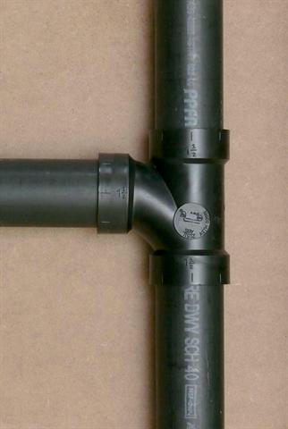
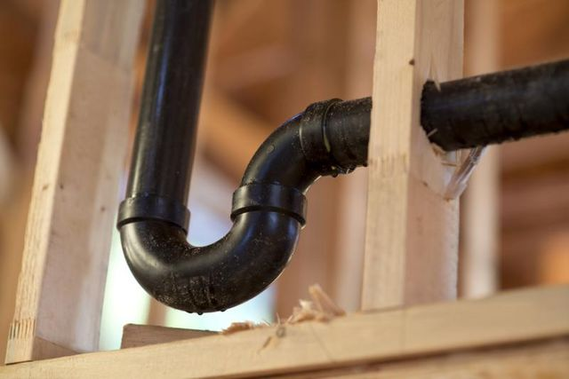
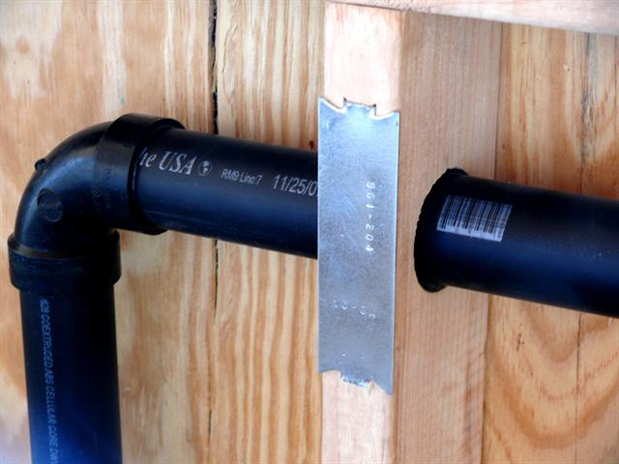
Plumbing Material
Acrylonitrile-Butadiene- Styrene (ABS) Pipe and Fittings
Schedule 40 ABS DWV
Black plastic
Sanitary Drainage and vent piping
Aboveground and underground storm water drainage
Easier to install and cheaper than metal pipe. Less time needed to rough-in than metal DWV
-40°F to 180°F
No priming required
1 ¼” – 6”
10’ and 20’ pipe lengths
CMGT235 Mechanical and Electrical Systems

Slide 16
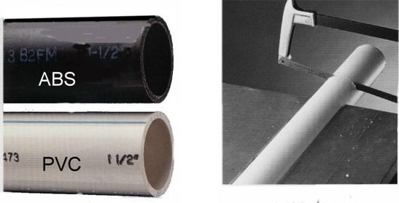
Plumbing Material
Polyvinyl Chloride (PVC) Pipe and Fittings
Schedule 40 PVC DWV
White plastic
Sanitary Drainage and vent piping
Aboveground and underground storm water drainage
Water mains
Water service lines
Joined by solvent cementing
1 ¼” – 6”
10’ and 20’ pipe lengths
Up to 16” available – underground drainage piping
ABS can only be joined to PVC using the proper transition coupling
CMGT235 Mechanical and Electrical Systems

Slide 17
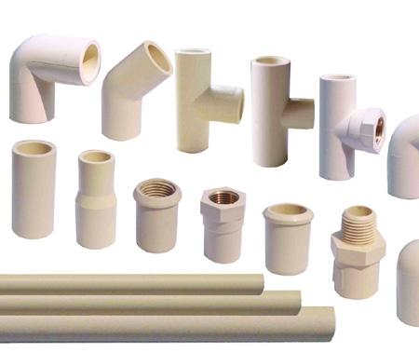
Plumbing Material
Chlorinated Polyvinyl Chloride (CPVC) Pipe and Fittings
Cream-colored thermoplastic
Commonly used for hot and cold water distribution
Potable water distribution
Fire Suppression Materials
Industry fluid handling
Rated for 180°F at 100 psi of pressure
Joined by solvent cementing
½” to 12”
Schedule 40 and Schedule 80
10’ pipe length
CMGT235 Mechanical and Electrical Systems

Slide 18
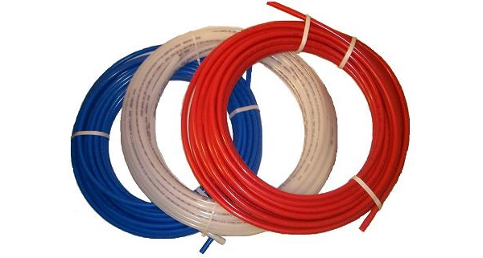
Plumbing Material
Cross-Linked Polyethylene (PEX) Pipe and Fittings
Water Service piping
Hot and cold water distribution
¼” to 2”
Straight lengths of 20’
Coils of 100’, 300’, 400’, 500’, and 1000’
Fast to install
Corrosion resistance
Superior strength
High-temperature and high-pressure resistant
CMGT235 Mechanical and Electrical Systems

Slide 19
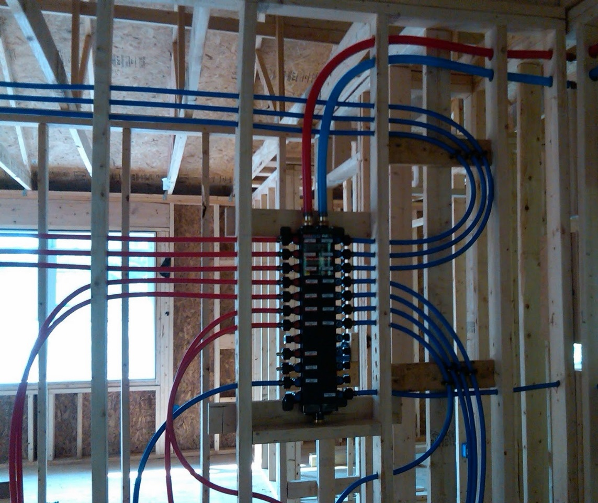
Plumbing Material
Cross-Linked Polyethylene (PEX)
CMGT235 Mechanical and Electrical Systems

Slide 20
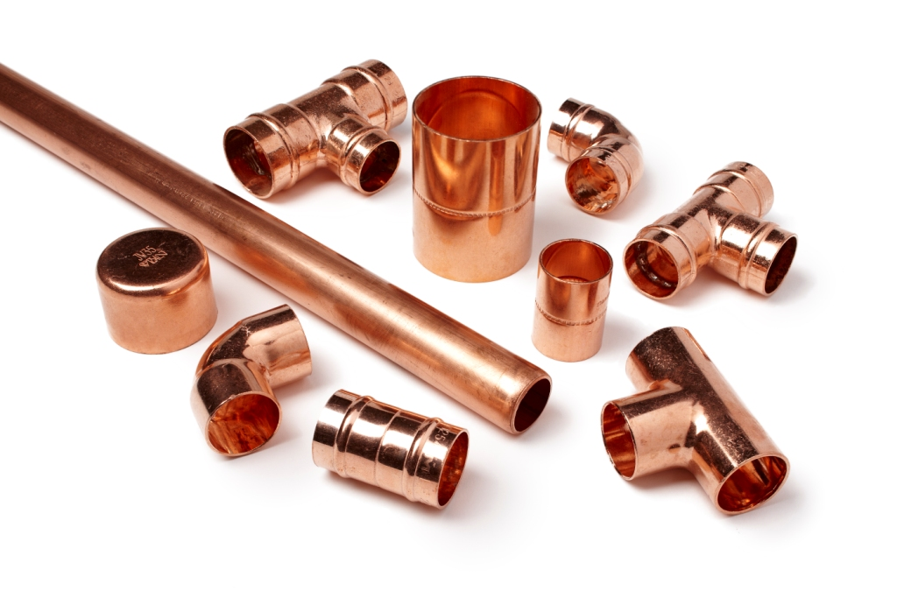

Plumbing Material
COPPER TUBE AND FITTINGS
CMGT235 Mechanical and Electrical Systems

Slide 21
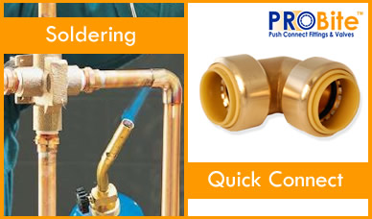
Plumbing Material
Copper Tube Fittings
Cast copper alloy
Cast Bronze
Wrought Copper
Joining
Solder Joint Fittings
Copper Press Fittings
Rolled Groove Joint Fittings
Flared Joint Fittings
Compression Joint Fittings
CMGT235 Mechanical and Electrical Systems

Slide 22
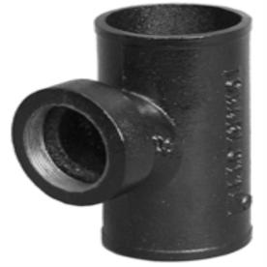

Plumbing Material
CAST IRON SOIL PIPE AND FITTINGS
Gray cast iron – strong, corrosion-resistant
Leakproof, nonabsorbent, easily cut and joined
No-hub and Bell-and-spigot
No-hub: aboveground sanitary drainage, vent, and storm water drainage piping
Bell-and-spigot: underground sanitary drainage, vent, and storm water drainage piping
CMGT235 Mechanical and Electrical Systems

Slide 23
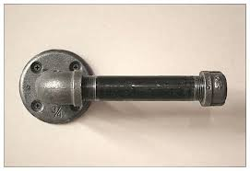
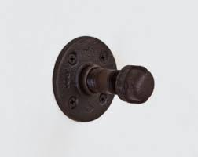
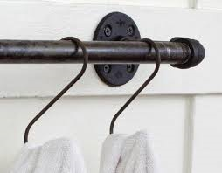
Plumbing Material
STEEL PIPE AND FITTINGS
Water distribution, sanitary waste and vent, storm water drainage, and gas piping Materials
Inexpensive, strong, and rugged
Weight and installation cost are factors
CMGT235 Mechanical and Electrical Systems

Slide 24
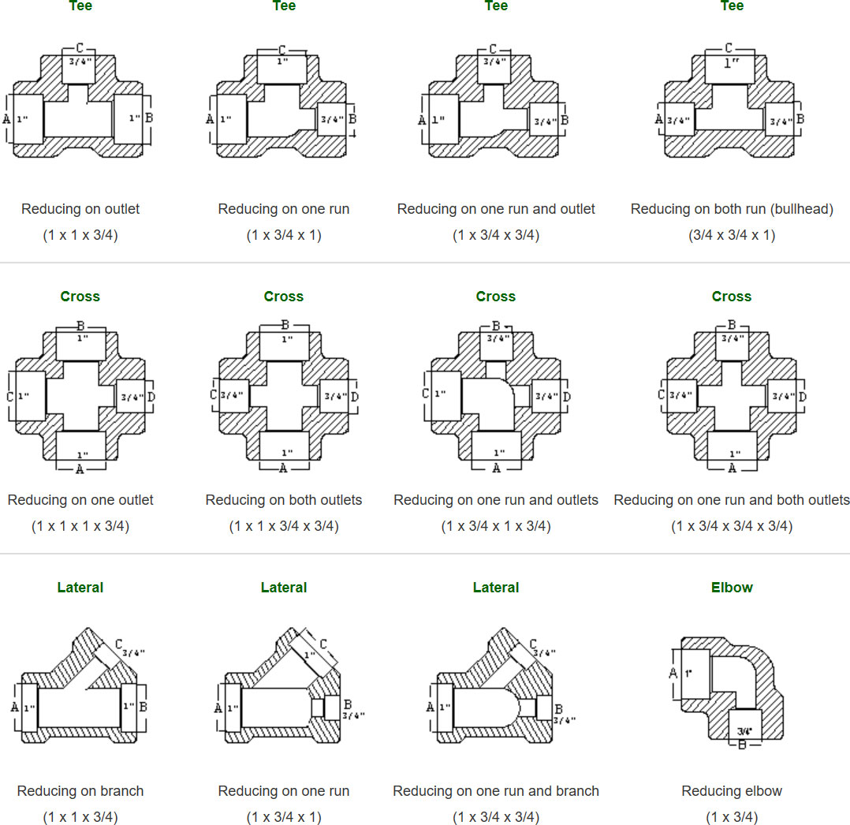
Plumbing Material
READING REDUCING FITTINGS
CMGT235 Mechanical and Electrical Systems

Slide 25
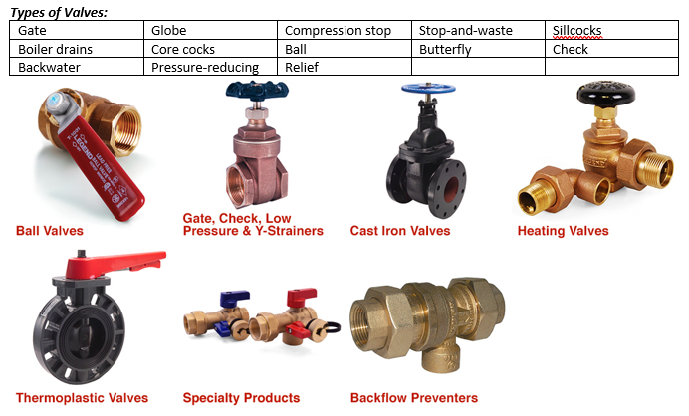
Plumbing Material
PLUMBING VALVES
Used to regulate fluid flow
On or off
Control direction, pressure, and/or temperature
CMGT235 Mechanical and Electrical Systems

Slide 26
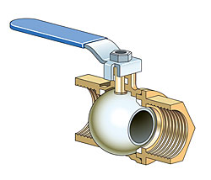
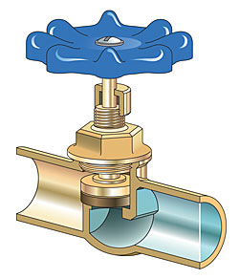
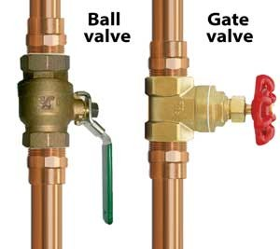
CMGT235 Mechanical and Electrical Systems

Slide 27
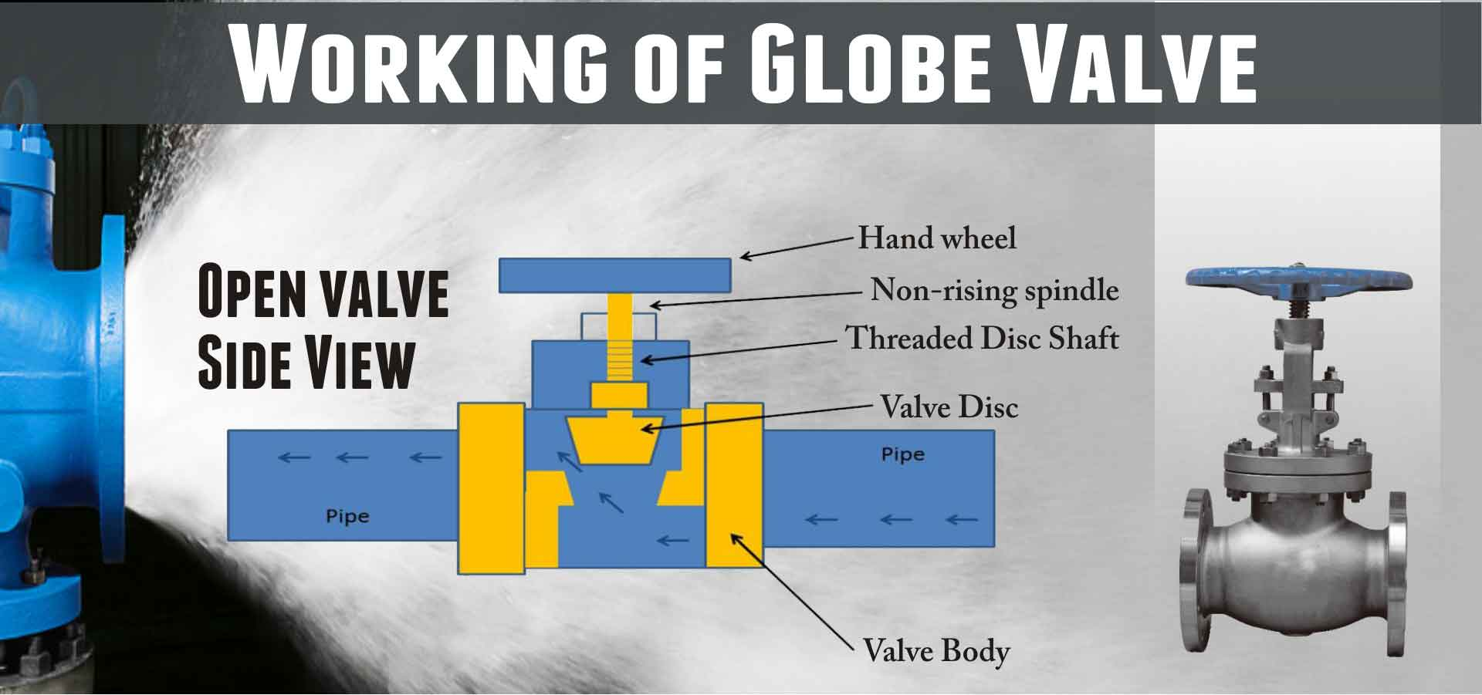
CMGT235 Mechanical and Electrical Systems

Slide 28
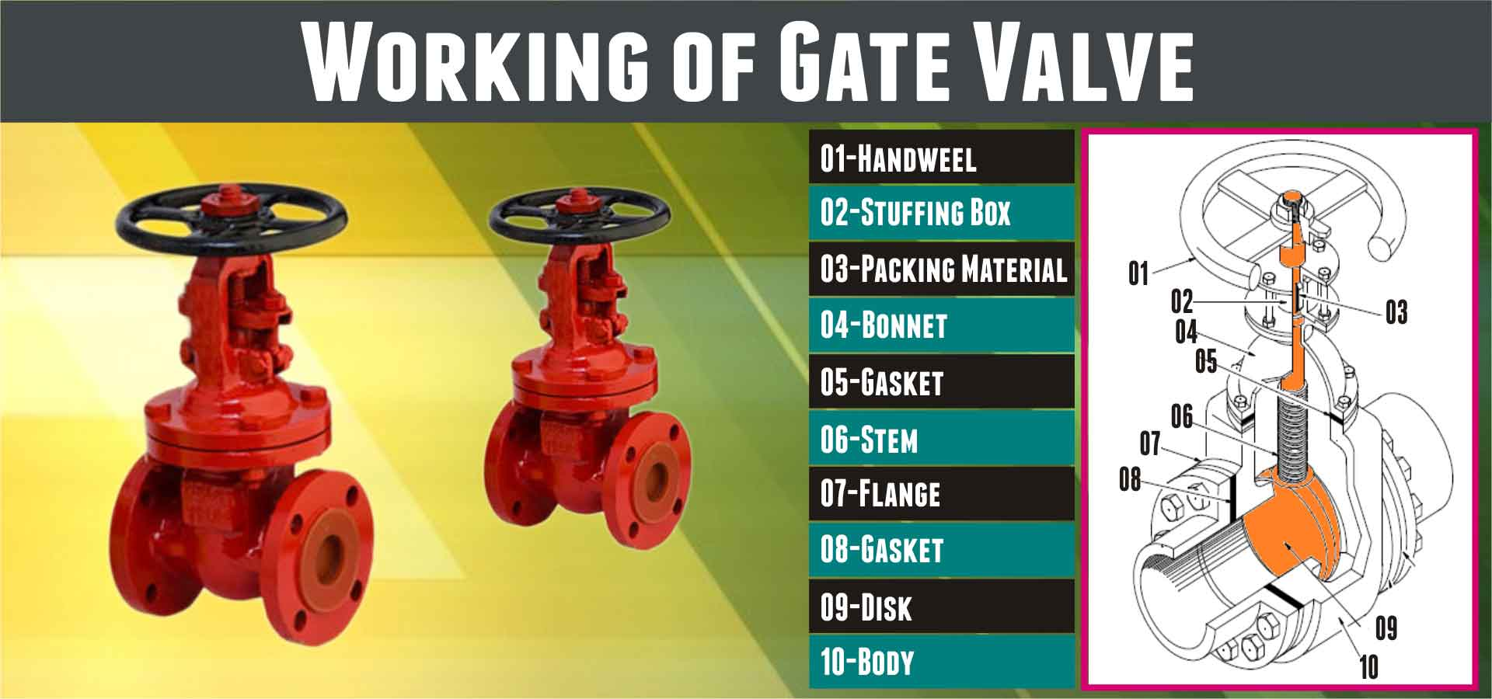
CMGT235 Mechanical and Electrical Systems

Slide 29
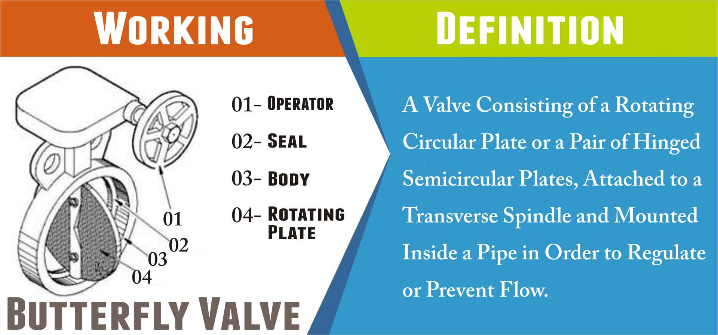
CMGT235 Mechanical and Electrical Systems

Slide 30
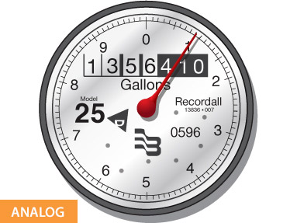
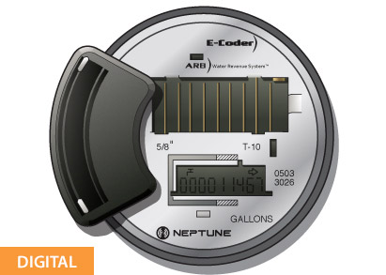
Plumbing Material
WATER METERS
Measure and indicate water usage for a building in order to be charged for the amount of water used.
Measures in cubic feet or gallons
Installed at the end of the water service pipe – inside or outside the building
CMGT235 Mechanical and Electrical Systems

Slide 31
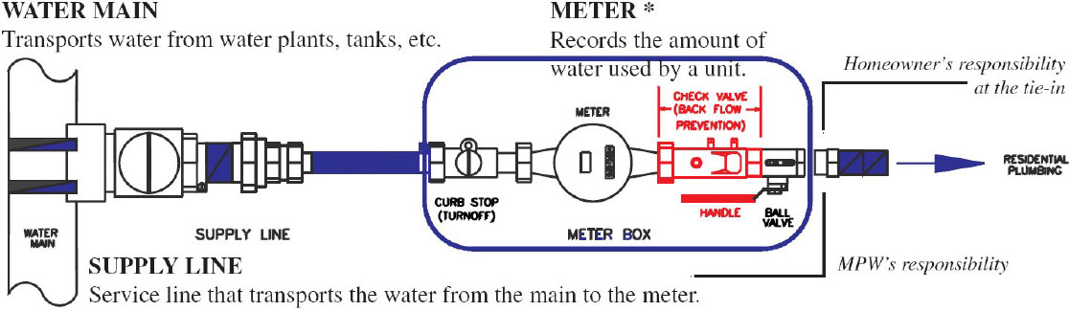
Plumbing Material
WATER METERS
Measure and indicate water usage for a building in order to be charged for the amount of water used.
Measures in cubic feet or gallons
Installed at the end of the water service pipe – inside or outside the building
CMGT235 Mechanical and Electrical Systems

Slide 32
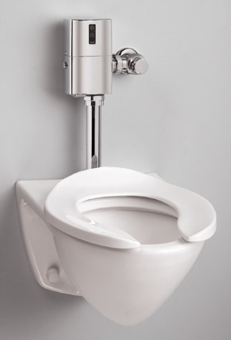
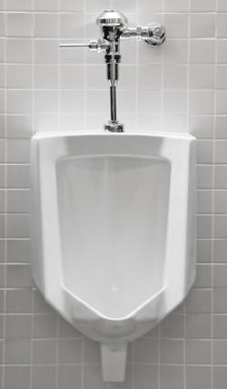
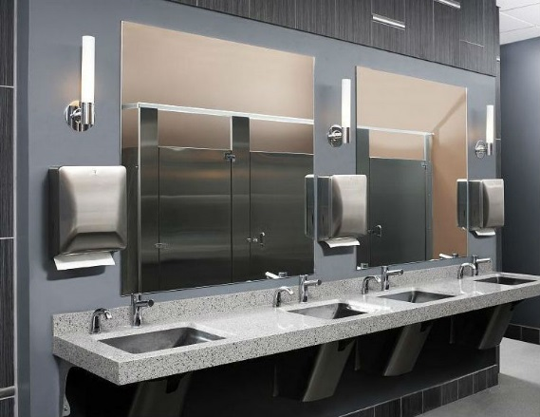
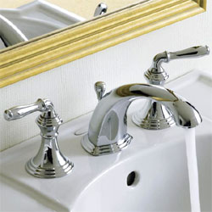
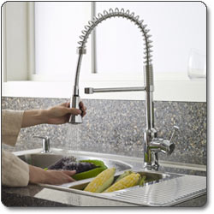
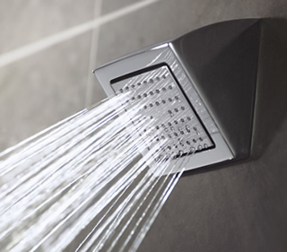

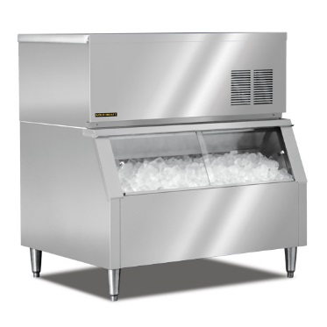
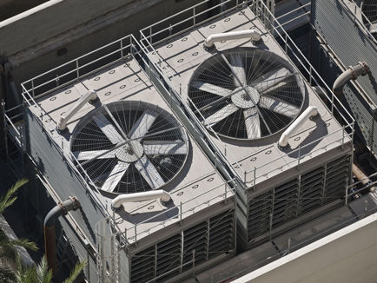
Plumbing Fixtures
Building Indoor Water Use
Flush and Flow Fixtures
Appliances and Process Water Use
CMGT235 Mechanical and Electrical Systems

Slide 33
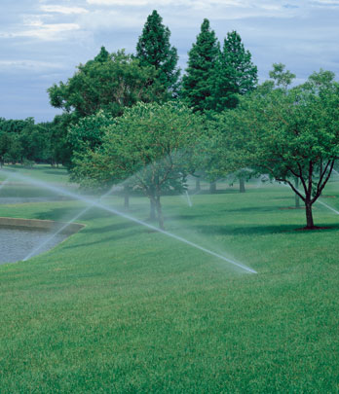
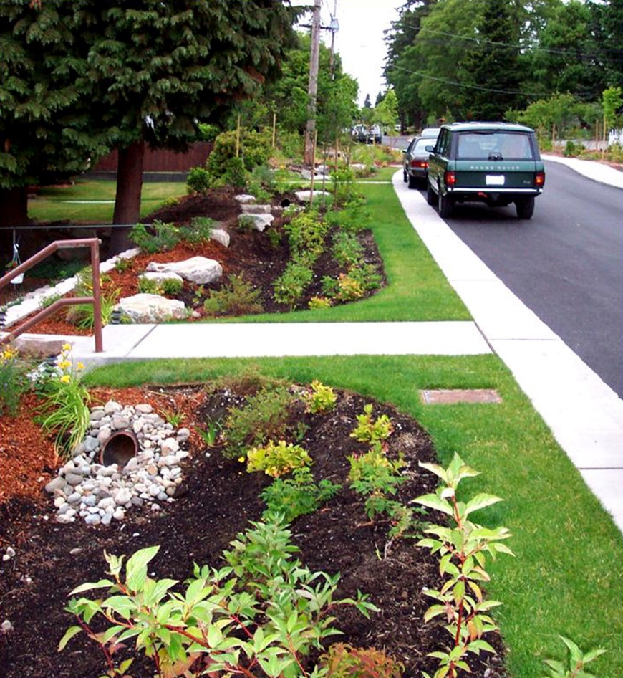
Plumbing Fixtures
Building Outdoor Water Use
Landscape Irrigation
Process Water Use: Cooling and Heating
CMGT235 Mechanical and Electrical Systems

Slide 34

Plumbing Fixtures
https://www.epa.gov/watersense
CMGT235 Mechanical and Electrical Systems

Slide 35
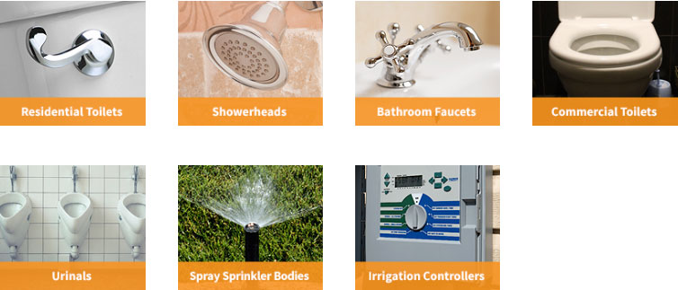
Plumbing Fixtures
WaterSense® Products
https://www.epa.gov/watersense/watersense-products
CMGT235 Mechanical and Electrical Systems

Slide 36
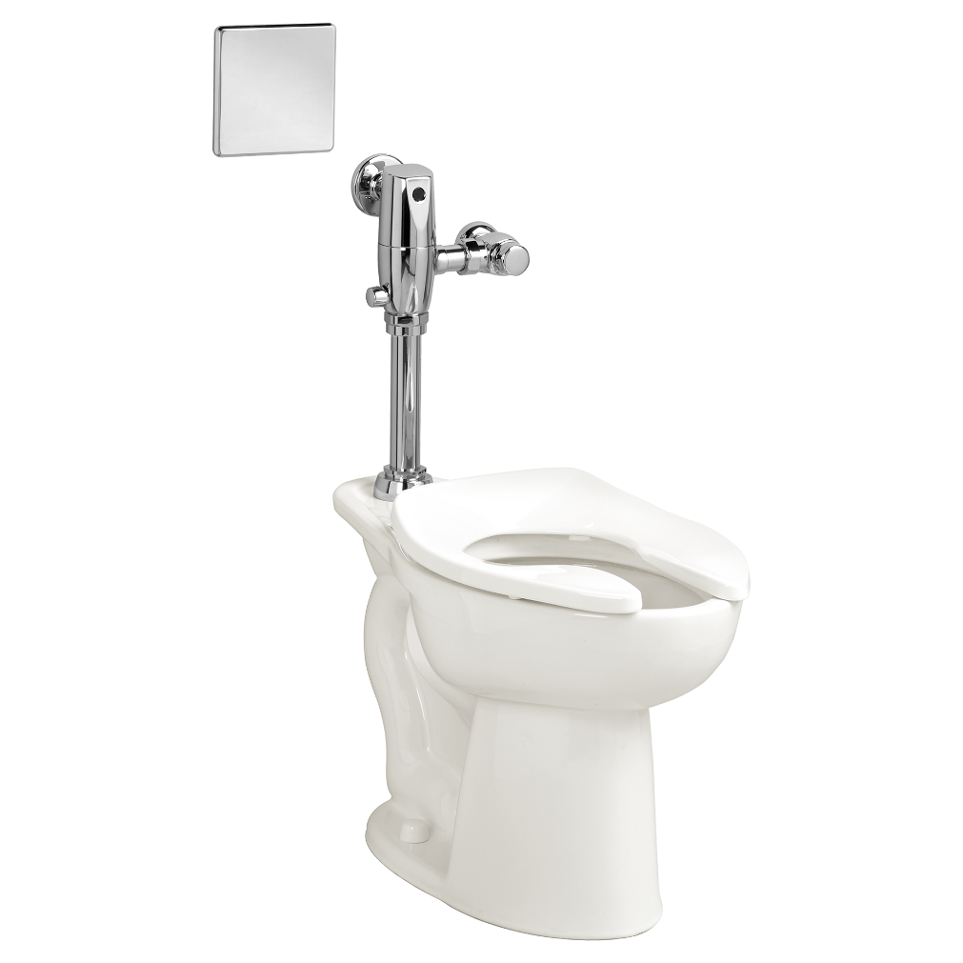
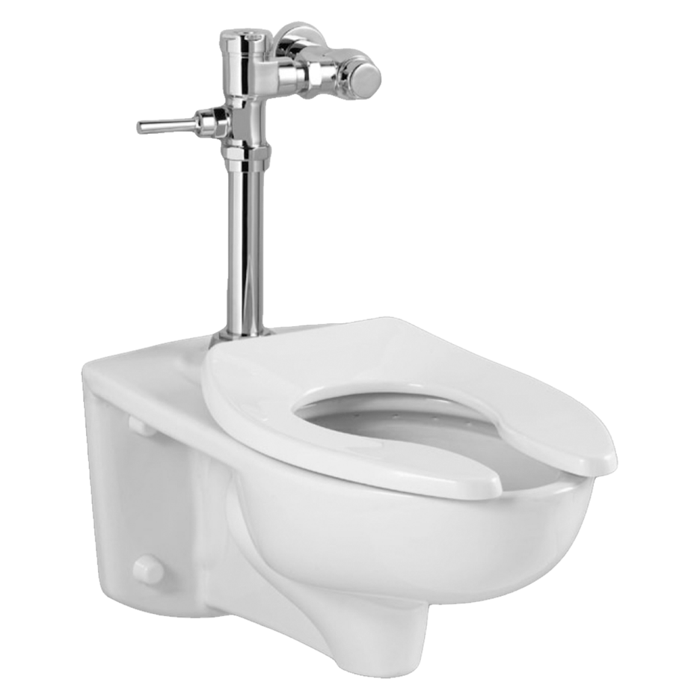
Plumbing Fixtures
Water Closets
Flushometer
CMGT235 Mechanical and Electrical Systems

Slide 37
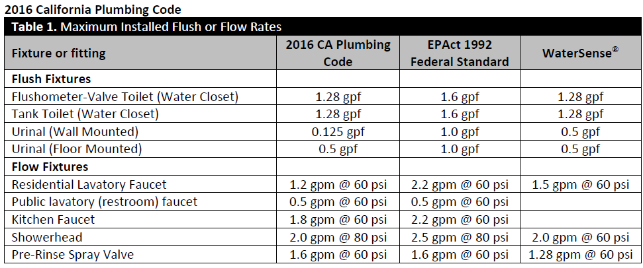
Plumbing Fixtures
CMGT235 Mechanical and Electrical Systems

Slide 38


Plumbing Fixtures
CMGT235 Mechanical and Electrical Systems

Slide 39


Plumbing Fixtures
LEED for Building Design and Construction (LEED BD+C v4)
Credit Category
Water Efficiency (WE)
CMGT235 Mechanical and Electrical Systems

Slide 40
Plumbing Fixtures
LEED for Building Design and Construction (LEED BD+C v4)
Credit Category
Water Efficiency (WE)
Reduce 30%
Reduce 20%
No irrigation system or Reduce 50% or 100%
Reduce 25%, 30%, 35%, 40%, 45%, 50% EP ≥55%
Cycles of Concentration
CMGT235 Mechanical and Electrical Systems

Slide 41

Plumbing Fixtures
Prerequisite Indoor Water Use Reduction
CMGT235 Mechanical and Electrical Systems

Slide 42


Plumbing Fixtures
Dual Flush Water Closets
CMGT235 Mechanical and Electrical Systems

Slide 43

Plumbing Fixtures
Bathroom Lavatory Faucet
CMGT235 Mechanical and Electrical Systems

Slide 44


Slide 45


