Slide 1
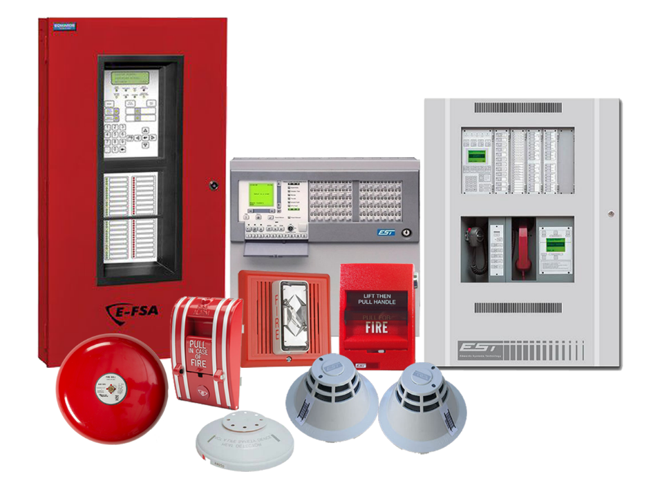
Fire Detection and Alarm Systems
CMGT235 Mechanical and Electrical Systems
Notes:
Another everyday form of building energy use is the provision of hot water.
Water-heating energy efficiency depends upon water-heating equipment, delivery, and operational controls.
Energy codes provide criteria for such issues as insulating circulating hot water systems, service water heating equipment performance efficiencies in commercial applications, heat traps, controls and pool heaters.

Slide 2

Fire Detection and Alarm Systems
Fire Protection
About NFPA - https://www.nfpa.org/About-NFPA
The National Fire Protection Association (NFPA)
Originated in 1896
Sets Guidelines for Fire Protection
OSHA also sets Standards
Fire Marshal Oversees Inspection
Our vision: We are the leading global advocate for the elimination of death, injury, property, and economic loss due to fire, electrical and related hazards.
Our mission: To help save lives and reduce loss with information, knowledge, and passion.
CMGT235 Mechanical and Electrical Systems
Notes:
Another everyday form of building energy use is the provision of hot water.
Water-heating energy efficiency depends upon water-heating equipment, delivery, and operational controls.
Energy codes provide criteria for such issues as insulating circulating hot water systems, service water heating equipment performance efficiencies in commercial applications, heat traps, controls and pool heaters.

Slide 3
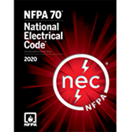
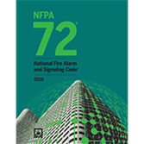
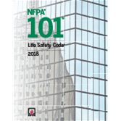
Fire Detection and Alarm Systems
NFPA Codes and Standards
https://www.nfpa.org/Codes-and-Standards
CMGT235 Mechanical and Electrical Systems
Notes:
Another everyday form of building energy use is the provision of hot water.
Water-heating energy efficiency depends upon water-heating equipment, delivery, and operational controls.
Energy codes provide criteria for such issues as insulating circulating hot water systems, service water heating equipment performance efficiencies in commercial applications, heat traps, controls and pool heaters.

Slide 4
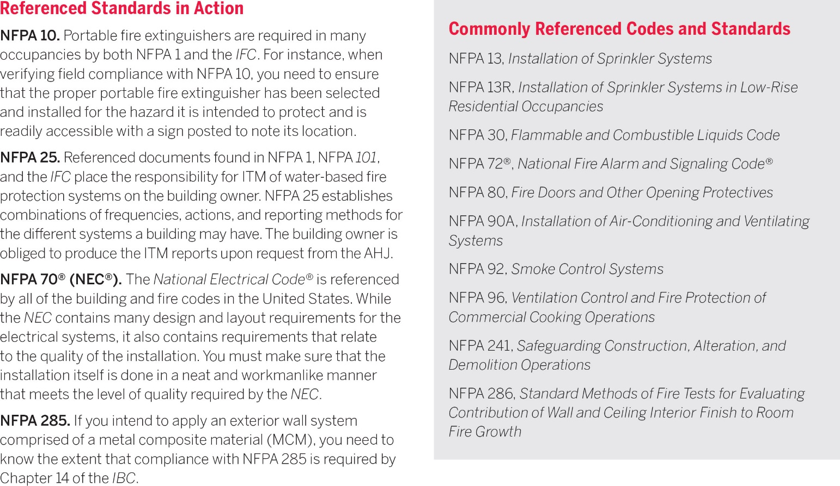
Fire Detection and Alarm Systems
CMGT235 Mechanical and Electrical Systems
Notes:
Another everyday form of building energy use is the provision of hot water.
Water-heating energy efficiency depends upon water-heating equipment, delivery, and operational controls.
Energy codes provide criteria for such issues as insulating circulating hot water systems, service water heating equipment performance efficiencies in commercial applications, heat traps, controls and pool heaters.

Slide 5
Fire Detection and Alarm Systems
NFPA 72 – National Fire Alarm and Signaling Code
NFPA 72 provides the latest safety provisions to meet society's changing fire detection, signaling, and emergency communications demands. In addition to the core focus on fire alarm systems, the Code includes requirements for mass notification systems used for weather emergencies; terrorist events; biological, chemical, and nuclear emergencies; and other threats.
CMGT235 Mechanical and Electrical Systems
Notes:
Another everyday form of building energy use is the provision of hot water.
Water-heating energy efficiency depends upon water-heating equipment, delivery, and operational controls.
Energy codes provide criteria for such issues as insulating circulating hot water systems, service water heating equipment performance efficiencies in commercial applications, heat traps, controls and pool heaters.

Slide 6
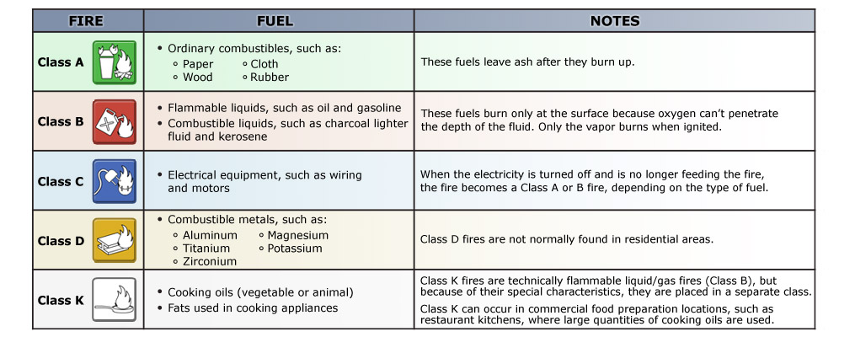
Fire Detection and Alarm Systems
Classification of Fires
CMGT235 Mechanical and Electrical Systems
Notes:
Another everyday form of building energy use is the provision of hot water.
Water-heating energy efficiency depends upon water-heating equipment, delivery, and operational controls.
Energy codes provide criteria for such issues as insulating circulating hot water systems, service water heating equipment performance efficiencies in commercial applications, heat traps, controls and pool heaters.

Slide 7
Fire Detection and Alarm Systems
Building Types
A – Assembly: Auditoriums, Theaters
B – Business: Office, Retail, Restaurants
E – Educational: Schools
F – Factories
H – Hazardous Uses
I – Institutional: Hospitals, Nursing Homes
R – Residential: Apartments, Hotels
https://www.youtube.com/watch?v=zJgQ2kfwhoA
CMGT235 Mechanical and Electrical Systems
Notes:
Another everyday form of building energy use is the provision of hot water.
Water-heating energy efficiency depends upon water-heating equipment, delivery, and operational controls.
Energy codes provide criteria for such issues as insulating circulating hot water systems, service water heating equipment performance efficiencies in commercial applications, heat traps, controls and pool heaters.

Slide 8
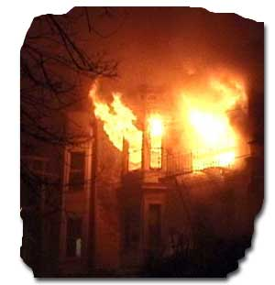
Fire Detection and Alarm Systems
Life Safety Design
Detect Danger
Warn the building occupants
Provide safe egress
Control the fire
Eliminate the fire
Assist firefighters
CMGT235 Mechanical and Electrical Systems
Notes:
Another everyday form of building energy use is the provision of hot water.
Water-heating energy efficiency depends upon water-heating equipment, delivery, and operational controls.
Energy codes provide criteria for such issues as insulating circulating hot water systems, service water heating equipment performance efficiencies in commercial applications, heat traps, controls and pool heaters.

Slide 9
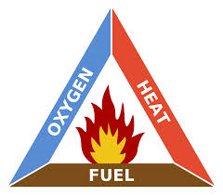
Fire Detection and Alarm Systems
What does it take for a fire to burn?
Three elements:
Fuel, or material to be burned, which may be a liquid, a solid, or a gas
Heat that raises the temperature of the fuel to its ignition point
Oxygen: In an atmosphere of less than 20% oxygen, most fuels can be heated until they entirely vaporize, without burning.
CMGT235 Mechanical and Electrical Systems
Notes:
Another everyday form of building energy use is the provision of hot water.
Water-heating energy efficiency depends upon water-heating equipment, delivery, and operational controls.
Energy codes provide criteria for such issues as insulating circulating hot water systems, service water heating equipment performance efficiencies in commercial applications, heat traps, controls and pool heaters.

Slide 10
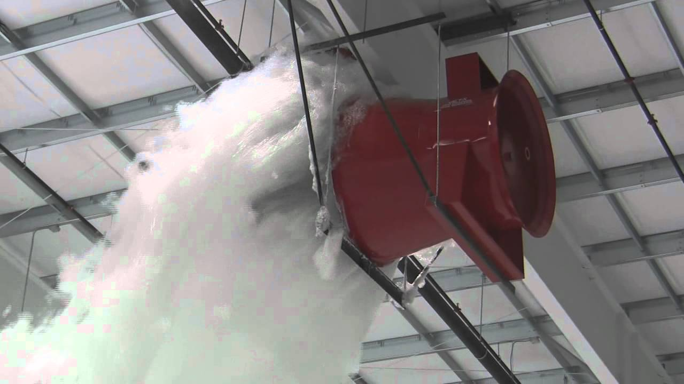
Fire Detection and Alarm Systems
Firefighting Resources
One important reason for identifying the fire classification is to select the most effective means of suppressing the fire.
Four types of firefighting resources are available:
Portable fire extinguishers
Interior wet standpipes
Confinement
Creative resources
CMGT235 Mechanical and Electrical Systems
Notes:
Another everyday form of building energy use is the provision of hot water.
Water-heating energy efficiency depends upon water-heating equipment, delivery, and operational controls.
Energy codes provide criteria for such issues as insulating circulating hot water systems, service water heating equipment performance efficiencies in commercial applications, heat traps, controls and pool heaters.

Slide 11
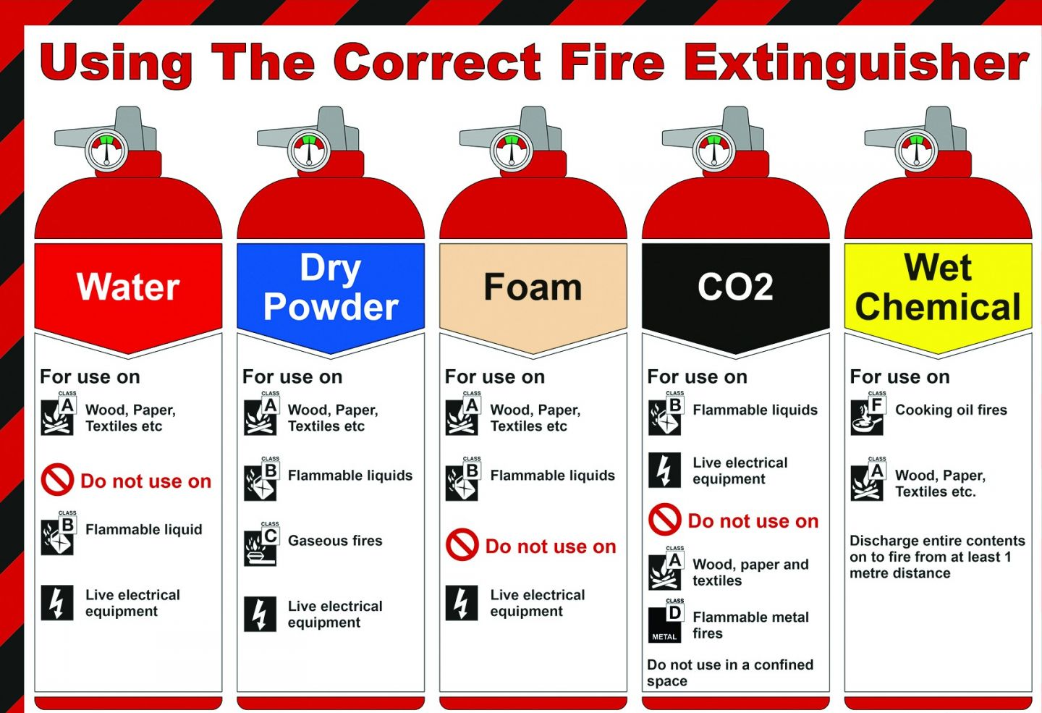
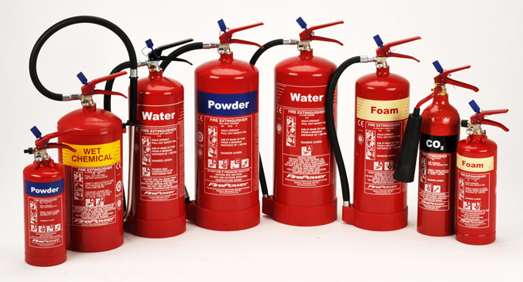
Fire Detection and Alarm Systems
Portable Fire Extinguishers
CMGT235 Mechanical and Electrical Systems
Notes:
Another everyday form of building energy use is the provision of hot water.
Water-heating energy efficiency depends upon water-heating equipment, delivery, and operational controls.
Energy codes provide criteria for such issues as insulating circulating hot water systems, service water heating equipment performance efficiencies in commercial applications, heat traps, controls and pool heaters.

Slide 12
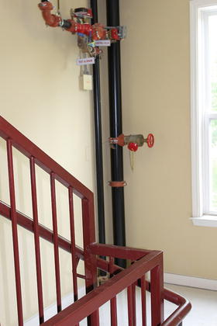
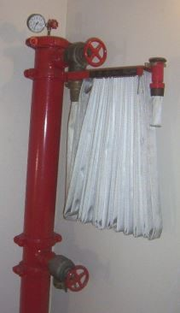
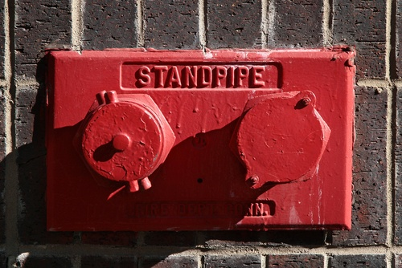
Fire Detection and Alarm Systems
Interior Wet Standpipes
Typically found in commercial and apartment buildings.
Usually consist of 100 feet of 1-inch jacketed hose with a nozzle tip
Deliver up to 125 gallons of water per minute
Should be used by three-person teams (one person to handle the hose, one to bleed air from the line, and one to control water pressure)
Interior Dry Standpipe
CMGT235 Mechanical and Electrical Systems
Notes:
Another everyday form of building energy use is the provision of hot water.
Water-heating energy efficiency depends upon water-heating equipment, delivery, and operational controls.
Energy codes provide criteria for such issues as insulating circulating hot water systems, service water heating equipment performance efficiencies in commercial applications, heat traps, controls and pool heaters.

Slide 13
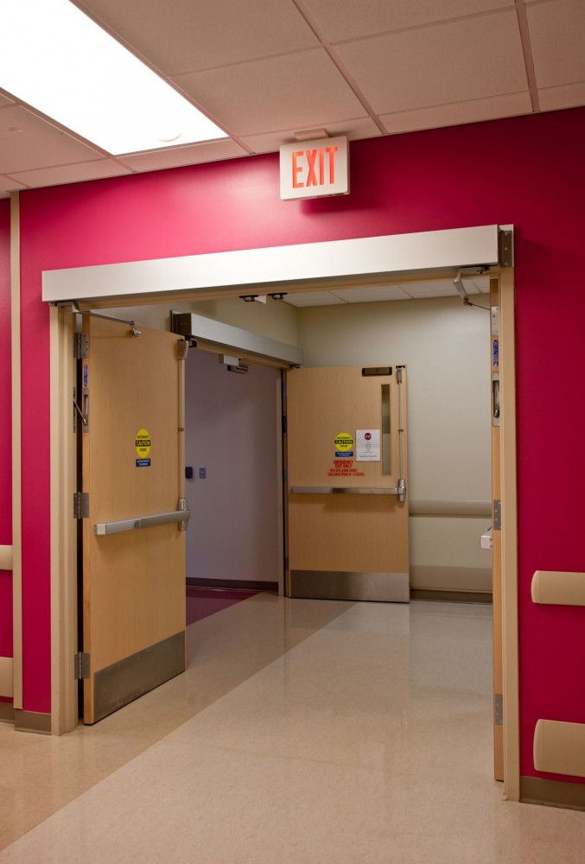
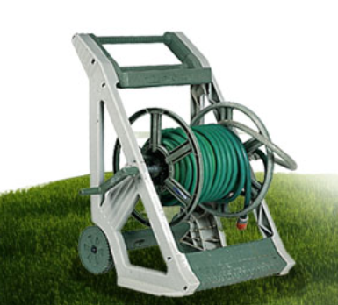
Fire Detection and Alarm Systems
Confinement
Confining an interior fire by closing doors to rooms and hallways may help restrict the spread of smoke and heat, and it limits the amount of oxygen available to the fire.
Creative Resources
In certain circumstances you can make use of resources on hand to fight fires.
Such as:
Swimming pool or spa water and buckets
Sand or dirt and shovels
A garden hose
CMGT235 Mechanical and Electrical Systems
Notes:
Another everyday form of building energy use is the provision of hot water.
Water-heating energy efficiency depends upon water-heating equipment, delivery, and operational controls.
Energy codes provide criteria for such issues as insulating circulating hot water systems, service water heating equipment performance efficiencies in commercial applications, heat traps, controls and pool heaters.

Slide 14
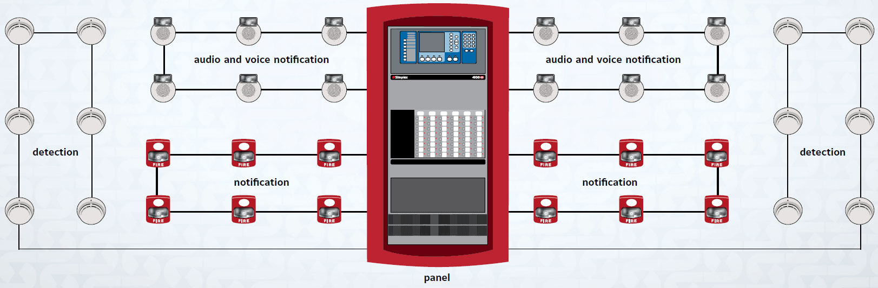
Fire Detection and Alarm Systems
Fire Alarm System Components
Fire Alarm Control Panel (FACP) – The main fire alarm system component that monitors equipment and circuits, receives input signals from initiating devices, activates notification appliances, and transmits signals off-site. Also called the Fire Alarm Control Unit (FACU).
Controls for the system are in the FACP.
CMGT235 Mechanical and Electrical Systems
Notes:
Another everyday form of building energy use is the provision of hot water.
Water-heating energy efficiency depends upon water-heating equipment, delivery, and operational controls.
Energy codes provide criteria for such issues as insulating circulating hot water systems, service water heating equipment performance efficiencies in commercial applications, heat traps, controls and pool heaters.

Slide 15
Fire Detection and Alarm Systems
The FACP can also perform other functions, such as:
Providing two-way firefighter communication
Providing remote annunciator integration
Controlling elevators, HVAC, fire doors, dampers, locks, or other fire protection features
The FACP can also provide public address messages and mass notification alerts through prerecorded evacuation messages or independent voice communications.
NOTE: Some fire alarm control units are designed for both security and fire protection. In these types of systems, fire protection is engineered into the system to assume the highest priority.
CMGT235 Mechanical and Electrical Systems
Notes:
Another everyday form of building energy use is the provision of hot water.
Water-heating energy efficiency depends upon water-heating equipment, delivery, and operational controls.
Energy codes provide criteria for such issues as insulating circulating hot water systems, service water heating equipment performance efficiencies in commercial applications, heat traps, controls and pool heaters.

Slide 16
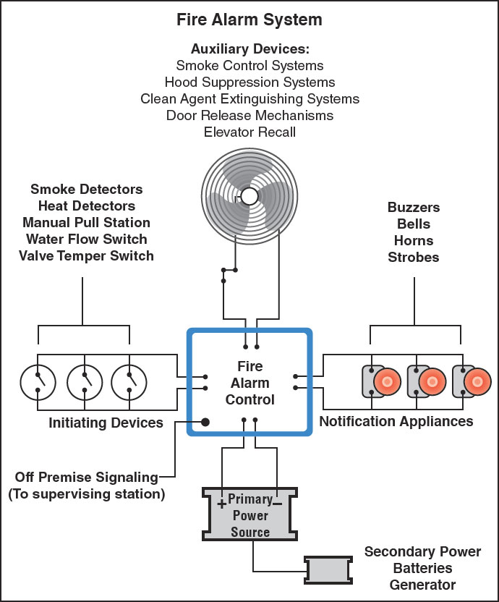
Fire Detection and Alarm Systems
CMGT235 Mechanical and Electrical Systems
Notes:
Another everyday form of building energy use is the provision of hot water.
Water-heating energy efficiency depends upon water-heating equipment, delivery, and operational controls.
Energy codes provide criteria for such issues as insulating circulating hot water systems, service water heating equipment performance efficiencies in commercial applications, heat traps, controls and pool heaters.

Slide 17
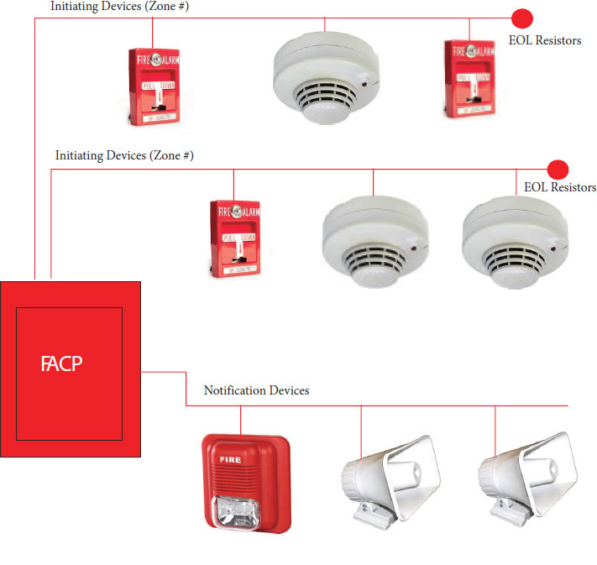
Fire Detection and Alarm Systems
Types of Fire Alarm Systems
Conventional
Simplest type of protected premises alarm system
Initiating device sends a signal to the FACP
All the alarm-signaling devices operate simultaneously until the FACP is reset
The FACP is incapable of identifying which initiating device triggered the alarm; building and fire department personnel must walk around the entire facility and visually check to see which device was activated.
Practical for small occupancies with a limited number of rooms and initiating devices
CMGT235 Mechanical and Electrical Systems
Notes:
Another everyday form of building energy use is the provision of hot water.
Water-heating energy efficiency depends upon water-heating equipment, delivery, and operational controls.
Energy codes provide criteria for such issues as insulating circulating hot water systems, service water heating equipment performance efficiencies in commercial applications, heat traps, controls and pool heaters.

Slide 18
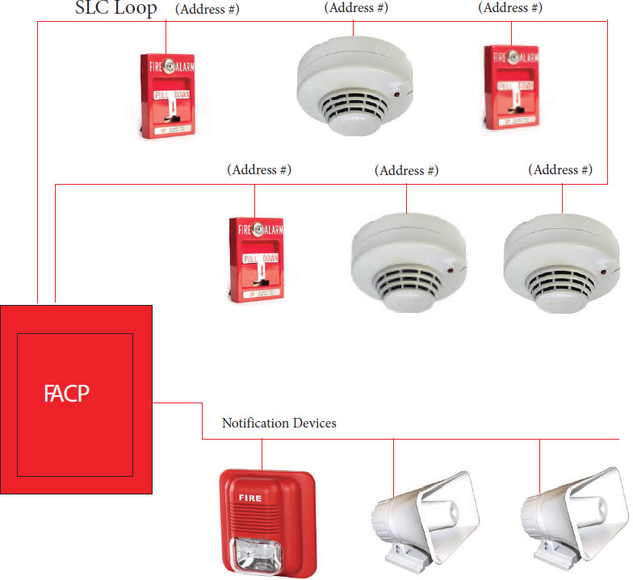
Fire Detection and Alarm Systems
Addressable Alarm Systems
Each component has individual unique identifiers
Displays the location of each initiating device on the FACP and on fire alarm annunciator panel (FAAP)
Exact location of the specific device that has been activated is identified on the FACP and FAAP
Large facilities utilize these systems because they can quickly pinpoint where the trouble signal originated
CMGT235 Mechanical and Electrical Systems
Notes:
Another everyday form of building energy use is the provision of hot water.
Water-heating energy efficiency depends upon water-heating equipment, delivery, and operational controls.
Energy codes provide criteria for such issues as insulating circulating hot water systems, service water heating equipment performance efficiencies in commercial applications, heat traps, controls and pool heaters.

Slide 19
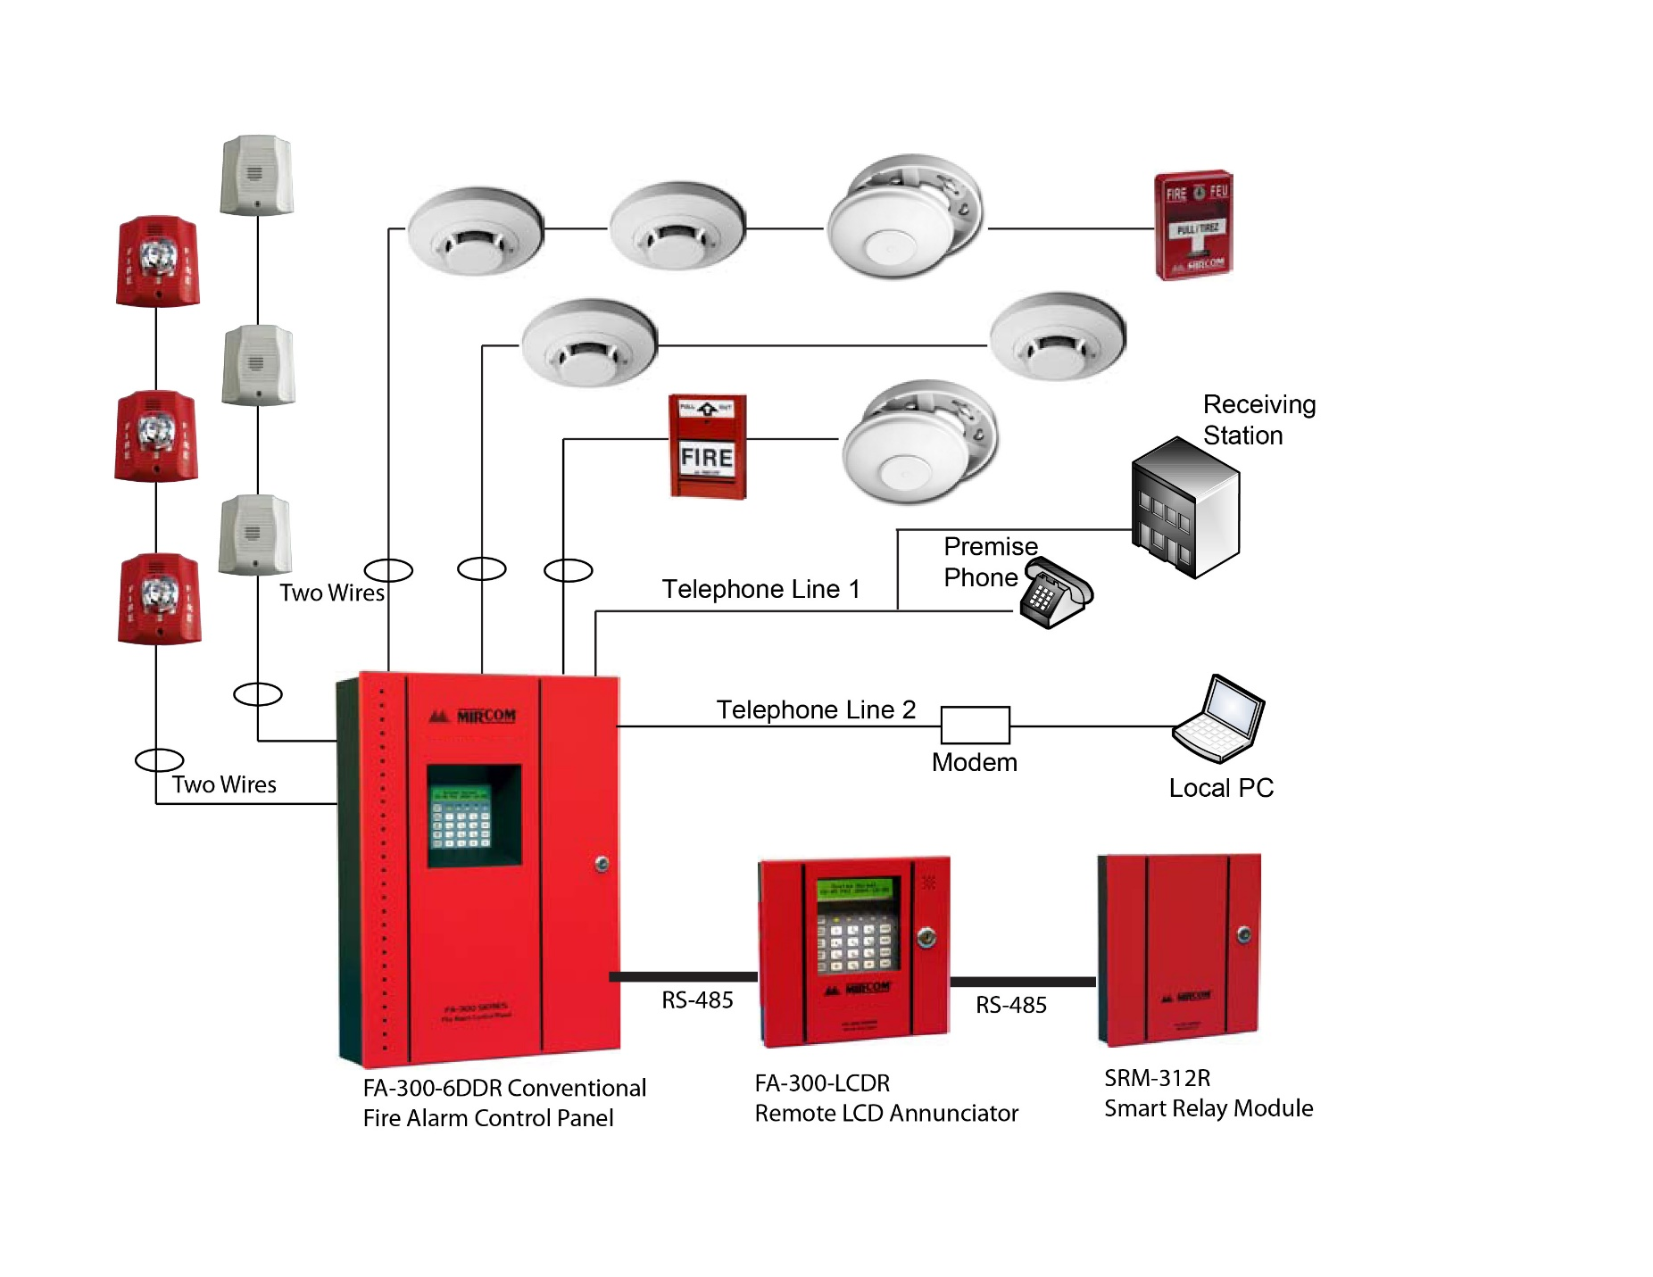
Fire Detection and Alarm Systems
CMGT235 Mechanical and Electrical Systems
Notes:
Another everyday form of building energy use is the provision of hot water.
Water-heating energy efficiency depends upon water-heating equipment, delivery, and operational controls.
Energy codes provide criteria for such issues as insulating circulating hot water systems, service water heating equipment performance efficiencies in commercial applications, heat traps, controls and pool heaters.

Slide 20
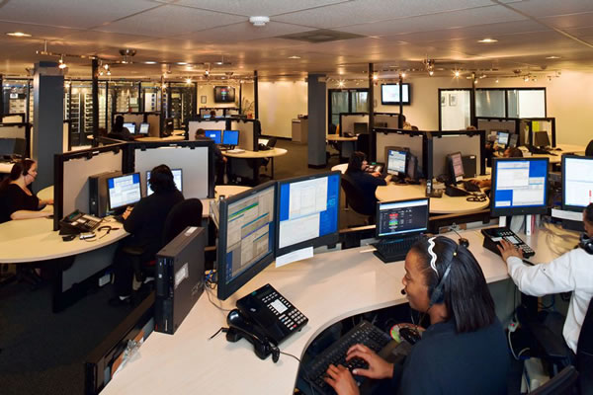
Fire Detection and Alarm Systems
Supervising Station Alarm Systems
Fire alarm systems are required by model fire codes to be monitored at a constantly attended location. For buildings that are not constantly attended by qualified personnel, initiating device signals are required to be transmitted to a supervising station. A supervising station is a facility that receives signals from a protected premises fire alarm system and where the signal is processed by personnel.
CMGT235 Mechanical and Electrical Systems
Notes:
Another everyday form of building energy use is the provision of hot water.
Water-heating energy efficiency depends upon water-heating equipment, delivery, and operational controls.
Energy codes provide criteria for such issues as insulating circulating hot water systems, service water heating equipment performance efficiencies in commercial applications, heat traps, controls and pool heaters.

Slide 21
Fire Detection and Alarm Systems
NFPA® 72 designates supervising stations as:
Central — A central supervising station is an independent business that is also listed by a nationally recognized testing laboratory. A central station is recognized as the most reliable type of supervising station.
Proprietary — A proprietary supervising station is a supervising station under the same ownership as the buildings protected by the fire alarm systems. At a proprietary supervising station, personnel are constantly in attendance to supervise and investigate fire alarm system signals.
Remote — A remote supervising station is not listed and operates as a business. Personnel are in attendance at all times to supervise and investigate signals.
CMGT235 Mechanical and Electrical Systems
Notes:
Another everyday form of building energy use is the provision of hot water.
Water-heating energy efficiency depends upon water-heating equipment, delivery, and operational controls.
Energy codes provide criteria for such issues as insulating circulating hot water systems, service water heating equipment performance efficiencies in commercial applications, heat traps, controls and pool heaters.

Slide 22
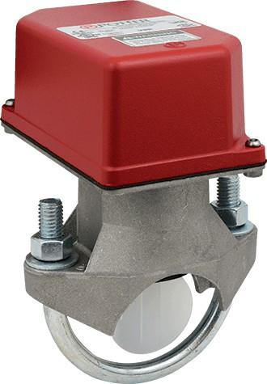
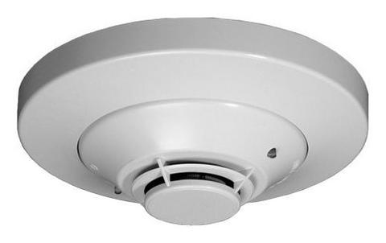
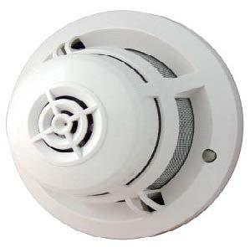
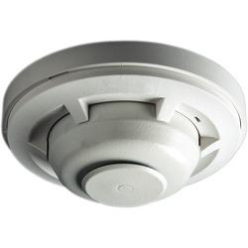
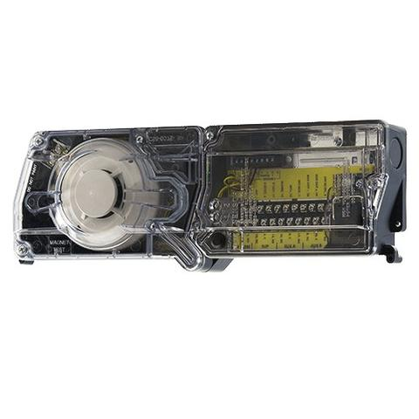
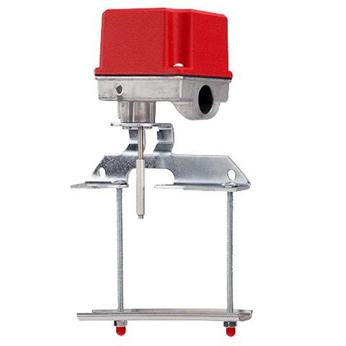
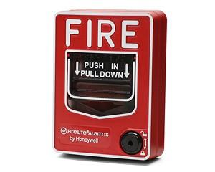
Fire Detection and Alarm Systems
Alarm Initiating Devices
CMGT235 Mechanical and Electrical Systems
Notes:
Another everyday form of building energy use is the provision of hot water.
Water-heating energy efficiency depends upon water-heating equipment, delivery, and operational controls.
Energy codes provide criteria for such issues as insulating circulating hot water systems, service water heating equipment performance efficiencies in commercial applications, heat traps, controls and pool heaters.

Slide 23
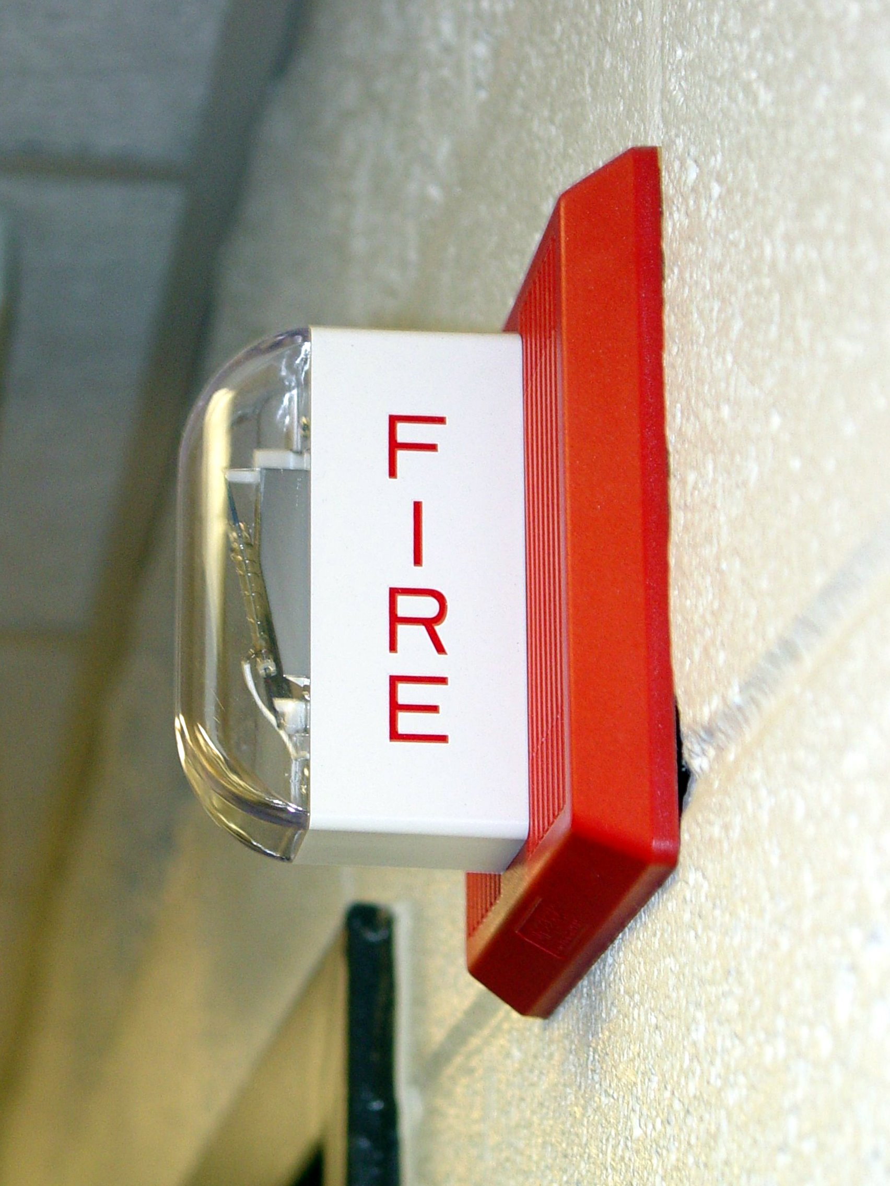
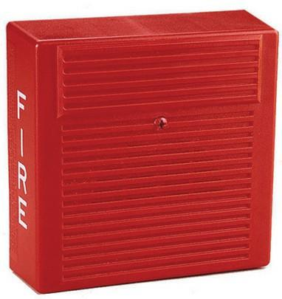
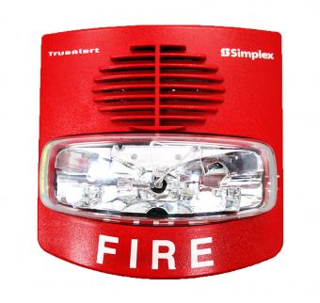
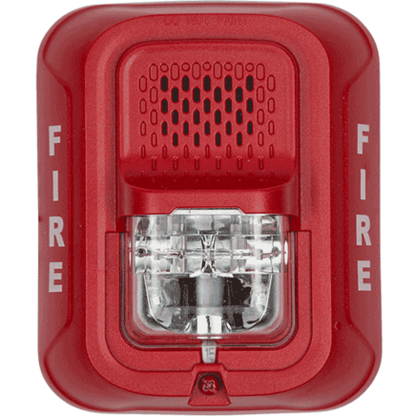
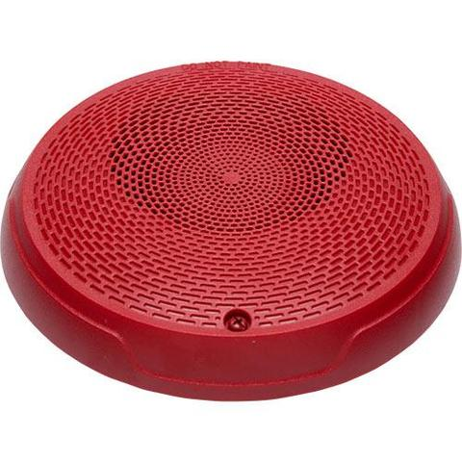
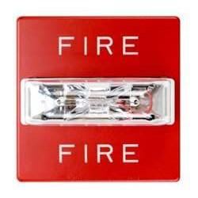
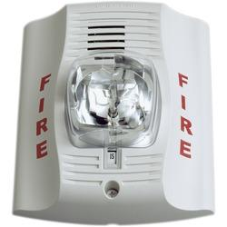
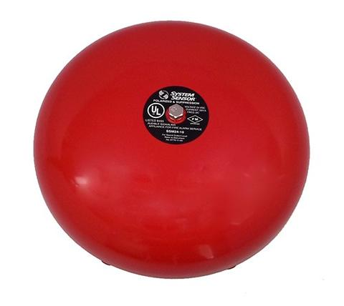
Fire Detection and Alarm Systems
Alarm Signaling Devices
CMGT235 Mechanical and Electrical Systems
Notes:
Another everyday form of building energy use is the provision of hot water.
Water-heating energy efficiency depends upon water-heating equipment, delivery, and operational controls.
Energy codes provide criteria for such issues as insulating circulating hot water systems, service water heating equipment performance efficiencies in commercial applications, heat traps, controls and pool heaters.

Slide 24
Fire Detection and Alarm Systems
Fire Alarm System Wiring
Initiating Device Circuits (IDCs)
Notification Appliance Circuits (NACs)
Signaling Line Circuit (SLC)
Addressable Systems
Addressable systems use a Signaling Line Circuit (SLC) to communicate with detectors and modules. SLCs are a huge benefit because the fire panel can be expanded to perform more remote relay functions, dry contact monitoring, remote power control, releasing service and conventional zone monitoring.
SLCs provide 2-way communication between a device and the panel via a SLC circuit. The panel and a device "talk" to each other every 4–5 seconds, referred to as "polling."
CMGT235 Mechanical and Electrical Systems
Notes:
Another everyday form of building energy use is the provision of hot water.
Water-heating energy efficiency depends upon water-heating equipment, delivery, and operational controls.
Energy codes provide criteria for such issues as insulating circulating hot water systems, service water heating equipment performance efficiencies in commercial applications, heat traps, controls and pool heaters.

Slide 25
Fire Detection and Alarm Systems
Circuit Types Overview
Addressable system panels can be wired as either Class A or Class B. The circuit type determines how a break in the loop affects the system's operation.
Class B Wiring
Most fire alarm system installations use Class B circuits. They provide the minimum level of protection that most facilities require. Class B circuits are characterized by the following features:
The circuit does not include a redundant path.
A single open on the circuit will render the devices located behind the location of the open circuit inoperable.
Any condition that affects the operation of the circuit will be annunciated as a trouble signal at the fire alarm control panel.
A single ground fault will not render the circuit inoperable. The presence of a single ground fault will be annunciated at the fire alarm control panel.
CMGT235 Mechanical and Electrical Systems
Notes:
Another everyday form of building energy use is the provision of hot water.
Water-heating energy efficiency depends upon water-heating equipment, delivery, and operational controls.
Energy codes provide criteria for such issues as insulating circulating hot water systems, service water heating equipment performance efficiencies in commercial applications, heat traps, controls and pool heaters.

Slide 26
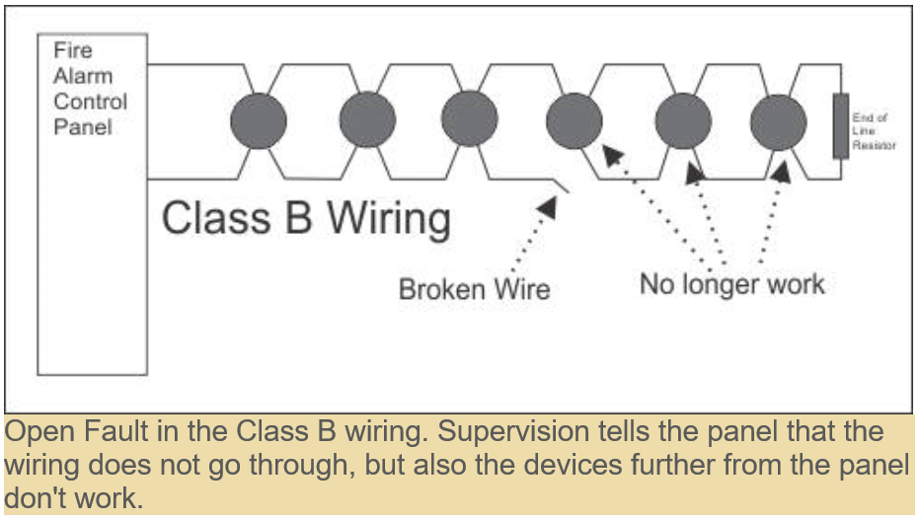
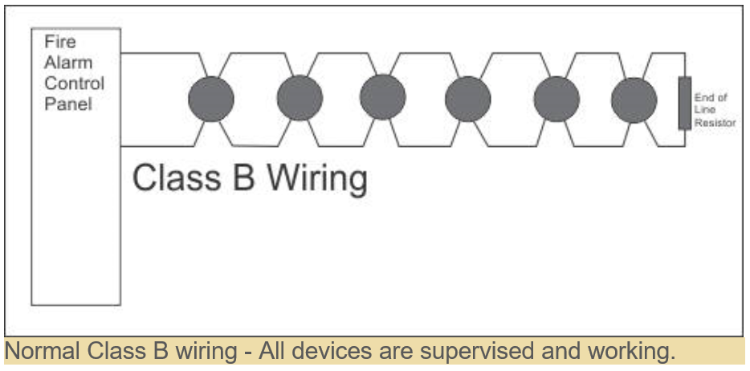
Fire Detection and Alarm Systems
Class B Wiring
CMGT235 Mechanical and Electrical Systems
Notes:
Another everyday form of building energy use is the provision of hot water.
Water-heating energy efficiency depends upon water-heating equipment, delivery, and operational controls.
Energy codes provide criteria for such issues as insulating circulating hot water systems, service water heating equipment performance efficiencies in commercial applications, heat traps, controls and pool heaters.

Slide 27
Fire Detection and Alarm Systems
Class A Wiring
Class A circuits are used on certain types of installations (i.e., government, schools, hospitals, etc.), and when insurance authorities require it at a facility. Class A circuits can provide a higher level of system survivability.
Class A circuits are characterized by the following features:
The circuit includes a redundant path.
The circuit will remain operable when there is a single open. The open will annunciate the fire alarm control panel as a trouble condition.
Any condition that affects the operation of the circuit will be annunciated as a trouble signal at the fire alarm control panel.
A single ground fault will not render the circuit inoperable. The presence of a single ground fault will be annunciated at the fire alarm control panel.
CMGT235 Mechanical and Electrical Systems
Notes:
Another everyday form of building energy use is the provision of hot water.
Water-heating energy efficiency depends upon water-heating equipment, delivery, and operational controls.
Energy codes provide criteria for such issues as insulating circulating hot water systems, service water heating equipment performance efficiencies in commercial applications, heat traps, controls and pool heaters.

Slide 28
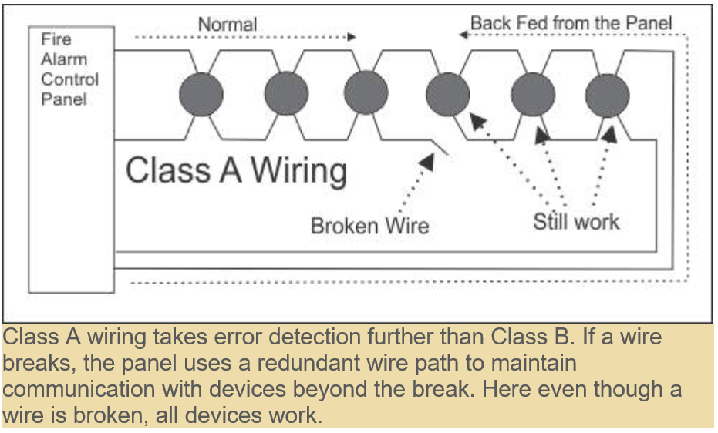
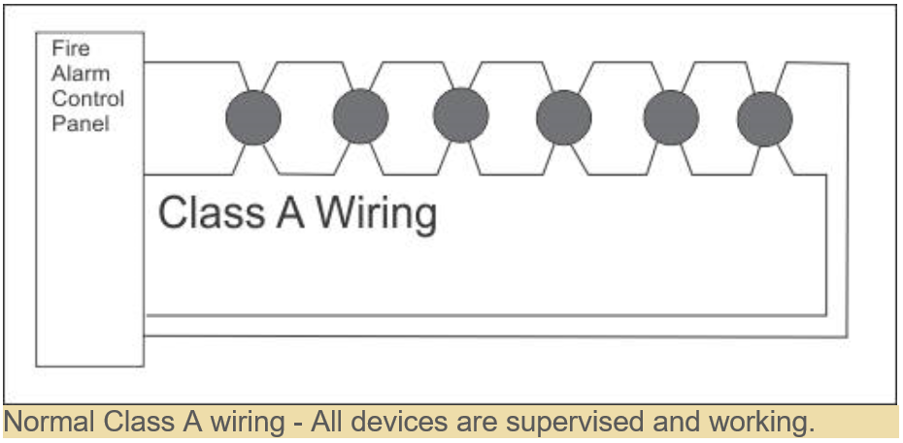
Fire Detection and Alarm Systems
Class A Wiring
CMGT235 Mechanical and Electrical Systems
Notes:
Another everyday form of building energy use is the provision of hot water.
Water-heating energy efficiency depends upon water-heating equipment, delivery, and operational controls.
Energy codes provide criteria for such issues as insulating circulating hot water systems, service water heating equipment performance efficiencies in commercial applications, heat traps, controls and pool heaters.

Slide 29
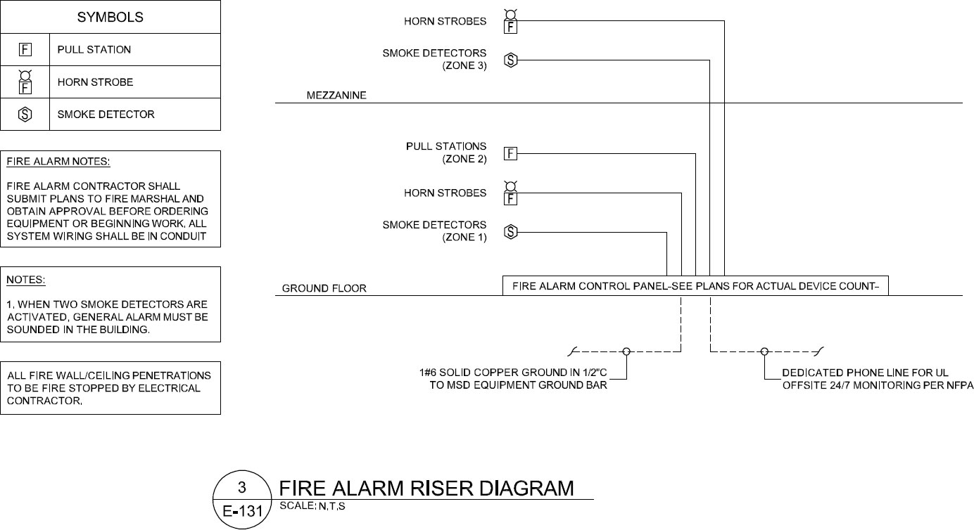
Fire Detection and Alarm Systems
CMGT235 Mechanical and Electrical Systems
Notes:
Another everyday form of building energy use is the provision of hot water.
Water-heating energy efficiency depends upon water-heating equipment, delivery, and operational controls.
Energy codes provide criteria for such issues as insulating circulating hot water systems, service water heating equipment performance efficiencies in commercial applications, heat traps, controls and pool heaters.

Slide 30
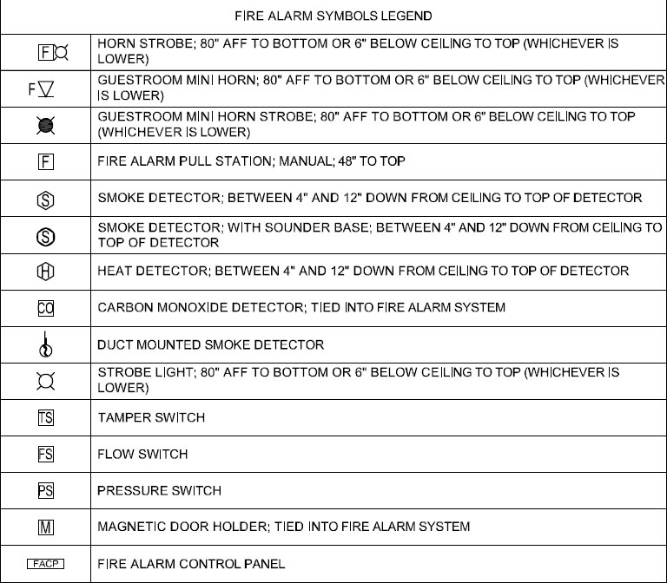
Fire Detection and Alarm Systems
CMGT235 Mechanical and Electrical Systems
Notes:
Another everyday form of building energy use is the provision of hot water.
Water-heating energy efficiency depends upon water-heating equipment, delivery, and operational controls.
Energy codes provide criteria for such issues as insulating circulating hot water systems, service water heating equipment performance efficiencies in commercial applications, heat traps, controls and pool heaters.

Slide 31
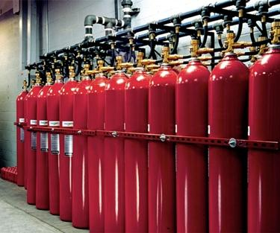
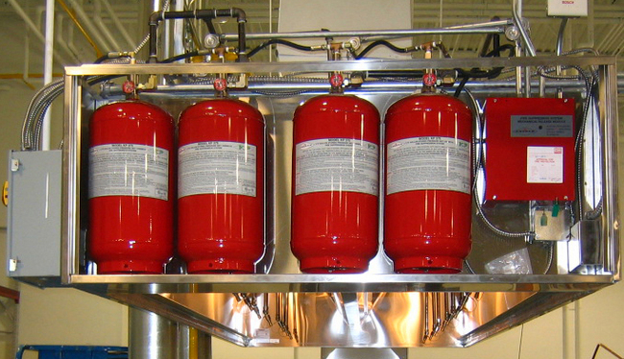
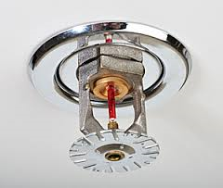
Fire Detection and Alarm Systems
Fire Suppression Systems
A fire suppression system is any product designed to stop a fire from spreading. It gets the name suppression system as it aims to hold back the fire and the damage it may cause. Preventing the fire from spreading mitigates losses and allows time for emergency personnel to respond.
CMGT235 Mechanical and Electrical Systems
Notes:
Another everyday form of building energy use is the provision of hot water.
Water-heating energy efficiency depends upon water-heating equipment, delivery, and operational controls.
Energy codes provide criteria for such issues as insulating circulating hot water systems, service water heating equipment performance efficiencies in commercial applications, heat traps, controls and pool heaters.

Slide 32
Fire Detection and Alarm Systems
Fire Suppression Systems
There are four basic types of automatic sprinkler systems that an alarm system may be connected to:
• Wet Pipe
• Dry Pipe
• Pre-Action
• Deluge
https://www.youtube.com/watch?v=-3JlcgqmKlI
https://www.youtube.com/watch?v=NCtM0kicwqE
CMGT235 Mechanical and Electrical Systems
Notes:
Another everyday form of building energy use is the provision of hot water.
Water-heating energy efficiency depends upon water-heating equipment, delivery, and operational controls.
Energy codes provide criteria for such issues as insulating circulating hot water systems, service water heating equipment performance efficiencies in commercial applications, heat traps, controls and pool heaters.

Slide 33
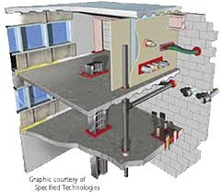
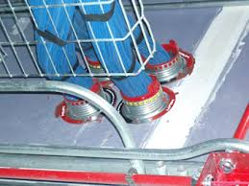
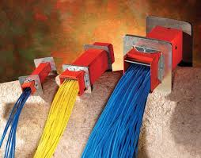
Fire Detection and Alarm Systems
Fire Stop Installations
https://www.youtube.com/watch?v=whK7CCR1uRg
CMGT235 Mechanical and Electrical Systems
Notes:
Another everyday form of building energy use is the provision of hot water.
Water-heating energy efficiency depends upon water-heating equipment, delivery, and operational controls.
Energy codes provide criteria for such issues as insulating circulating hot water systems, service water heating equipment performance efficiencies in commercial applications, heat traps, controls and pool heaters.

Slide 34
Fire Detection and Alarm Systems
Other fire fighting equipment
Fire Safety Signs
PRESS HERE TO SOUND THE FIRE ALARM
FIRE HOSE REEL
CMGT235 Mechanical and Electrical Systems
Notes:
Another everyday form of building energy use is the provision of hot water.
Water-heating energy efficiency depends upon water-heating equipment, delivery, and operational controls.
Energy codes provide criteria for such issues as insulating circulating hot water systems, service water heating equipment performance efficiencies in commercial applications, heat traps, controls and pool heaters.

Slide 35
Fire Detection and Alarm Systems
Safety Signs
Blue/White = Must Do
Green/White = Safety Information
!
Red/White = Must NOT Do
Yellow/Black = Health & Safety Hazard Warning
CMGT235 Mechanical and Electrical Systems
Notes:
Another everyday form of building energy use is the provision of hot water.
Water-heating energy efficiency depends upon water-heating equipment, delivery, and operational controls.
Energy codes provide criteria for such issues as insulating circulating hot water systems, service water heating equipment performance efficiencies in commercial applications, heat traps, controls and pool heaters.

Slide 36
Fire Detection and Alarm Systems
Safety Signs
Any Red and White sign with a line through means:
“ Not Allowed or Must Not”
NO SMOKING
CMGT235 Mechanical and Electrical Systems

Slide 37
Fire Detection and Alarm Systems
Safety Signs
Yellow + Black = HAZARD WARNING
FLAMMABLE SUBSTANCE
WARNING - LASER BEAMS
CMGT235 Mechanical and Electrical Systems

Slide 38



Fire Detection and Alarm Systems
Safety Signs
BEWARE
ELECTRICITY
TOXIC
EXPLOSIVE
CMGT235 Mechanical and Electrical Systems

Slide 39
Fire Detection and Alarm Systems
Safety Signs
Green + White = SAFETY Information
Safe Route to Fire Exit
First Aid Kit
CMGT235 Mechanical and Electrical Systems

Slide 40

Fire Detection and Alarm Systems
Safety Signs
Blue + White = Mandatory or Must Do
YOU MUST WEAR OVERALLS
YOU MUST WEAR SAFETY GLOVES
YOU MUST WEAR EAR DEFENDERS
CMGT235 Mechanical and Electrical Systems
40

Slide 41
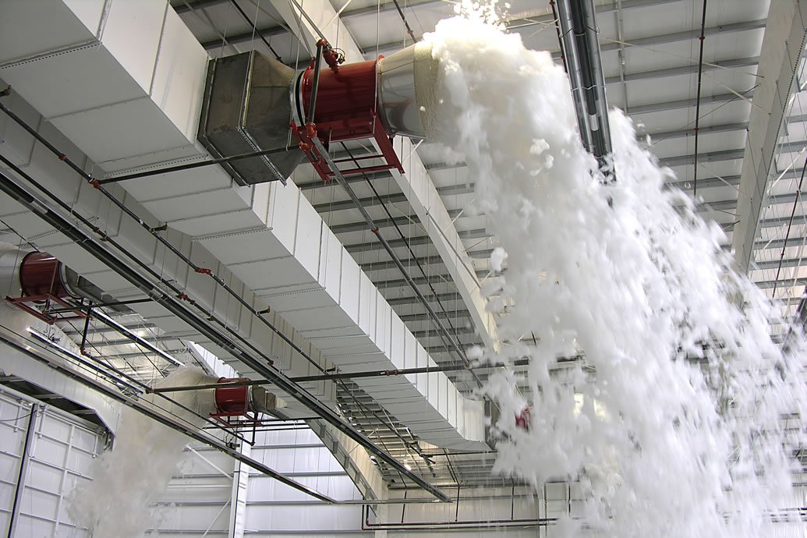

Fire Detection and Alarm Systems
CMGT235 Mechanical and Electrical Systems
Notes:
Another everyday form of building energy use is the provision of hot water.
Water-heating energy efficiency depends upon water-heating equipment, delivery, and operational controls.
Energy codes provide criteria for such issues as insulating circulating hot water systems, service water heating equipment performance efficiencies in commercial applications, heat traps, controls and pool heaters.

