Slide 1
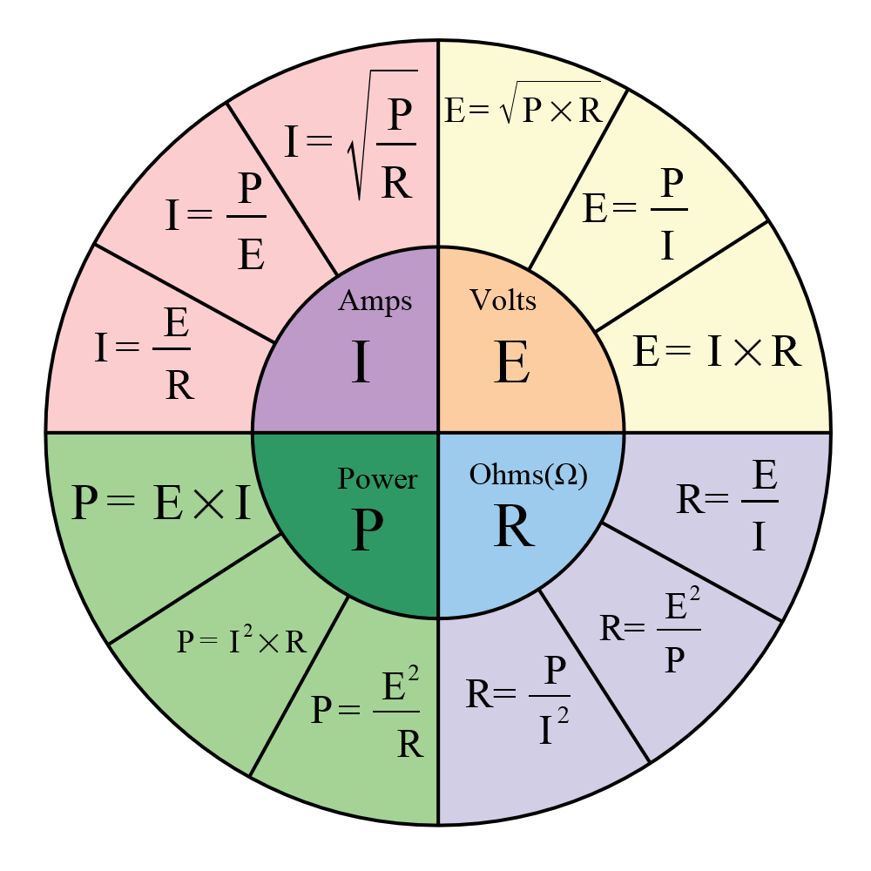
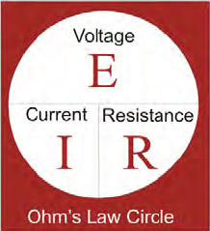
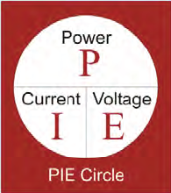
Electrical Fundamentals
Electrical Quantities
Quantity | Symbol | Unit of Measure | Unit Abbreviation
Current
Voltage
Resistance
Power
Ohm’s Law
Definition of an Ohm
An ohm is a unit of electrical resistance seen between two points across a resistor, conductor, device or circuit. One ohm means that a potential difference (voltage) of 1V between these two points produces a current of 1A.
Electric Power
Electric power is the rate, per unit time, at which electrical energy is transferred by an electric circuit. The SI unit of power is the watt, one joule per second.
Watt’s Law

Slide 2
Electrical Fundamentals
Electrical Quantities
Quantity | Symbol | Unit of Measure | Unit Abbreviation
Current | I | Amp | A
Voltage
Resistance
Power
Ohm’s Law
Definition of an Ohm
An ohm is a unit of electrical resistance seen between two points across a resistor, conductor, device or circuit. One ohm means that a potential difference (voltage) of 1V between these two points produces a current of 1A.
Electric Power
Electric power is the rate, per unit time, at which electrical energy is transferred by an electric circuit. The SI unit of power is the watt, one joule per second.
Watt’s Law

Slide 3
Electrical Fundamentals
Electrical Quantities
Quantity | Symbol | Unit of Measure | Unit Abbreviation
Current | I | Amp | A
Voltage | V or E | Volt | V
Resistance
Power
Ohm’s Law
Definition of an Ohm
An ohm is a unit of electrical resistance seen between two points across a resistor, conductor, device or circuit. One ohm means that a potential difference (voltage) of 1V between these two points produces a current of 1A.
Electric Power
Electric power is the rate, per unit time, at which electrical energy is transferred by an electric circuit. The SI unit of power is the watt, one joule per second.
Watt’s Law

Slide 4
Electrical Fundamentals
Electrical Quantities
Quantity | Symbol | Unit of Measure | Unit Abbreviation
Current | I | Amp | A
Voltage | V or E | Volt | V
Resistance | R | Ohm | Ω
Power
Ohm’s Law
Definition of an Ohm
An ohm is a unit of electrical resistance seen between two points across a resistor, conductor, device or circuit. One ohm means that a potential difference (voltage) of 1V between these two points produces a current of 1A.
Electric Power
Electric power is the rate, per unit time, at which electrical energy is transferred by an electric circuit. The SI unit of power is the watt, one joule per second.
Watt’s Law

Slide 5
Electrical Fundamentals
Electrical Quantities
Quantity | Symbol | Unit of Measure | Unit Abbreviation
Current | I | Amp | A
Voltage | V or E | Volt | V
Resistance | R | Ohm | Ω
Power | P | Watt | W or kW
Ohm’s Law
Definition of an Ohm
An ohm is a unit of electrical resistance seen between two points across a resistor, conductor, device or circuit. One ohm means that a potential difference (voltage) of 1V between these two points produces a current of 1A.
Electric Power
Electric power is the rate, per unit time, at which electrical energy is transferred by an electric circuit. The SI unit of power is the watt, one joule per second.
Watt’s Law

Slide 6
Electrical Fundamentals
Example 1.
If a single Red LED is connected to a 9V battery and has a voltage drop of 2V and is rated for a 20mA current, how much resistance must be added to the circuit to operate the LED at its specifications?
R

Slide 7
Electrical Fundamentals
Example 1.
If a single Red LED is connected to a 9V battery and has a voltage drop of 2V and is rated for a 20mA current, how much resistance must be added to the circuit to operate the LED at its specifications?
R
+
I = 20 mA
E_{R}
-
E_{s}
+
E_{LED} = 2V
-

Slide 8
Electrical Fundamentals
Example 1.
If a single Red LED is connected to a 9V battery and has a voltage drop of 2V and is rated for a 20mA current, how much resistance must be added to the circuit to operate the LED at its specifications?
From Kirchoff’s Voltage Law [ΣV_{Loop} = 0]
E_{S} - E_{R} – E_{LED} = 0
E_{R} = 9V – 2V = 7V
R = E/I = 7V/20mA = 350 Ω
m = milli = 10⁻³
20mA = 0.02A
R
+
I = 20 mA
E_{R}
-
E_{s}
+
E_{LED} = 2V
-

Slide 9
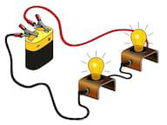
Electrical Fundamentals
Example 2.
For the circuit shown each bulb is 75W and the source voltage is 120V.
What type of circuit is this? __________________________
Sketch the circuit diagram.
Determine the total current and the voltage drop across each lamp.
Determine the Resistance of each of each lamp and the total Resistance.

Slide 10
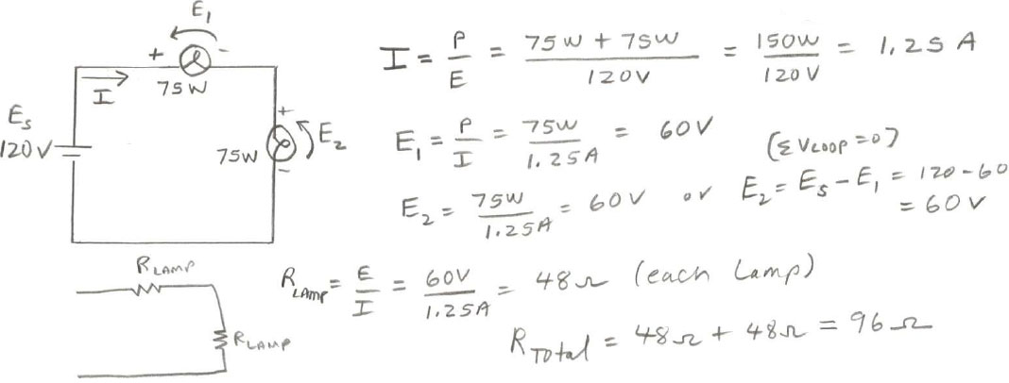
Electrical Fundamentals
Example 2.
For the circuit shown each bulb is 75W and the source voltage is 120V.
What type of circuit is this? __________________________
Sketch the circuit diagram.
Determine the total current and the voltage drop across each lamp.
Determine the Resistance of each of each lamp and the total Resistance.
Series Circuit

Slide 11
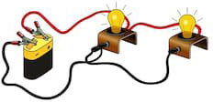
Electrical Fundamentals
Example 2.
For the circuit shown each bulb is 75W and the source voltage is 120V.
What type of circuit is this? __________________________
Sketch the circuit diagram.
Determine the current in each lamp and the total current.
Determine the Resistance of each of each lamp and the total Resistance.

Slide 12
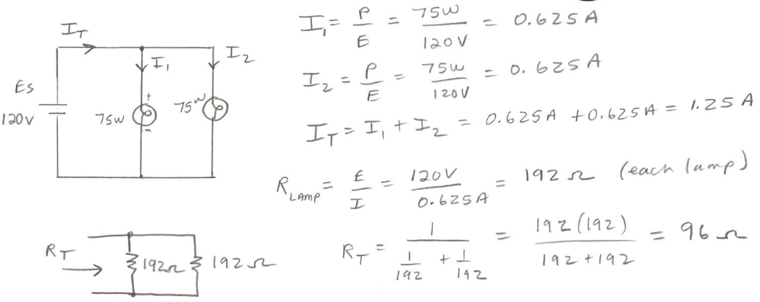
Electrical Fundamentals
Example 2.
For the circuit shown each bulb is 75W and the source voltage is 120V.
What type of circuit is this? __________________________
Sketch the circuit diagram.
Determine the current in each lamp and the total current.
Determine the Resistance of each of each lamp and the total Resistance.
Parallel Circuit

Slide 13
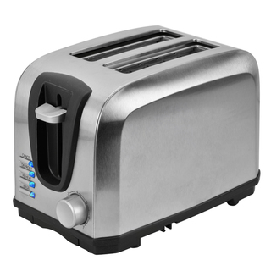

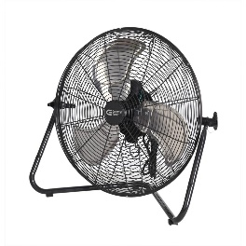

Electrical Fundamentals
Electric Power
The elements in a toaster changes electrical energy into _______________ energy.
An electric mixer changes electrical energy into ___________________ energy.
An electric fan transforms electrical energy into _______________ energy.
Heat
Mechanical
Kinetic
Can you think of another form of energy electricity is commonly changed into?
Light

Slide 14
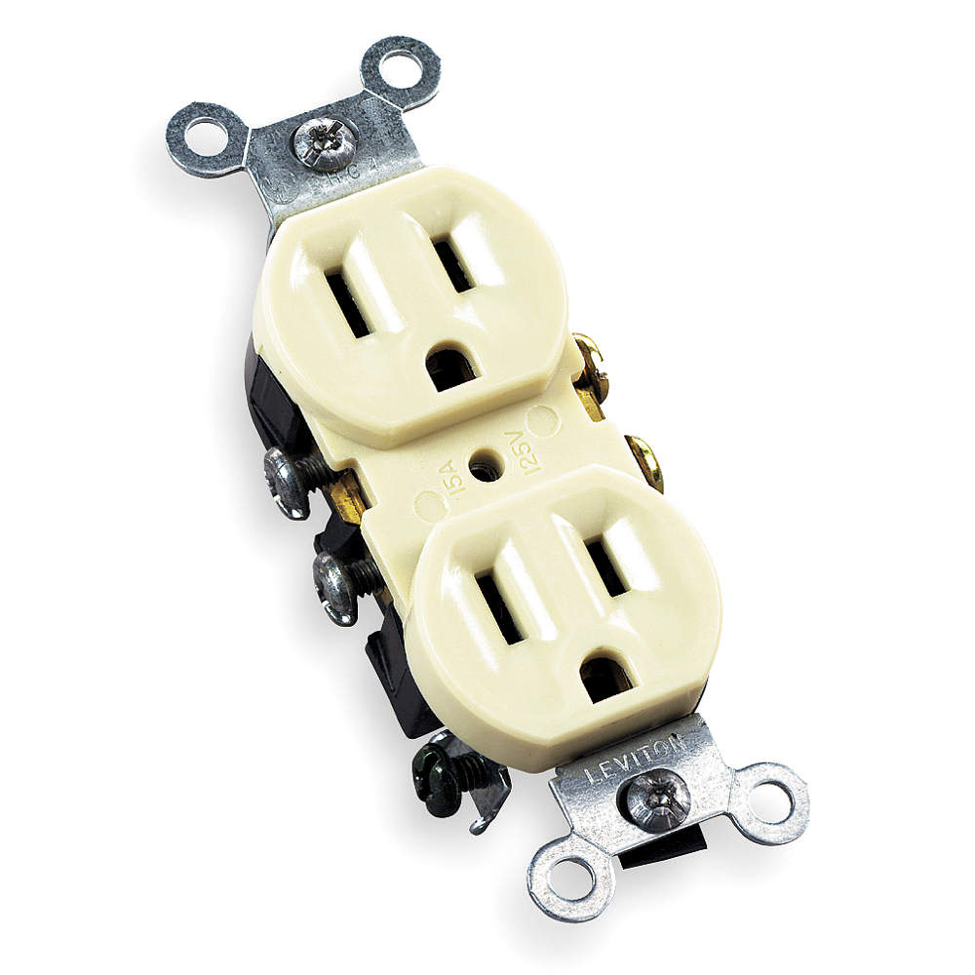
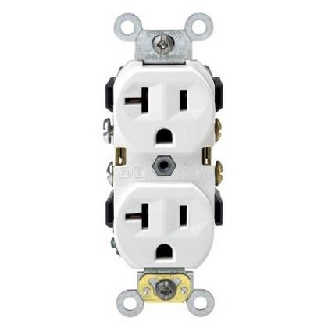
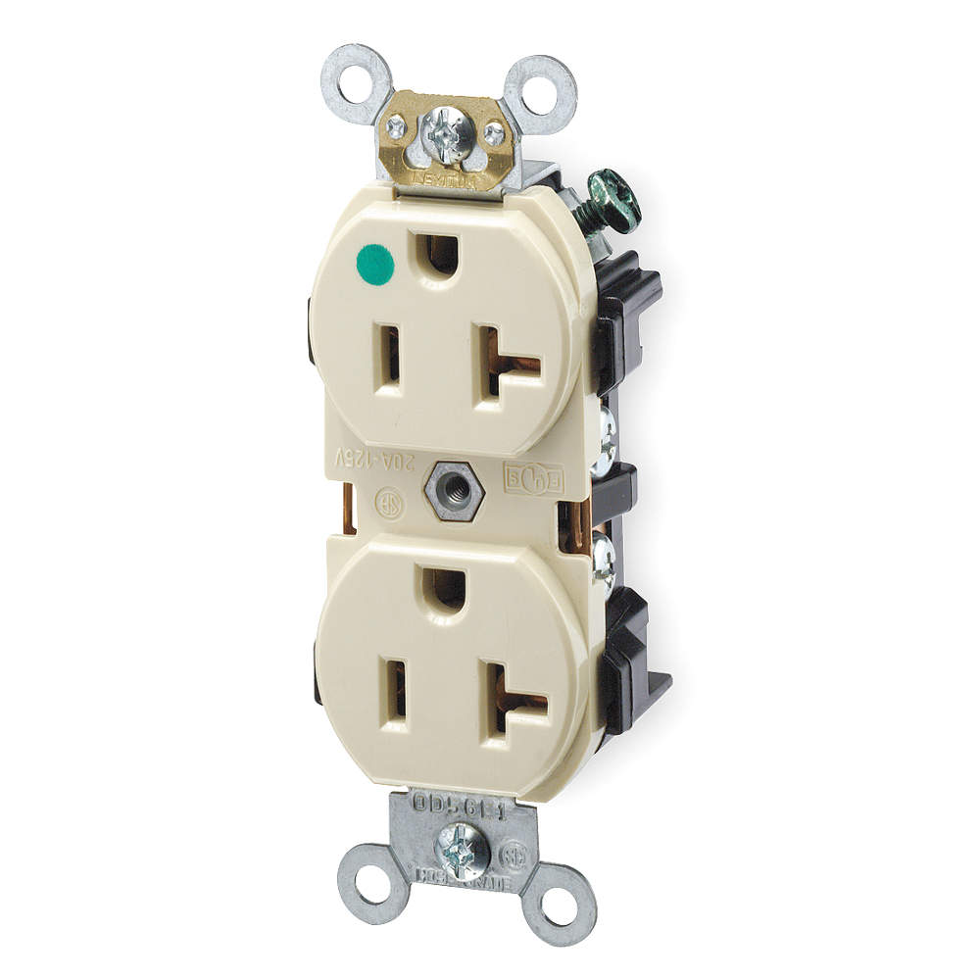
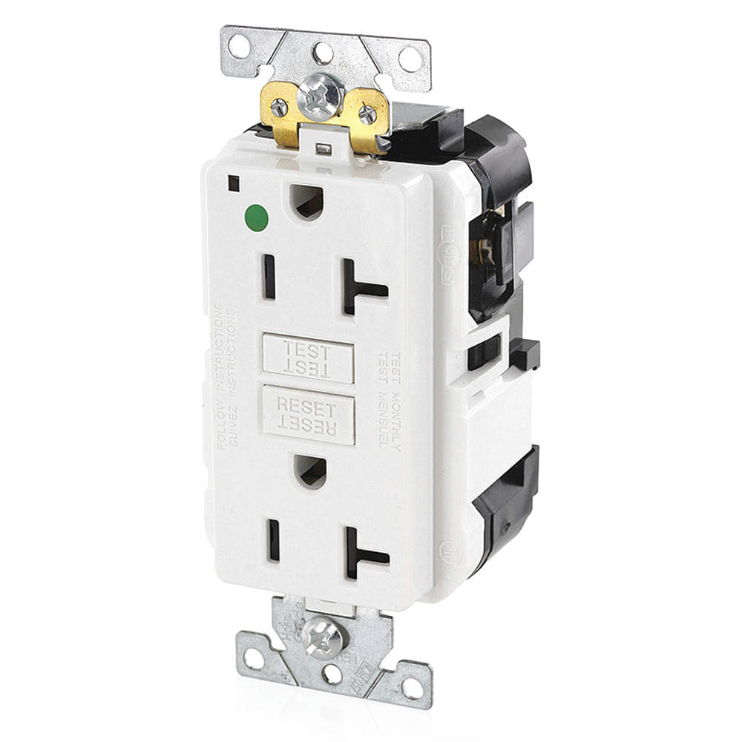
Electrical Fundamentals
Convenience Receptacles
15A, 125V
Residential
20A, 125V
Commercial
20A, 125V
Hospital
20A, 125V
GFCI
NEMA 5-20R

Slide 15

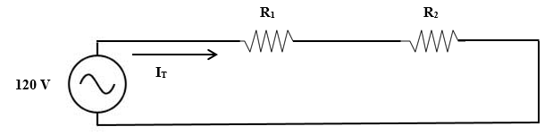
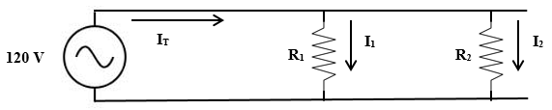

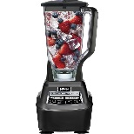
Electrical Fundamentals
How are Receptacles Wired?
1230 W
11.5 A
Series Circuit ?
Parallel Circuit ?
1230 W
11.5 A

Slide 16

Electrical Fundamentals
How are Receptacles Wired?
1230 W
11.5 A
Series Circuit ?
Parallel Circuit ?
1230 W
11.5 A

Slide 17
Electrical Fundamentals
How are Receptacles Wired?
1230 W
11.5 A
Series Circuit ?
Parallel Circuit ?
1230 W
11.5 A
What is the current in the toaster? I₁ = P₁ / E₁ = 1230 W / 120 V = 10.25 A
What is the power of the blender? P = I x E = 11.5A x 120V = 1380 W

Slide 18

Electrical Fundamentals
What is a UL Approved Label?
Many products must be permanently marked or labeled with specific safety-related information such as hazards, warnings, cautions, installation instructions and electrical ratings.
Where are UL Labels Typically Found?
UL labels are typically used in electronic applications, including household appliances and other consumer goods. Other industries that use UL labels include medical, industrial, and outdoor applications. Labels are often referred to as a nameplate.

Slide 19
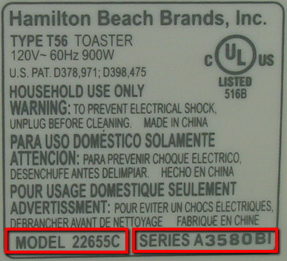
Electrical Fundamentals
How Much Current?

Slide 20
Electrical Fundamentals
How Much Current?
I = P / E = 900 W / 120 V = 7.5 A

Slide 21

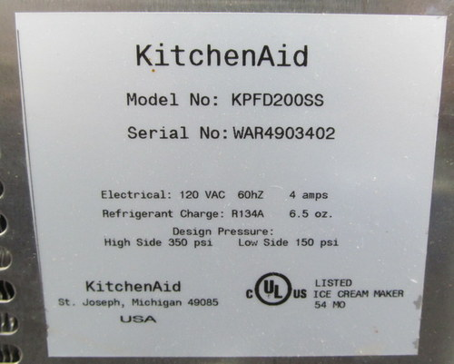
Electrical Fundamentals
How Much Power?

Slide 22
Electrical Fundamentals
How Much Power?
P = I x E = 4 A x 120 V = 480 W
What is the HP of the motor?
HP = 480 W x 0.001341 = 0.64 HP (< 1 HP)

Slide 23
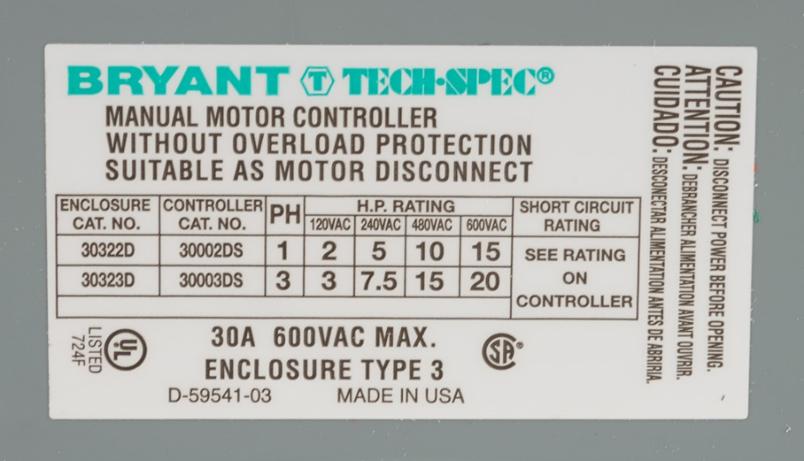
Electrical Fundamentals
UL Nameplate

Slide 24
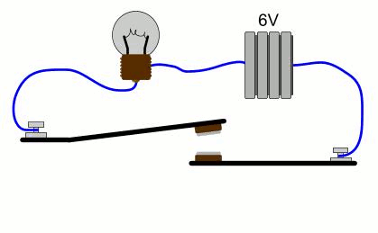
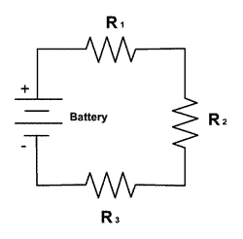

Electrical Fundamentals
Direct Current (DC)
Direct current (DC) is the constant flow of electricity through a conductor in one direction. A dry-cell battery connected to a light bulb is an example of a simple dc circuit.
Four rules apply to DC series circuits:
(1) The total voltage is the sum of the voltages across each load.
(2) The current is the same in all parts of the circuit.
(3) The total resistance is the sum of the individual load resistances.
(4) The total power is the sum of the powers used by the individual loads.
+
E₁
-
+
E_{S}
E₂
+
-
E₃
E_{S} = E₁ + E₂ + E₃
-

Slide 25
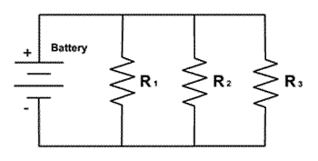

Electrical Fundamentals
The rules for DC parallel circuits are:
(1) The voltage across each load is the same.
(2) The total current is the sum of the currents in each load.
(3) The total resistance is always lower than the smallest load resistance. The formula for calculating total resistance (RT) is:
(4) The total power is the sum of the powers used by the individual loads.
I_{T}
I₁
I₂
I₃
E_{S}
I_{T} = I₁ + I₂ + I₃

Slide 26
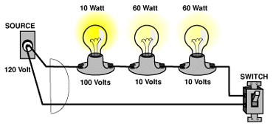
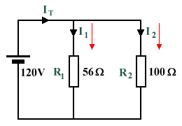
Electrical Fundamentals
Example 3.
For the series circuit shown determine I_{T}, R_{T}, and P_{T}.
For the parallel circuit shown determine R_{T}, I₁, I₂, I_{T} and P_{T}.

Slide 27
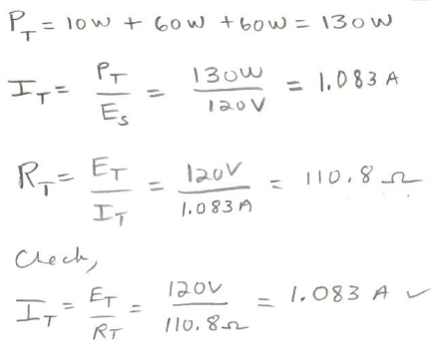
Electrical Fundamentals
Example 3.
For the series circuit shown determine I_{T}, R_{T}, and P_{T}.
For the parallel circuit shown determine R_{T}, I₁, I₂, I_{T} and P_{T}.

Slide 28
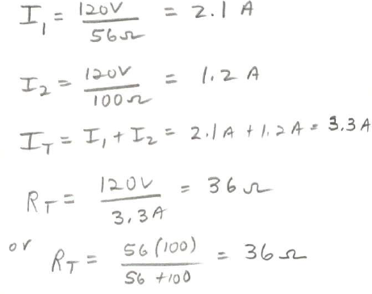
Electrical Fundamentals
Example 3.
For the series circuit shown determine I_{T}, R_{T}, and P_{T}.
For the parallel circuit shown determine R_{T}, I₁, I₂, I_{T} and P_{T}.

Slide 29
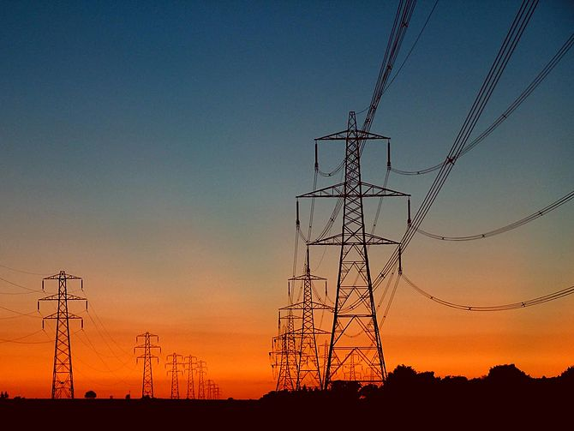
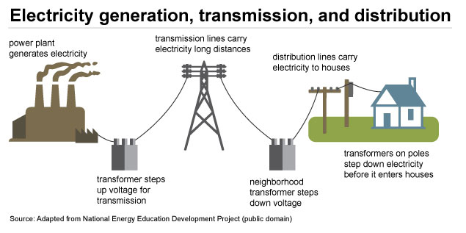
Electrical Fundamentals
Alternating Current (AC)
Alternating current (AC) is the flow of electric charge that periodically reverses direction. If the source varies periodically, particularly sinusoidally, the circuit is known as an alternating current circuit.
Examples include the commercial and residential power supplied by the electric power grid.

Slide 30
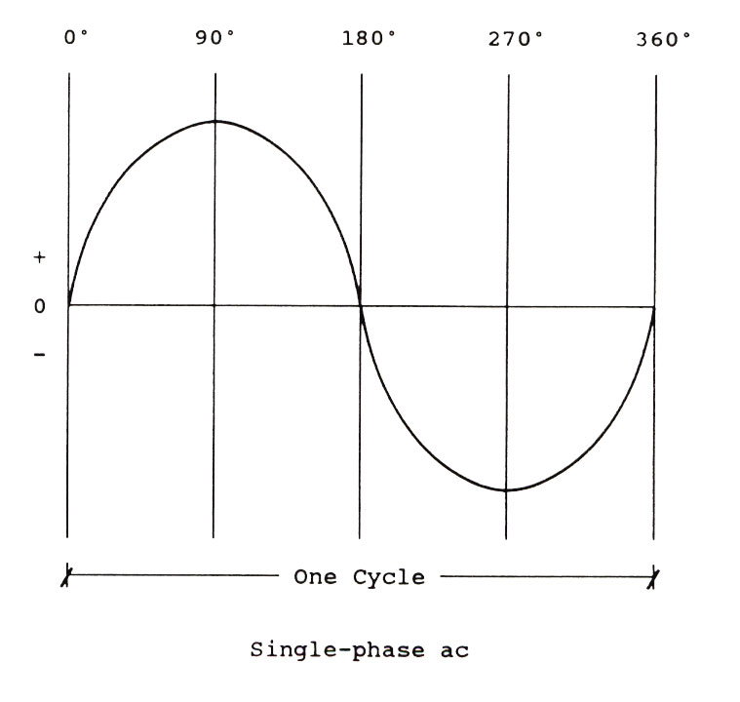
Electrical Fundamentals
Single-Phase AC
Throughout North America, homes are powered by 120-volt single-phase electricity.
At what frequency?
At that frequency, the alternating current sine wave crosses the zero point __________ times each second.
When either voltage or current crosses the zero point, the electrical power being delivered falls to zero. Does that matter to electronic equipment?

Slide 31
Electrical Fundamentals
Single-Phase AC
Throughout North America, homes are powered by 120-volt single-phase electricity.
At what frequency? 60HZ
At that frequency, the alternating current sine wave crosses the zero point __________ times each second.
When either voltage or current crosses the zero point, the electrical power being delivered falls to zero. Does that matter to electronic equipment?
120
Yes. Motors

Slide 32
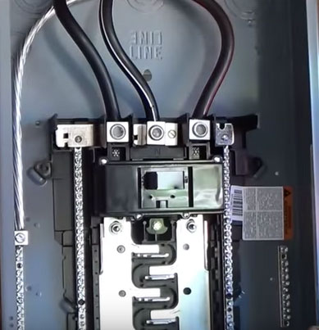
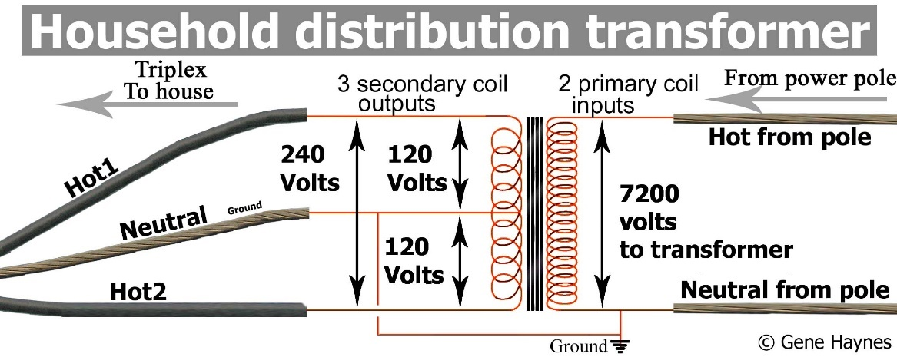
Electrical Fundamentals
Single-Phase AC
A typical residential circuit breaker box reveals four wires coming into our homes main panel: two “hot” wires, a neutral wire and ground.
For the panel shown which conductor is the neutral?
The two "hot" wires carry 240 VAC, which is used for heavy appliances like electric ranges and dryers. The voltage between both hot wire and the neutral wire is 120 VAC, which powers everything else in our homes.

Slide 33
Electrical Fundamentals
Single-Phase AC
A typical residential circuit breaker box reveals four wires coming into our homes main panel: two “hot” wires, a neutral wire and ground.
For the panel shown which conductor is the neutral?
Black w/white stripe
The two "hot" wires carry 240 VAC, which is used for heavy appliances like electric ranges and dryers. The voltage between both hot wire and the neutral wire is 120 VAC, which powers everything else in our homes.

Slide 34
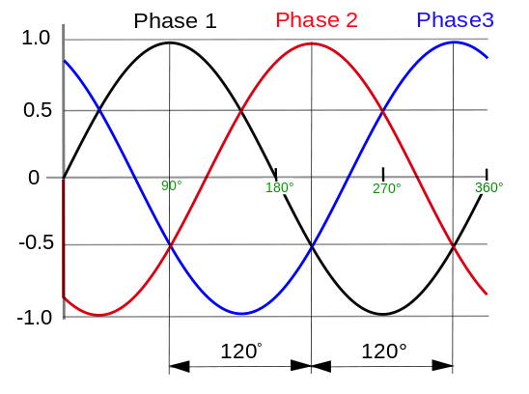
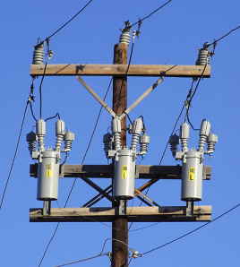
Electrical Fundamentals
Three-Phase AC
Three-phase power consists of three sine waves separated by 120 degrees that overlap.
This form of power is created by an AC generator with three independent windings, each exactly 120 degrees apart. Each current (phase) is carried on a separate conductor.
Due to the phase relationship, neither voltage nor current flow applied to a load ever drops to zero.
This means three-phase power at a given voltage can deliver more power. In fact, about 1.7 times the power of a single-phase supply
Three-phase allows for smaller, less expensive wiring and lower voltages, making it safer and less expensive to run.

Slide 35
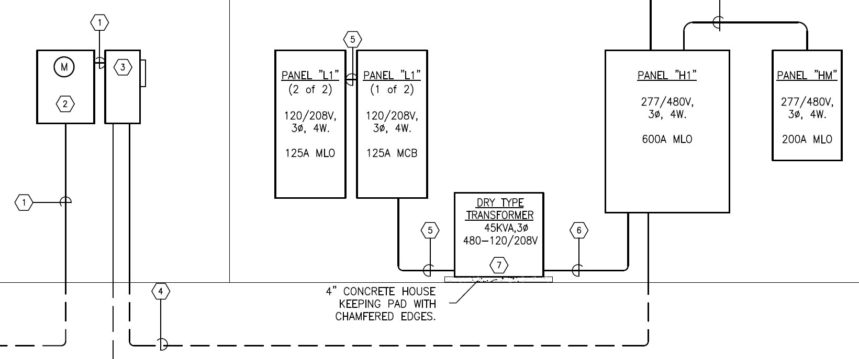
Electrical Fundamentals
Why do Commercial Buildings Use Three-Phase Power?
Used to power large motors and other heavy loads.
Motors perform better running on three-phase power.
It is more efficient for larger loads, less costly to install, and the industry norm for medium to large sized facilities.
Purchasing power at 13.8KV from the local utility is less costly. The owner will provide and maintain their own step-down transformer, which lowers the voltage to a more usable level (in the US, 277/480 volts). This transformer can be mounted on a pad outside the building or in a transformer room inside the building.

Slide 36
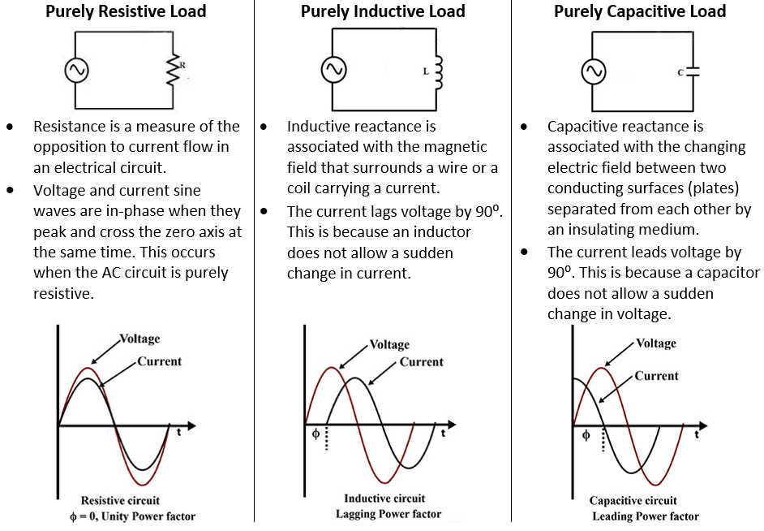
Electrical Fundamentals
Types of Loads

Slide 37
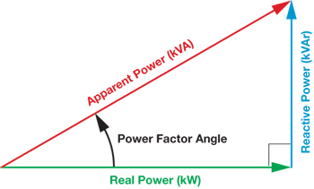
Electrical Fundamentals
Power Factor
Power factor is the ratio of real power (kW) to apparent power (kVA).
This ratio can be a value from 0 to 1, and it indicates how efficiently an AC circuit is using electricity, with a value of 1 representing high efficiency.
In AC circuits, inductive components (capacitors, motors, compressors, etc…) increases the reactive power and increases the difference between real and apparent power.
A greater difference between real and apparent power produces a lower power factor.
Cos θ = PF
kW is Working Power (also called Actual Power or Active Power or Real Power). It is the power that actually powers the equipment and performs useful work.
kVAR is Reactive Power. It is the power that magnetic equipment (transformer, motor, relay etc.) needs to produce the magnetizing flux.
kVA is Apparent Power. It is the “vectoral summation” of KVAR and KW.
Real Power (KW)
PF =
Apparent Power (kVA)
Ɵ

Slide 38
Electrical Fundamentals
Example 4.
The power bill for a commercial building is 600KWh, 216 hours of usage per month and a power factor of 0.75. Calculate the total Real Power (KW), Reactive Power (KVAR), and the Apparent Power (kVA).
Solution.

Slide 39
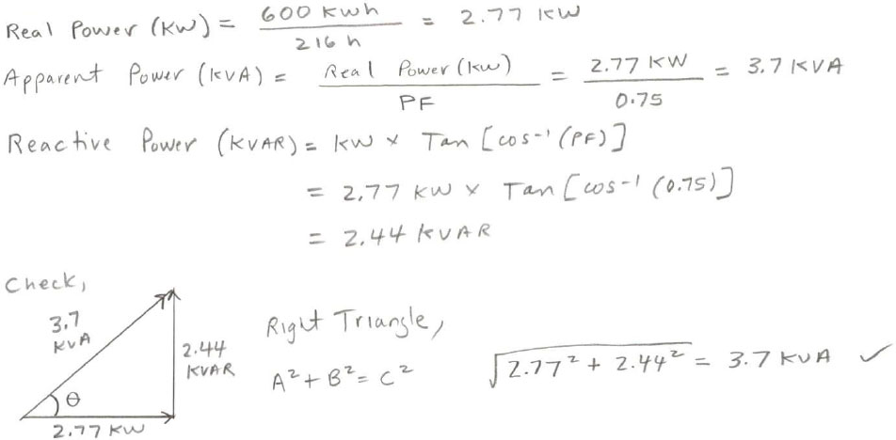
Electrical Fundamentals
Example 4.
The power bill for a commercial building is 600KWh, 216 hours of usage per month and a power factor of 0.75. Calculate the total Real Power (KW), Reactive Power (KVAR), and the Apparent Power (kVA).
Solution.

Slide 40
Electrical Fundamentals
Example 5.
A boring mill was operating at 100 kW and the apparent power consumed was 125 kVA, what is the power factor? Sketch the power triangle.
Solution.
Sketch the power triangles for a PF = 70% and PF = 95%

Slide 41
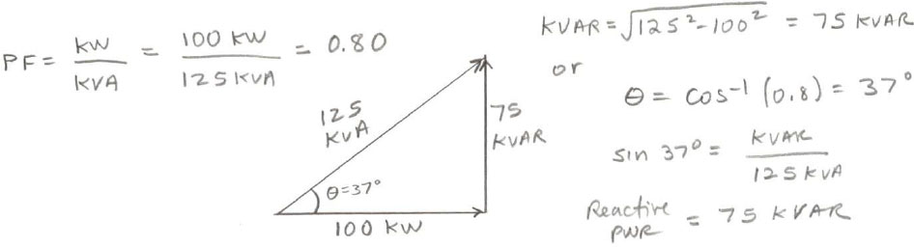
Electrical Fundamentals
Example 5.
A boring mill was operating at 100 kW and the apparent power consumed was 125 kVA, what is the power factor? Sketch the power triangle.
Solution.
Sketch the power triangles for a PF = 70% and PF = 95%

Slide 42
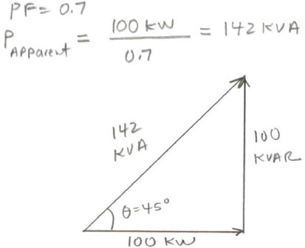
Electrical Fundamentals
Example 5.
A boring mill was operating at 100 kW and the apparent power consumed was 125 kVA, what is the power factor? Sketch the power triangle.
Solution.
Sketch the power triangles for a PF = 70% and PF = 95%

Slide 43
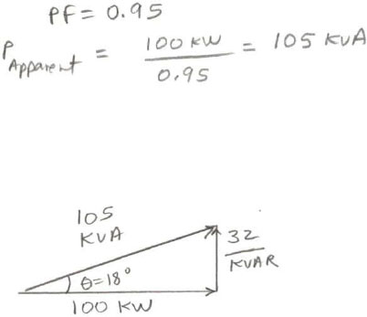
Electrical Fundamentals
Example 5.
A boring mill was operating at 100 kW and the apparent power consumed was 125 kVA, what is the power factor? Sketch the power triangle.
Solution.
Sketch the power triangles for a PF = 70% and PF = 95%

Slide 44
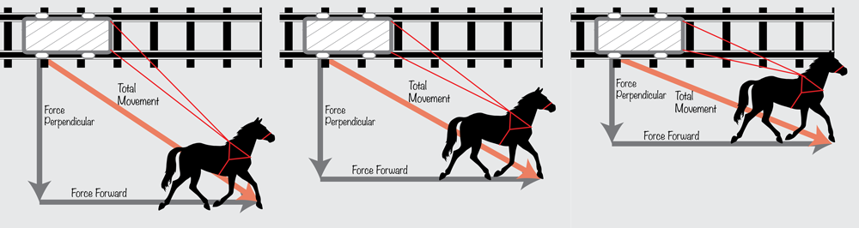
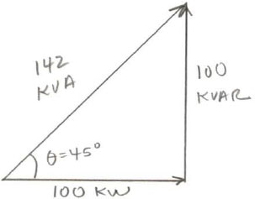
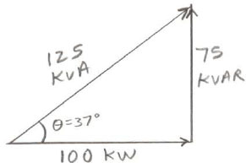
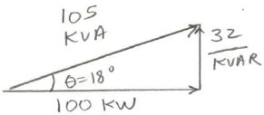
Electrical Fundamentals

Slide 45
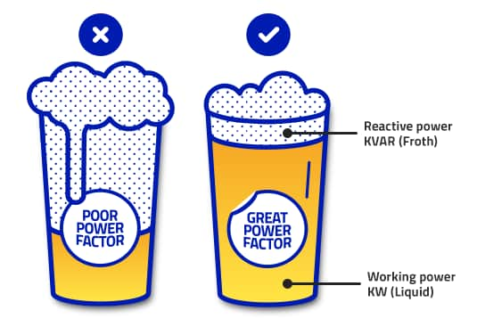
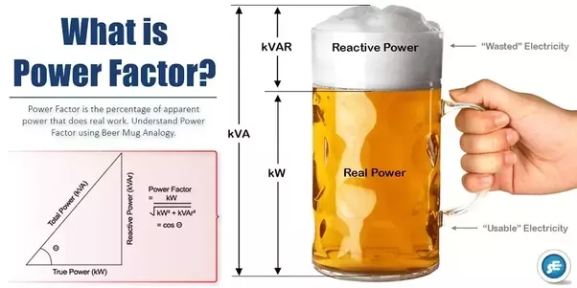
Electrical Fundamentals

Slide 46
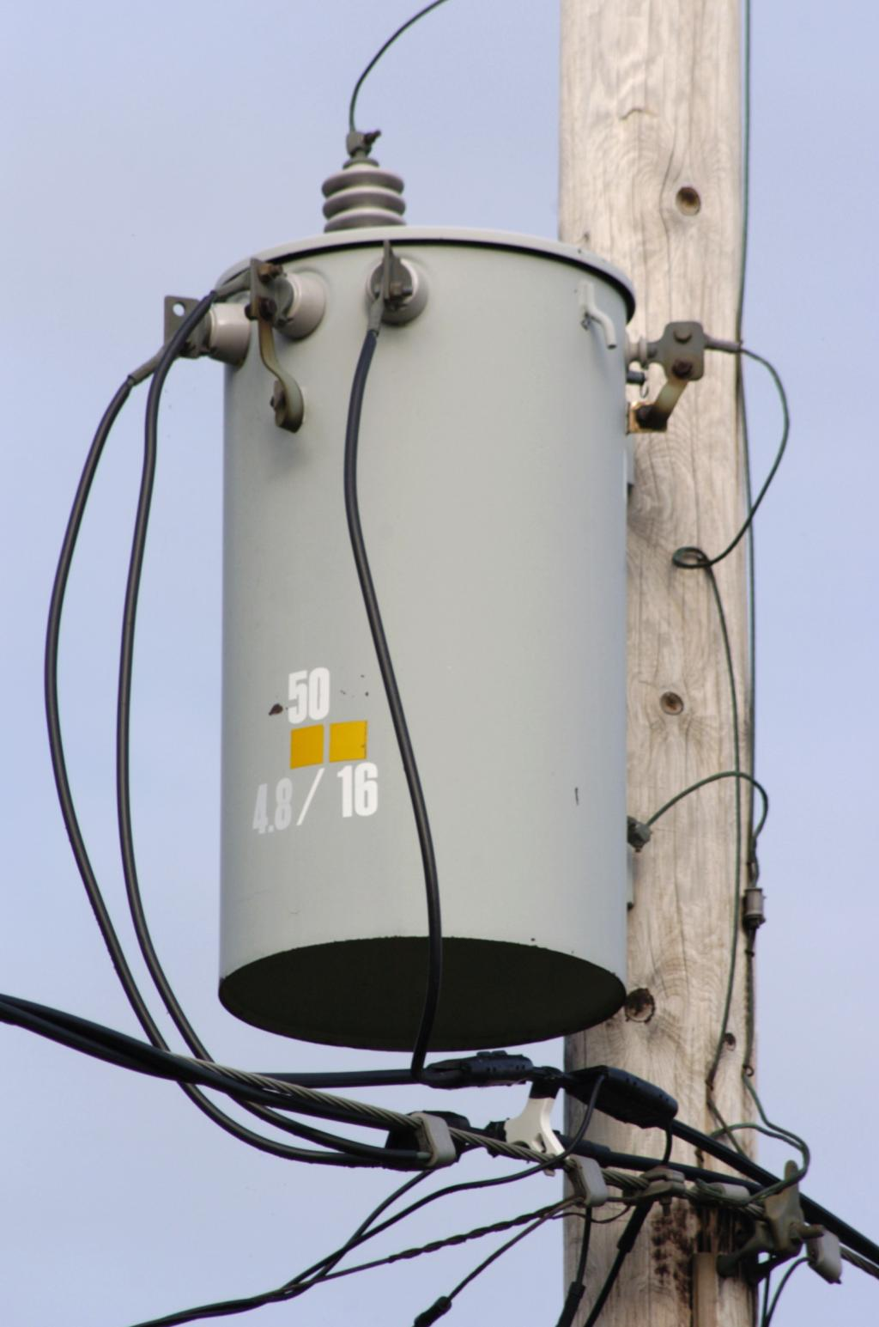
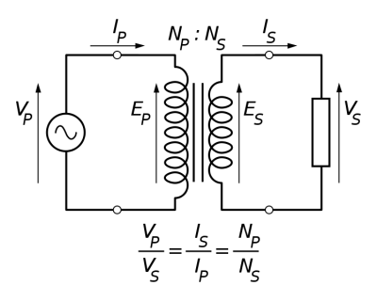
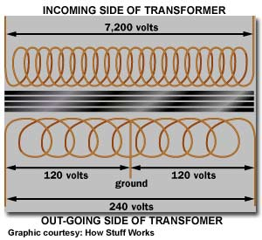
Electrical Fundamentals
Transformers
Transformers are electrical devices consisting of two or more coils of wire used to transfer electrical energy by means of a changing magnetic field.
Transformers are capable of either increasing or decreasing the voltage and current levels of their supply, without modifying its frequency, or the amount of electrical power being transferred from one winding to another via the magnetic circuit.

Slide 47
Electrical Fundamentals
Example 6.
A transformer has 500 turns of the primary winding and 10 turns of the secondary winding.
Determine the secondary voltage if the secondary circuit is open and the primary voltage is 120V.
Determine the current in the primary and secondary winding, given that the secondary winding is connected to a resistance load 15 Ω?
Determine the power of the primary and the power of the secondary.
Is this a step-up or step-down transformer?
Solution.

Slide 48
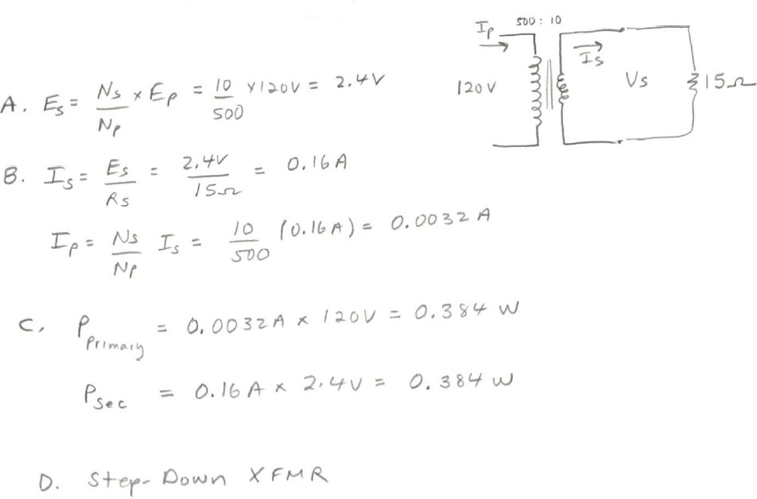
Electrical Fundamentals

Slide 49

Electrical Fundamentals

