Slide 1
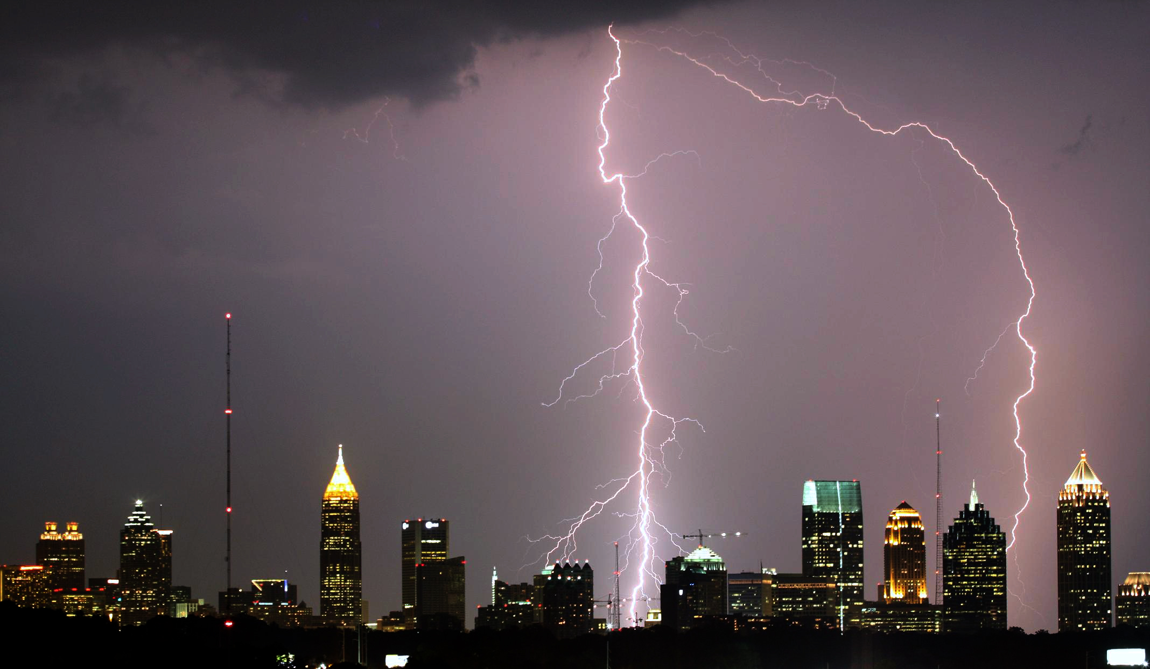
Power Distribution

Slide 2
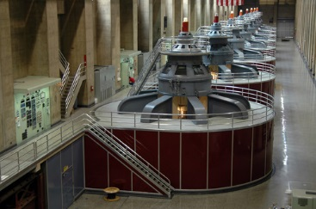
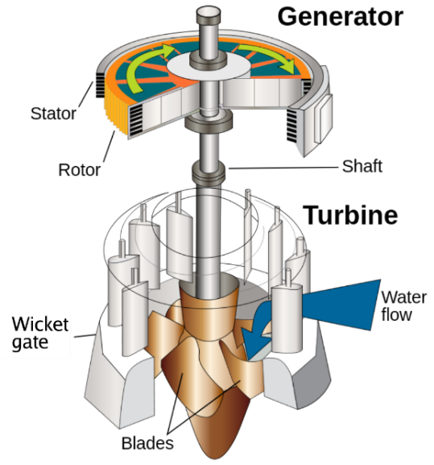
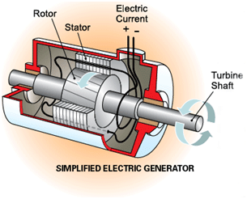
Power Distribution
Power Generation
Electricity generation is the process of generating electrical energy from other forms of energy.
Almost all electrical power on Earth is generated with a turbine of some type.
Turbines are commonly driven by wind, water, steam or burning gas.
The turbine drives an electric generator.
A generator converts mechanical energy into electricity by magnetic induction.

Slide 3
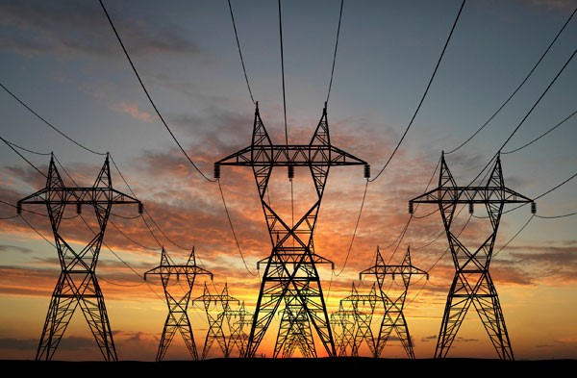
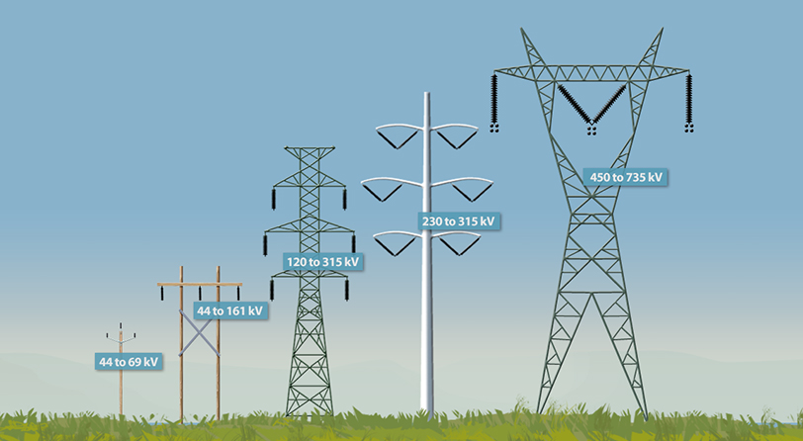
Power Distribution
Power Transmission Lines
Transmission lines are sets of wires, called conductors, that carry electric power from generating plants to the substations that deliver power to customers. At a generating plant, electric power is “stepped up” to several thousand volts by a transformer and delivered to the transmission line.

Slide 4
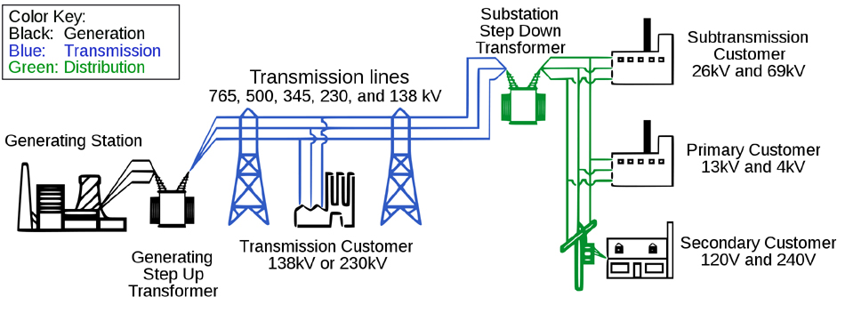
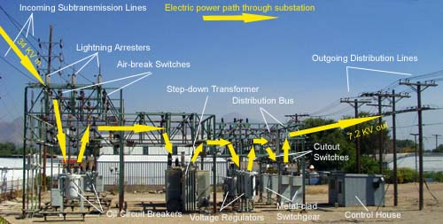
Power Distribution
Power Generation and Transmission
The Grid
Substation

Slide 5
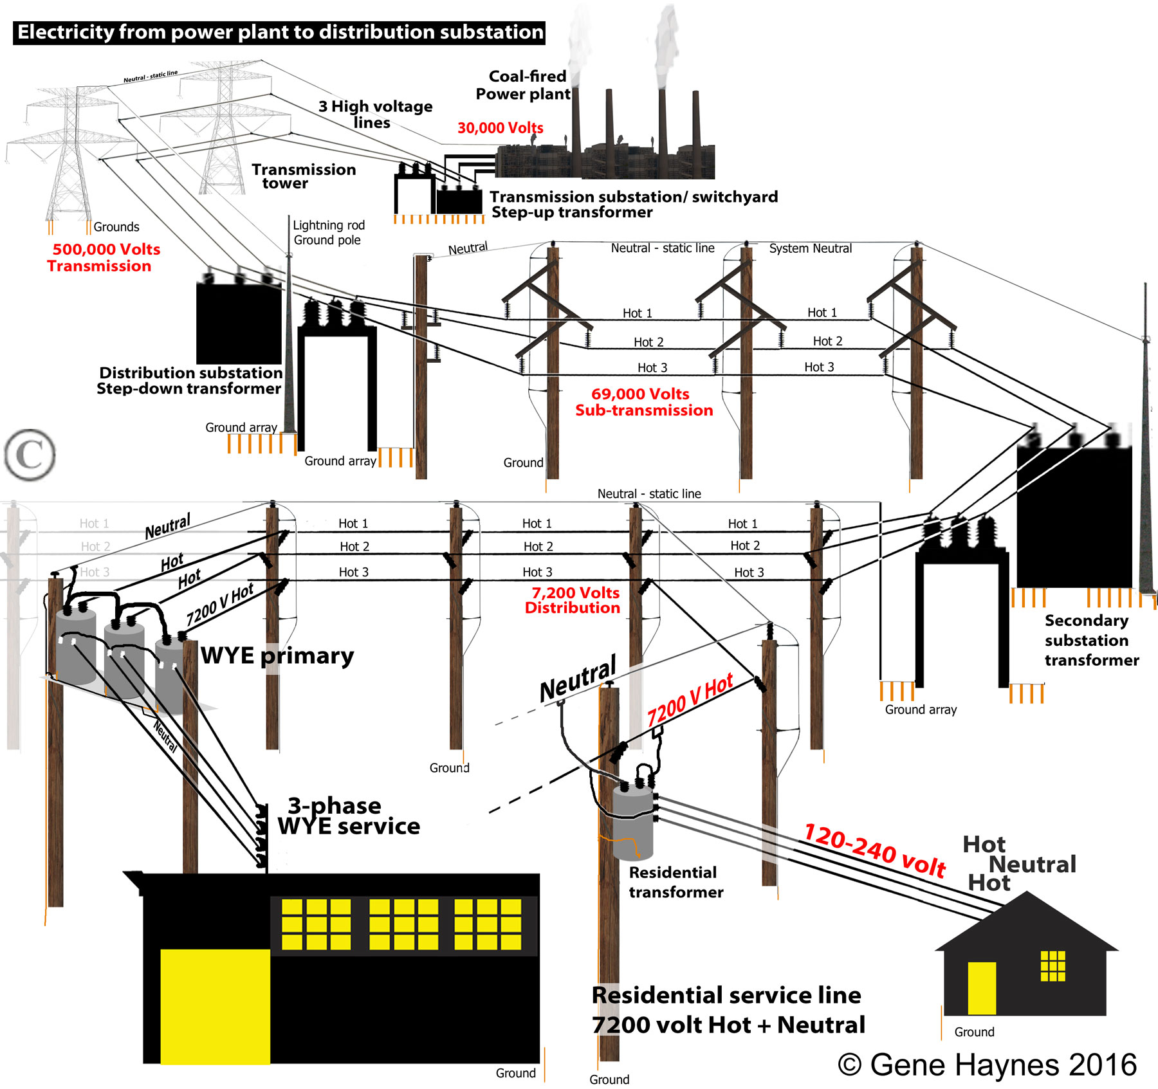
Power Distribution

Slide 6
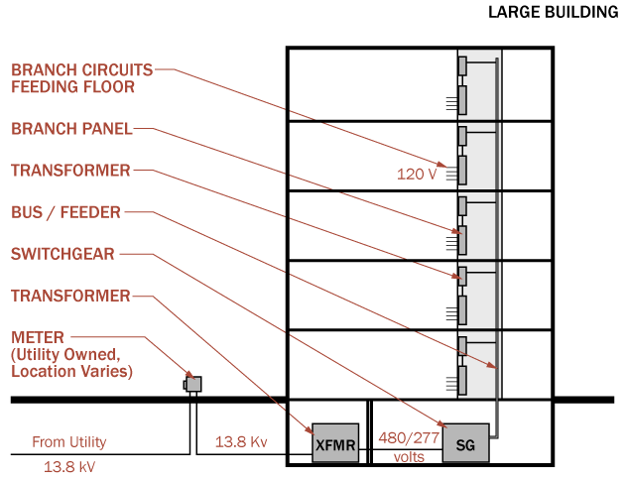
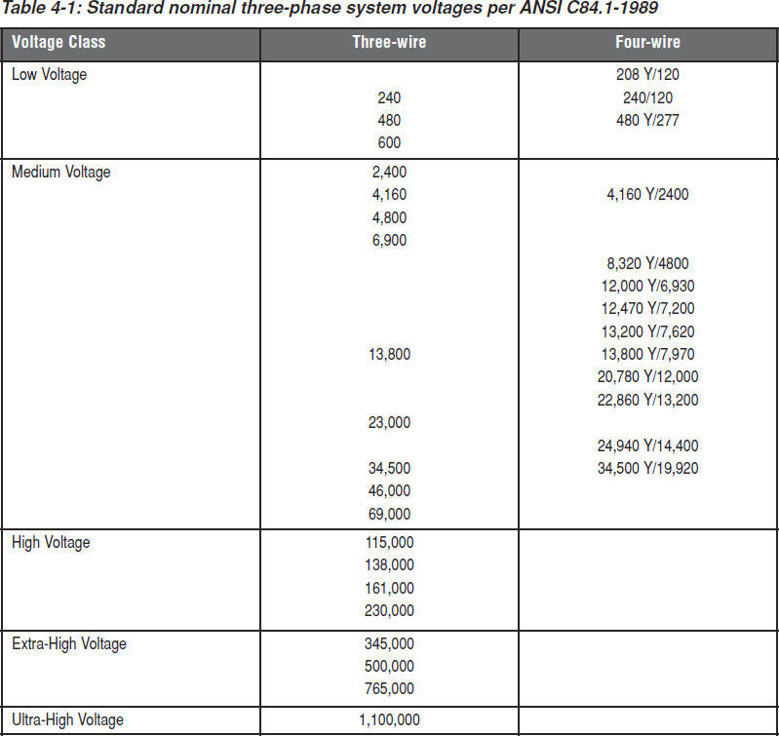
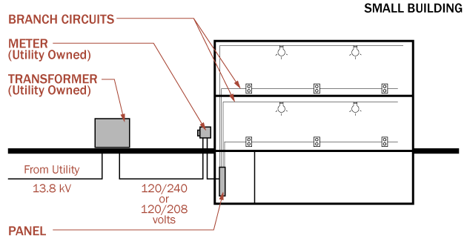
Power Distribution
Low Voltage Distribution Equipment

Slide 7
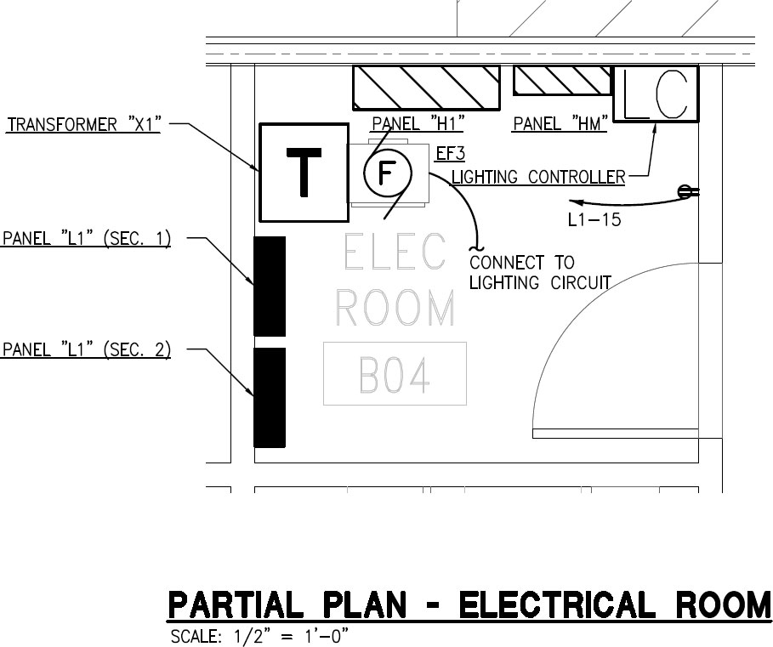
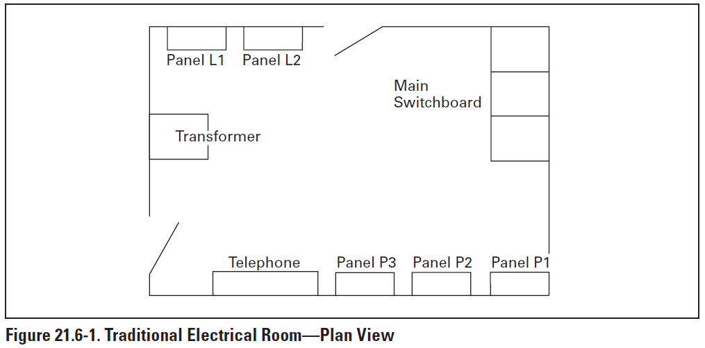
Power Distribution
Service Equipment
NEC Article 100 Definitions
Service Equipment - The necessary equipment, usually consisting of circuit breakers or switches and fuses and their accessories, connected to the load end of service conductors to a building or other structure, or an otherwise designated area, and intended to constitute the main control and cutoff of the supply. Service equipment does not include the metering equipment, such as the meter and/or meter enclosures.

Slide 8
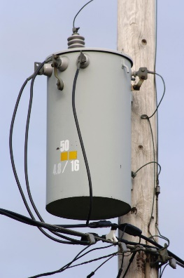
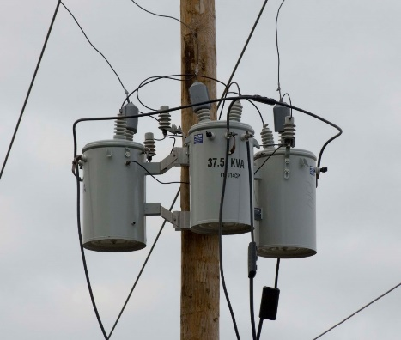
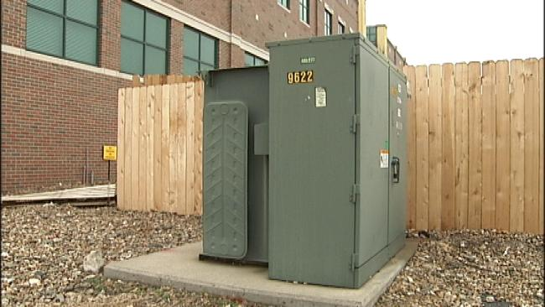
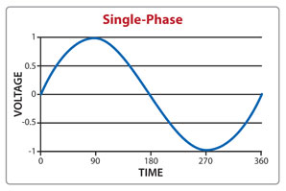
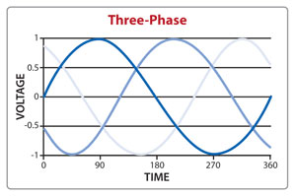
Power Distribution
Incoming Service - Power
All buildings have an electrical service.
A utility transformer is installed outside the building on a pad (site drawing) or pole.
Primary service (utility company) is shown on the One-line Diagram, Single-line Diagram, or Riser Diagram.

Slide 9
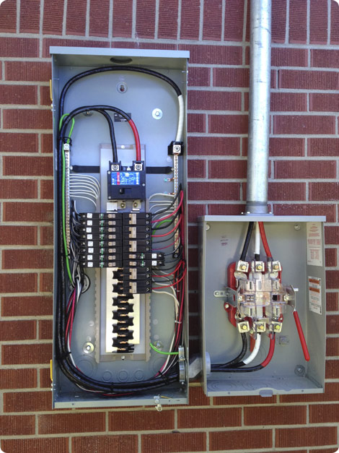
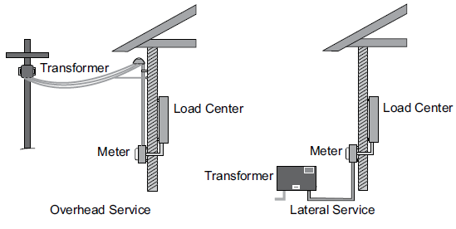
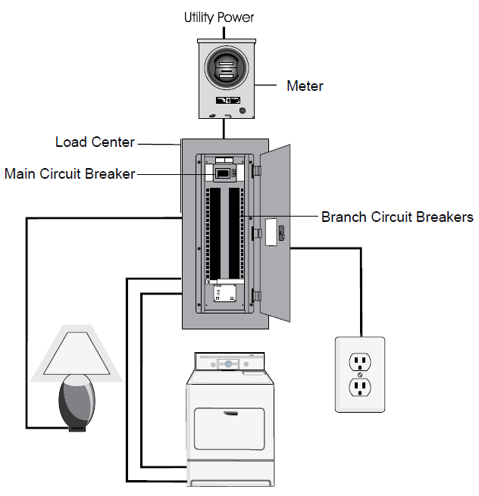
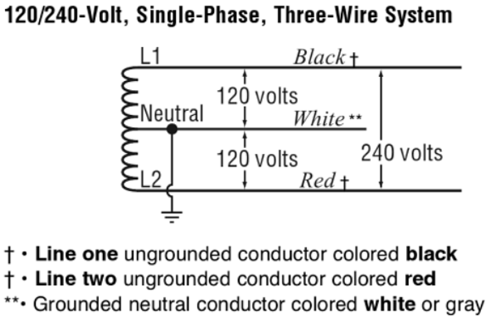
Power Distribution
Common Electrical Distribution Systems
Residential

Slide 10
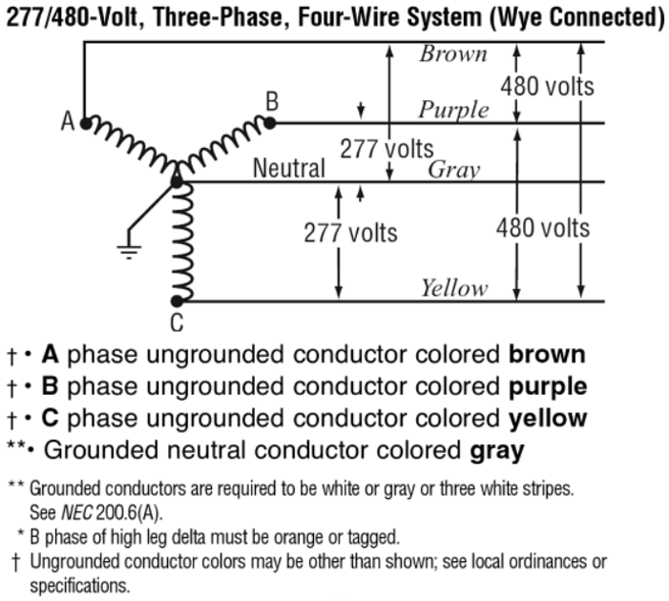
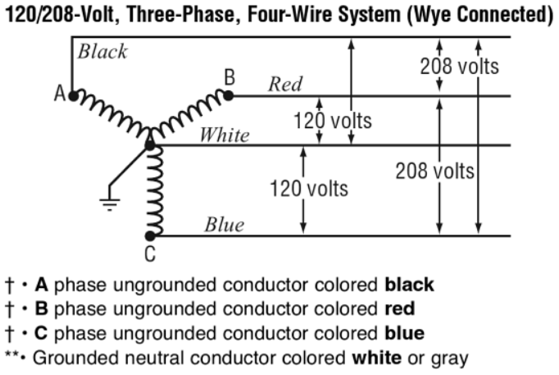
Power Distribution
Commercial / Industrial
Incoming Service Voltage
The most common commercial building electric service in North America is 120/208-Volt wye, which is used to power 120VAC plug loads, lighting, and smaller HVAC systems.
In larger facilities the voltage is 277/480-Volt and used to power single phase 277VAC lighting and larger HVAC loads.

Slide 11
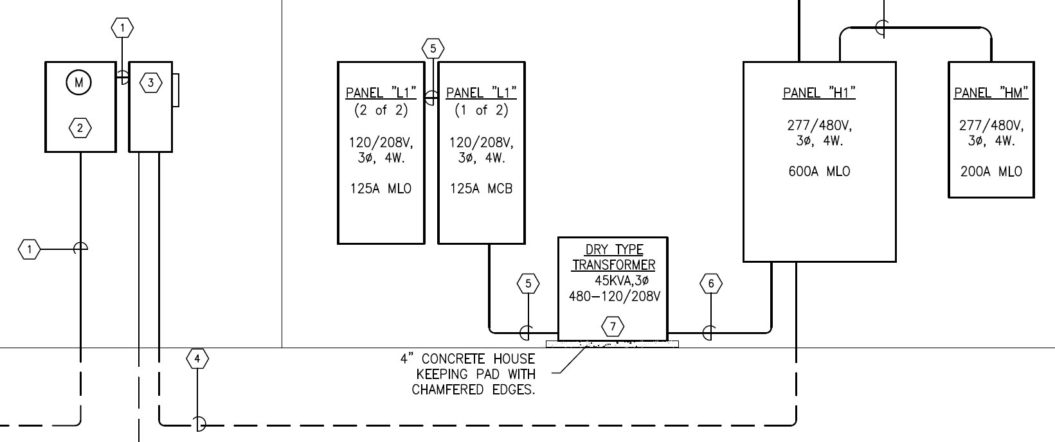

Power Distribution
Commercial / Industrial
Incoming Service Voltage
Single-Line Diagram (Partial)
Main Breaker
Utility Meter
Incoming Service

Slide 12
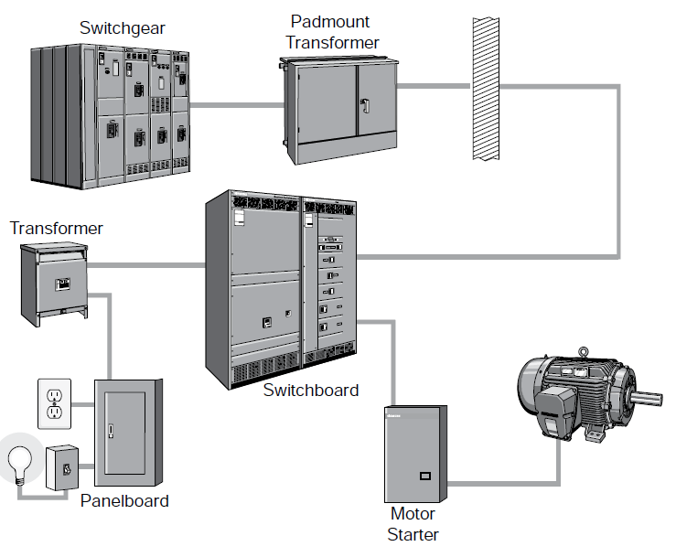
Power Distribution
Commercial and Industrial Power Distribution Equipment
Switchgear may or may not be part of the distribution system.
It is typically present if the incoming power provided by the utility company is at a much higher voltage level than the commonly supplied 277/480-volt.
The owner purchases a higher voltage level (5kV, 13.8kV, 15kV) and purchases and maintains the switchgear and step-down transformer(s).
Switchboards are generally for voltages less than 600 volts. They are free standing and intended to be accessible from the front and rear.

Slide 13
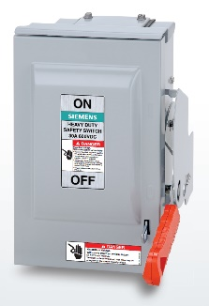
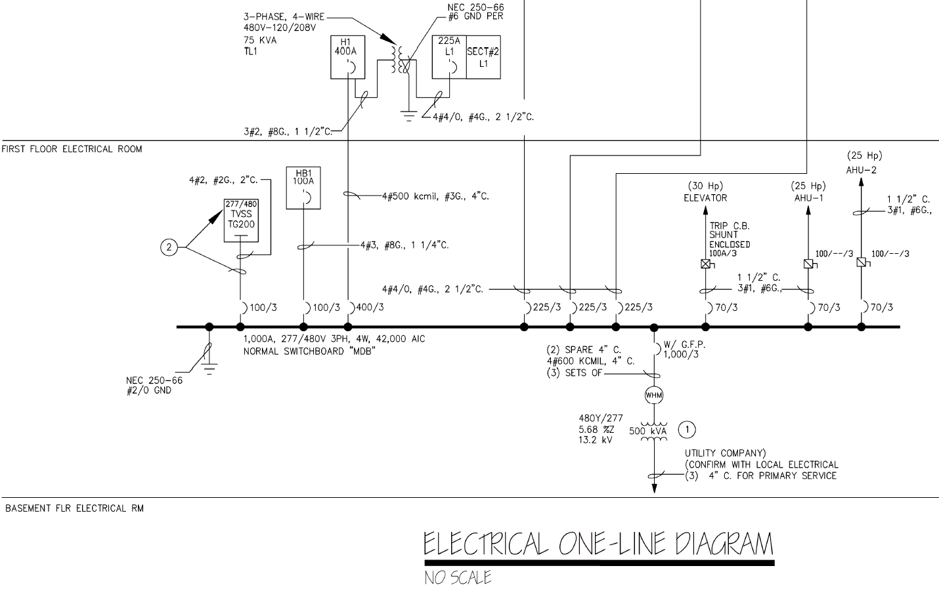
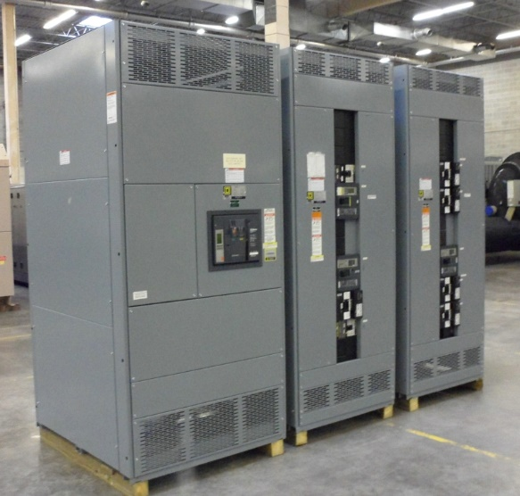
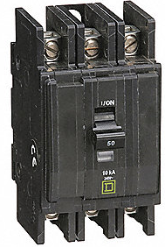
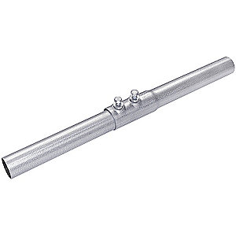
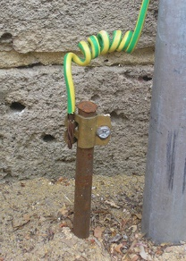
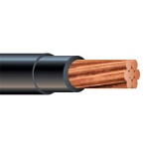
Power Distribution
Electrical One-Line Diagram
Single-Line Diagram
One-Line Diagram
Electrical Riser Diagram

Slide 14
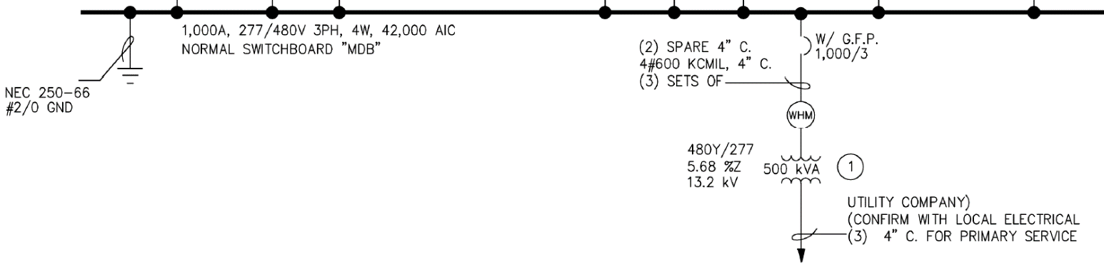
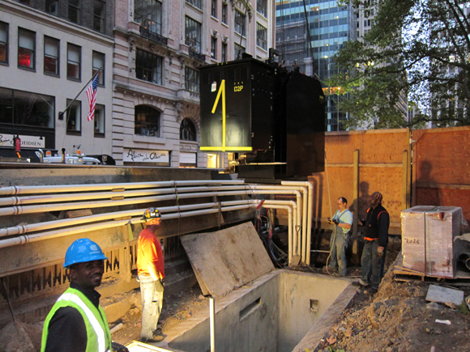
Power Distribution
Utility Primary Transformer
The power provided to a building all starts at the utility primary transformer. The secondary of the transformer is connected to the switchgear, switchboard, or a panel. The power company “owns” and connects the primary service. The EC connects the secondary to the building distribution.

Slide 15
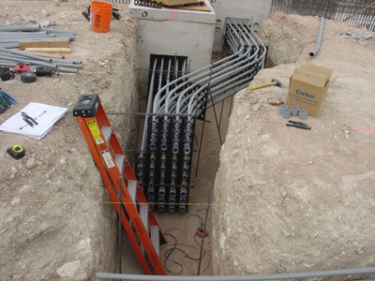
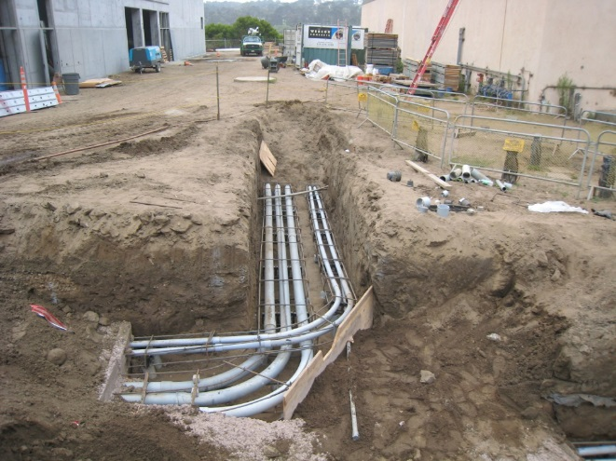
Power Distribution
In-Coming Service – Power

Slide 16
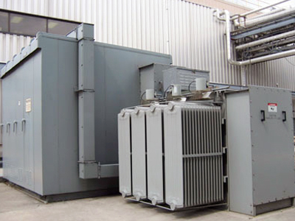
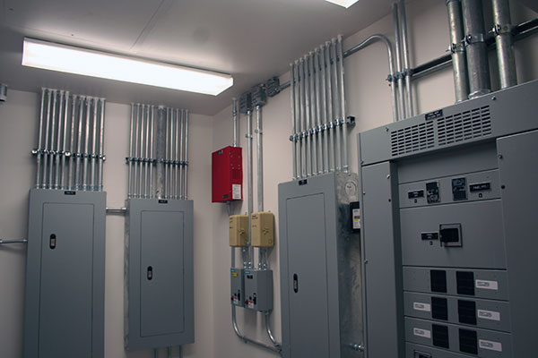
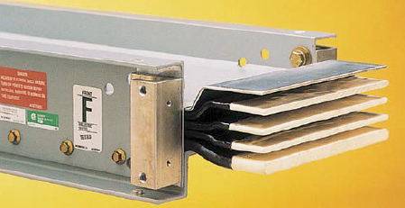
Power Distribution
Power Distribution System Equipment

Slide 17
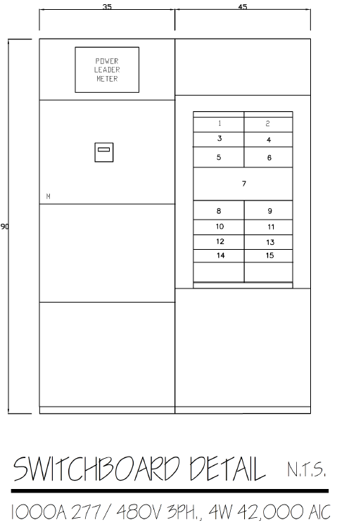

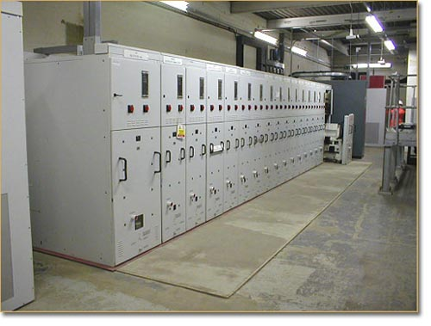
Power Distribution
Switchboard
Main Distribution Board (MDB)
Main Switchboard (MSB)

Slide 18
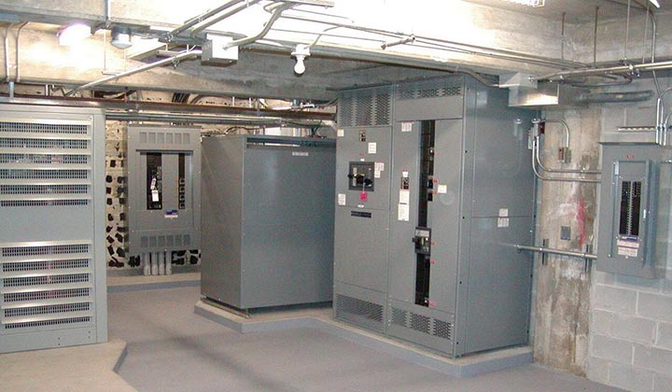
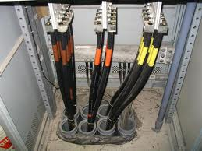
Power Distribution
Sections of a Switchboard
Incoming Section
Meter Main Section
Distribution Section
  Circuit Breakers (CB)
  Fusible Switches
Grounding
Bonding

Slide 19
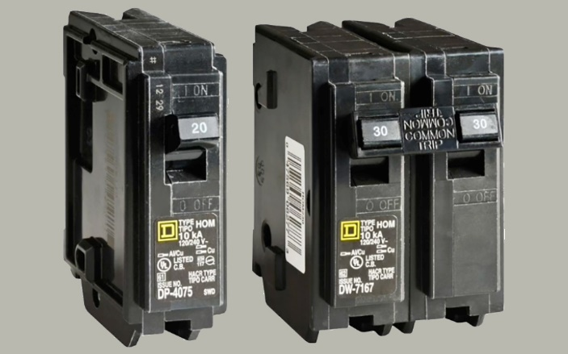
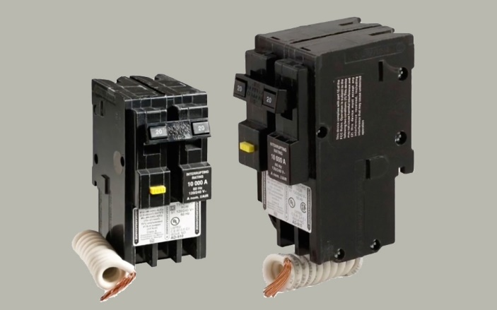
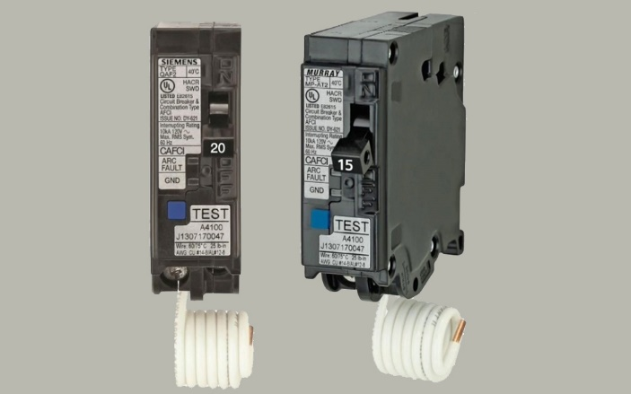
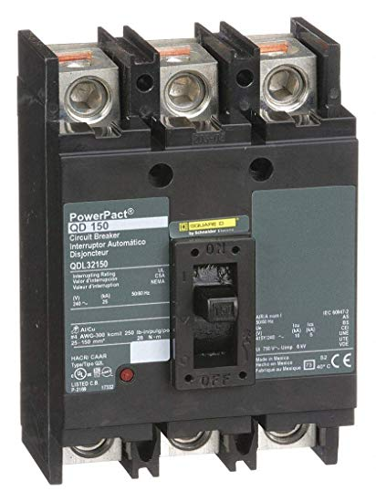
Power Distribution
Circuit Breakers
A circuit breaker is a switch that automatically interrupts electrical flow in a circuit in case of an overload or short.
The three types of circuit breakers:
standard
GFCI
AFCI
3-Pole CB
The 3-pole circuit breaker is used for three-phase circuits where there is L1, L2, L3 and N wire.

Slide 20
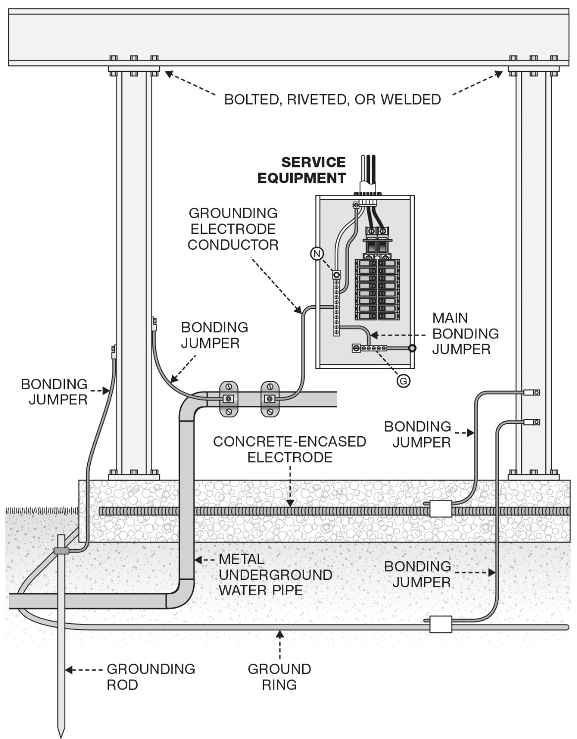
Power Distribution
Grounding
Article 100 of the NEC defines grounding as, "Establishing a connection, whether intentional or accidental, between an electrical circuit or equipment and the earth or to some conducting body that serves in place of the earth.“
Bonding
The NEC defines bonding as, "The permanent joining of metallic parts to form an electrically conductive path that ensures electrical continuity and the capacity to conduct safely any current likely to be imposed."

Slide 21

Power Distribution
Panelboard
NEC® definition, panelboards are:
Used to control light, heat, or power circuits
Placed in a cabinet or cutout box
Mounted in or against a wall
Accessible only from the front

Slide 22


Power Distribution
Panelboard
National Electrical Code® Article 408, Switchboards and Panelboards. Panelboards are frequently divided into two categories:
Lighting and appliance branch-circuit panelboards
Power panelboards (also called distribution panelboards)

Slide 23



Slide 24


Power Distribution

Slide 25


Power Distribution
Safety Switch - Disconnect Switch
Fusible or Non-Fusible
250V or 600V
2 Pole or 3 Pole
30A
60A
100A
200A
400A
600A
800A
1200A
4 & 6-Pole Heavy Duty Safety Switches
Two-speed, two-winding motors
4-pole switches are also used in 3-phase, 4-wire circuits when a switching neutral is required.

Slide 26
Power Distribution
Electrical Drawings
The drawings (plans) that are most important for understanding the scope of work for the project’s electrical distribution system are:
Single-Line Diagram (One-Line Diagram, Electrical Riser Diagram)
Panel Schedules
Equipment Schedules and HVAC Schedules
Lighting Control
Example Project – Broward Northside, Climate Controlled Storage
Drawings
E – 02 [Electrical Room, Elevator Equipment Room]
E – 03 [Single-Line Diagram, Exterior Lighting Control]
E – 04 [Panel Schedules, HVAC Equipment Schedules]

Slide 27


Power Distribution
Electrical Drawings
Electrical Legend (Partial)
Drawing E - 01
Drawing E-1 Lower Level Electrical Plan

