Slide 1
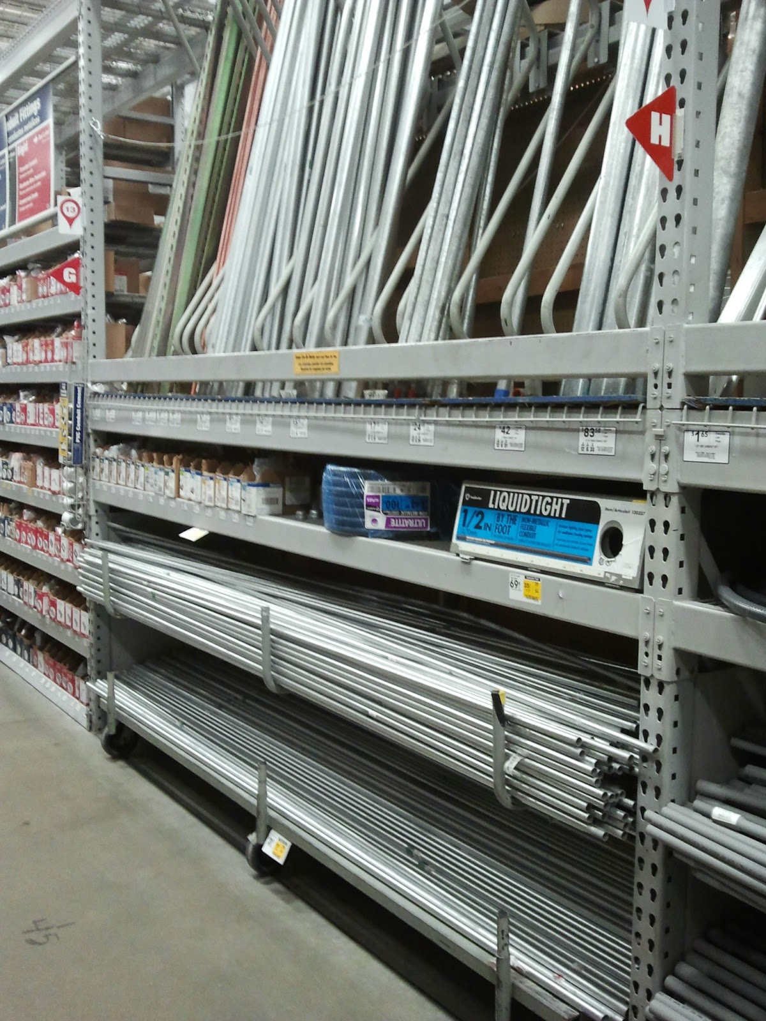
Electrical Material

Slide 2
Electrical Material
National Electrical Contractors Association - NECA
http://www.necanet.org/
NECA is the voice of the $130 billion electrical construction industry that brings power, light, and communication technology to buildings and communities across the U.S.

Slide 3
Electrical Material
NECA Manual of Labor Units
An estimate is only as good as the information it is based on, and the NECA Manual of Labor Units (MLU) has been the estimating resource of choice for electrical contractors since 1923.
The MLU provides an experience-based reference for estimating the electrical construction labor required to install typical electrical and communications systems.
The labor unit data comes directly from a national average of NECA’s member contractors and is reviewed and updated bi-annually to ensure you have the best information to accurately estimate.

Slide 4
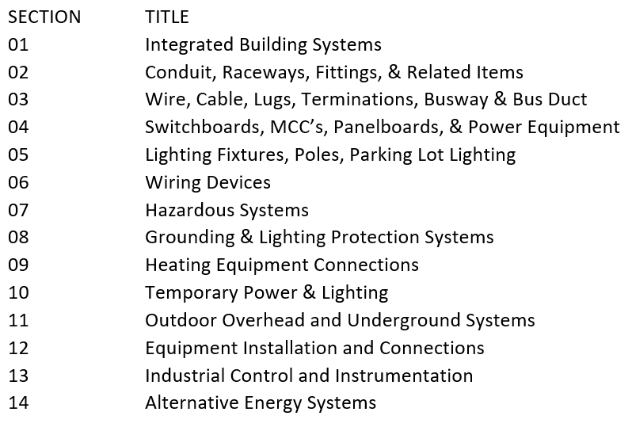
Electrical Material
NECA Categories of Work
The NECA Manual of Labor Units divides electrical materials into 14 categories. Many electrical contractors use a different breakdown of electrical material for estimating purposes.

Slide 5
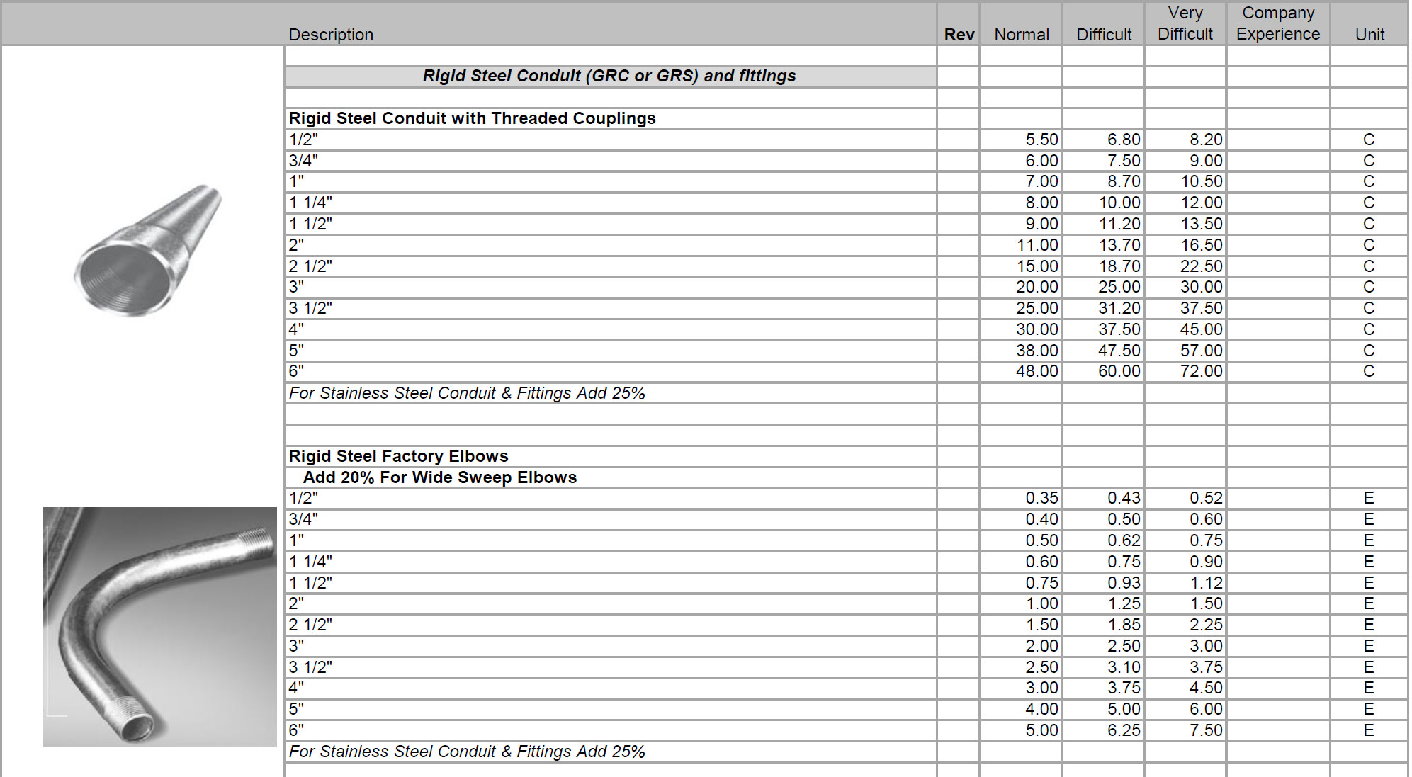
Electrical Material
Labor Units
E = One or per each item
C = Per hundred items
C = Per hundred linear feet of the item
M = Per thousand linear feet of the item
LF = Linear Foot
CY = Cubic Yard
Labor Units (Installation Conditions)
NECA 1 Normal (N)
NECA 2 Difficult (D)
NECA 3 Very Difficult (VD)
MLU 2015-16. Section 02 Conduit, Raceways, Fittings, & Related Items, Page 2-15

Slide 6
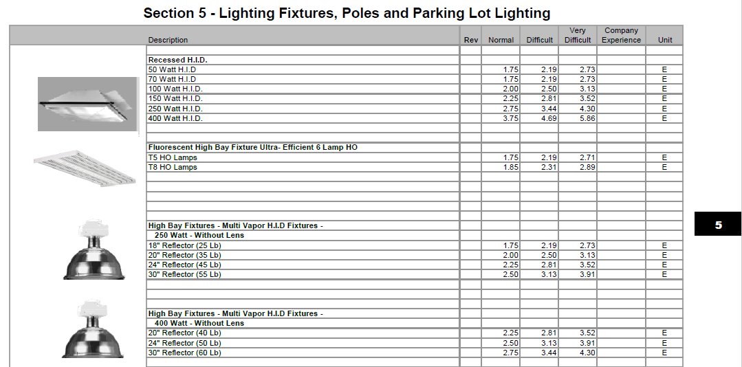
Electrical Material
What’s the difference between the three columns in the MLU?
The NECA labor unit tables include three different labor units for each item. Users of the MLU are also encouraged to consider labor units between the columns, or even lower than or exceeding the columns when appropriate.

Slide 7
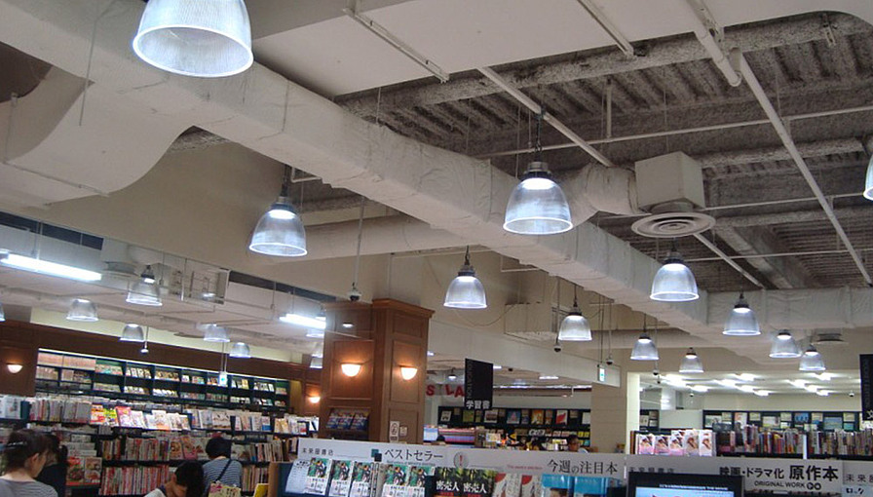
Electrical Material
Normal Installation Conditions – When all of the conditions associated with the installation of an item will permit the maximum productivity of the electricians on a project, these “normal” column labor units are applicable.

Slide 8
Electrical Material
Difficult Installation Conditions – When one or more of the conditions associated with the installation of an item will permit less than maximum productivity of the electricians on a typical project, these “difficult” column labor units are applicable.

Slide 9
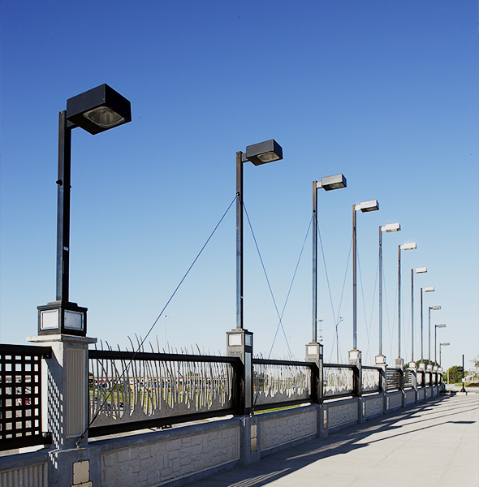
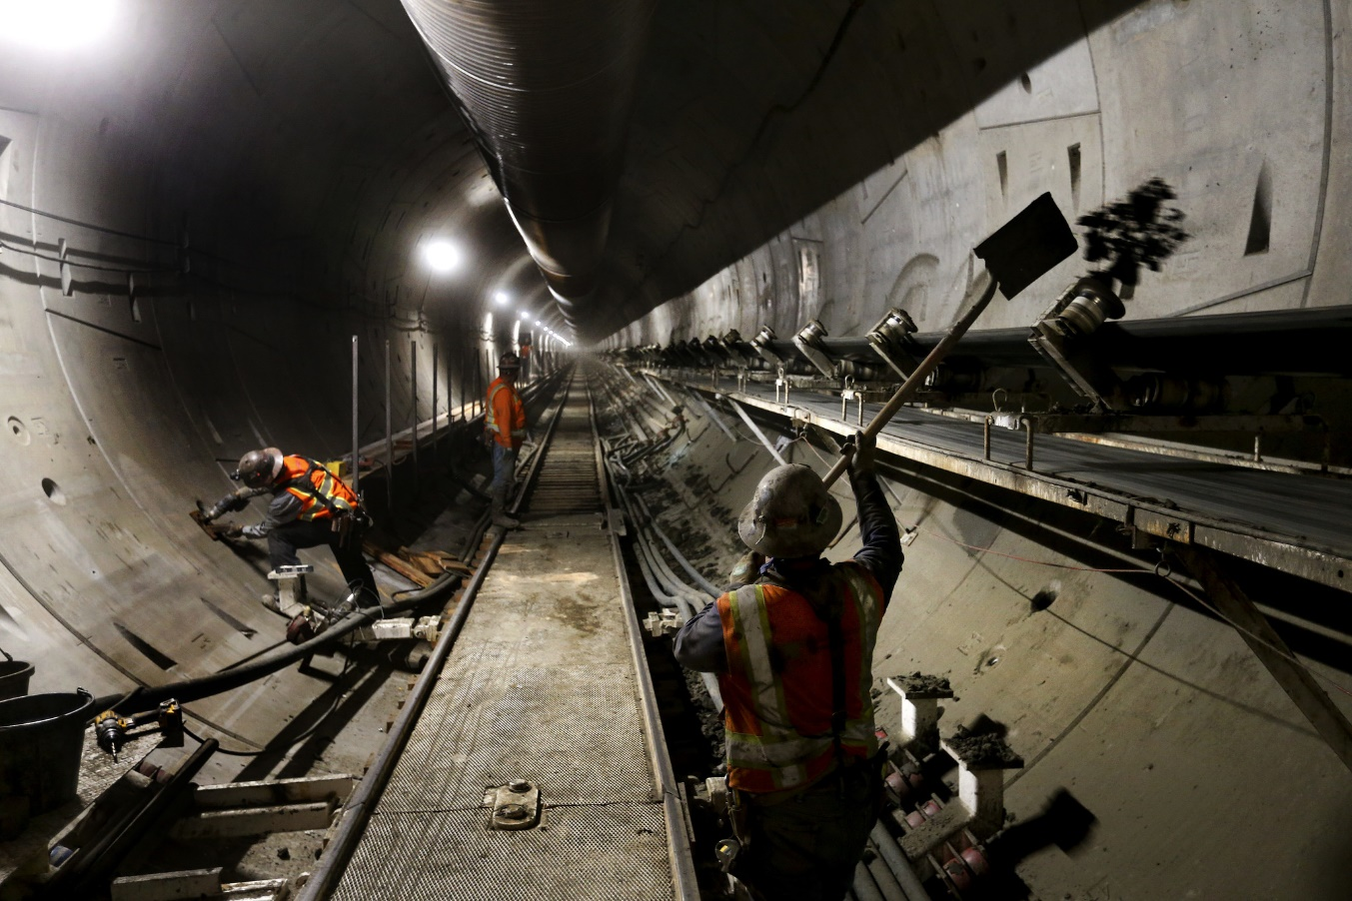
Electrical Material
Very Difficult Installation Conditions – When one or more of the conditions associated with the installation of an item will permit substantially less than maximum productivity of the electricians on a typical project, these “very difficult” column labor units are applicable.

Slide 10
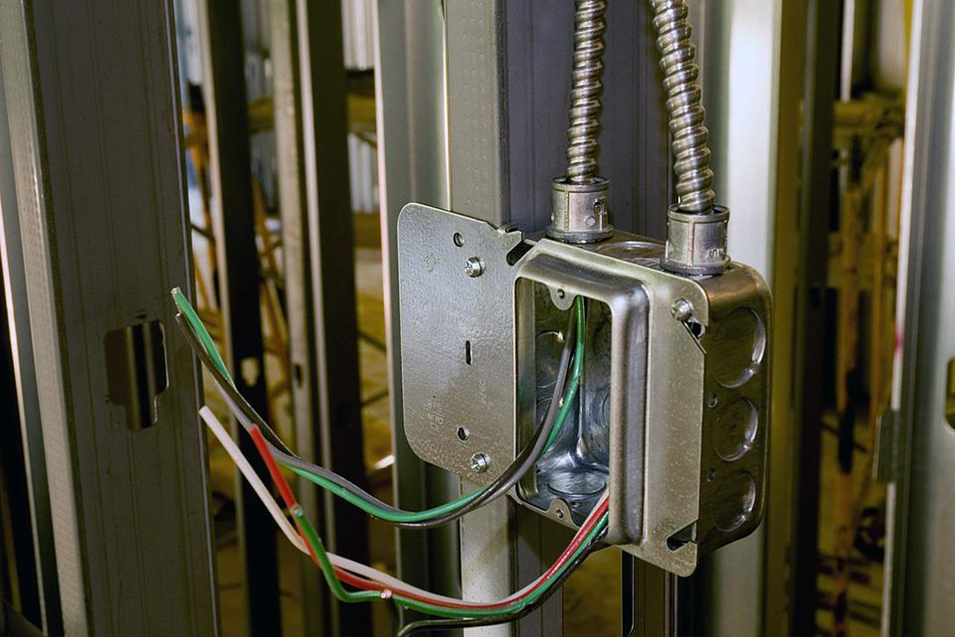
Electrical Material

Slide 11
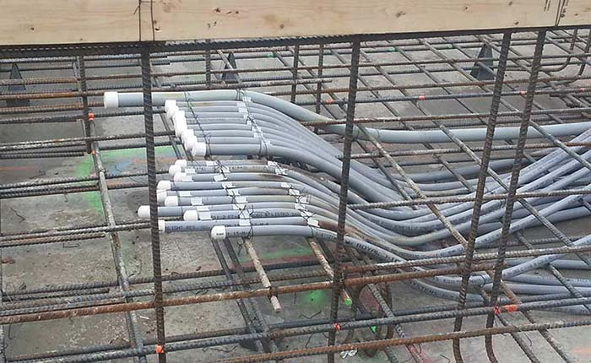
Electrical Material

Slide 12
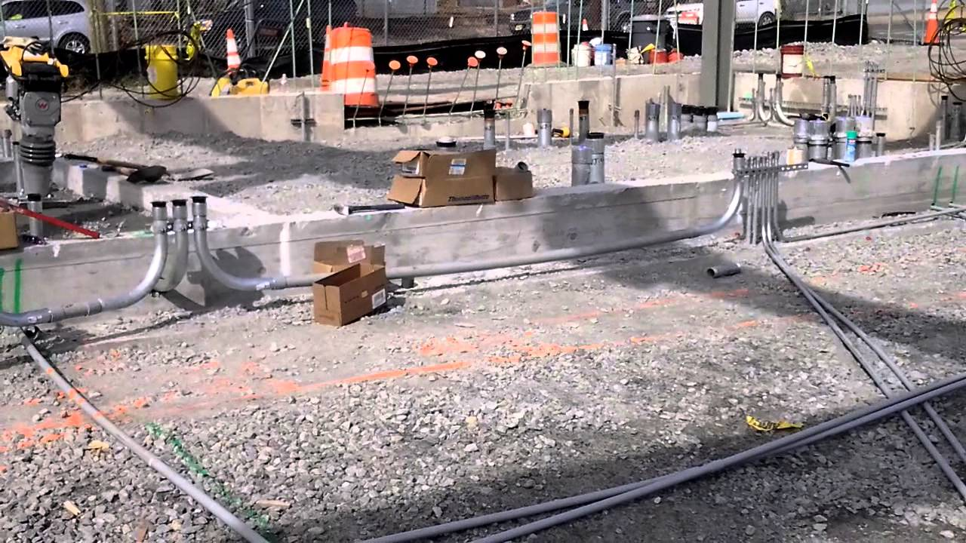
Electrical Material

Slide 13
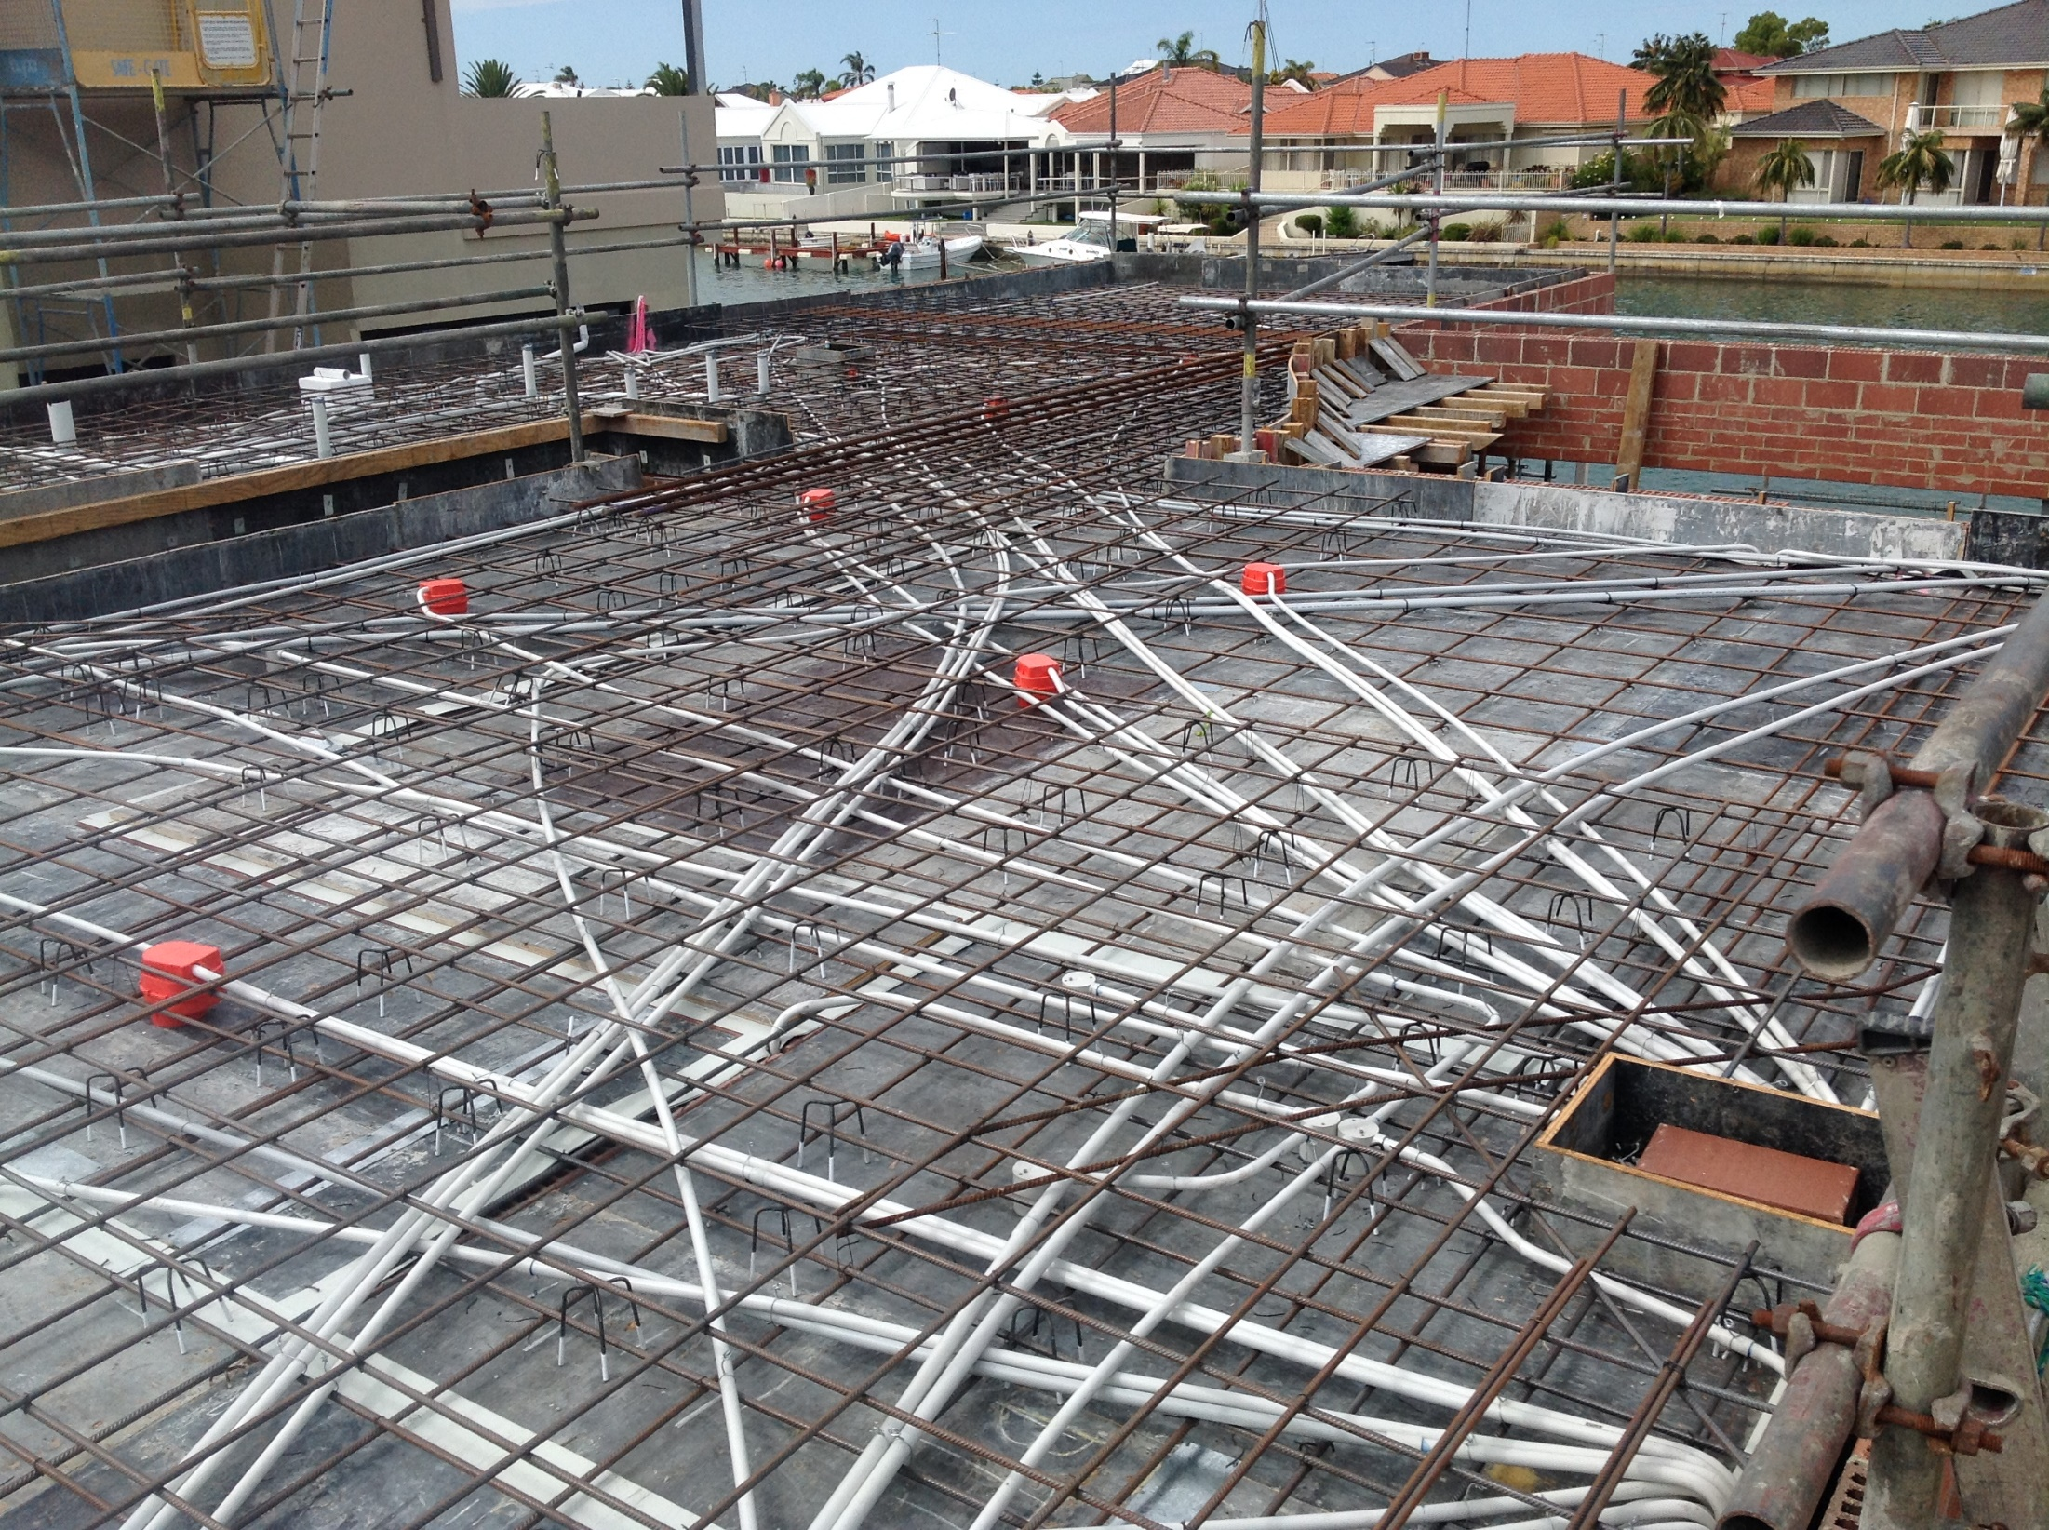

Slide 14
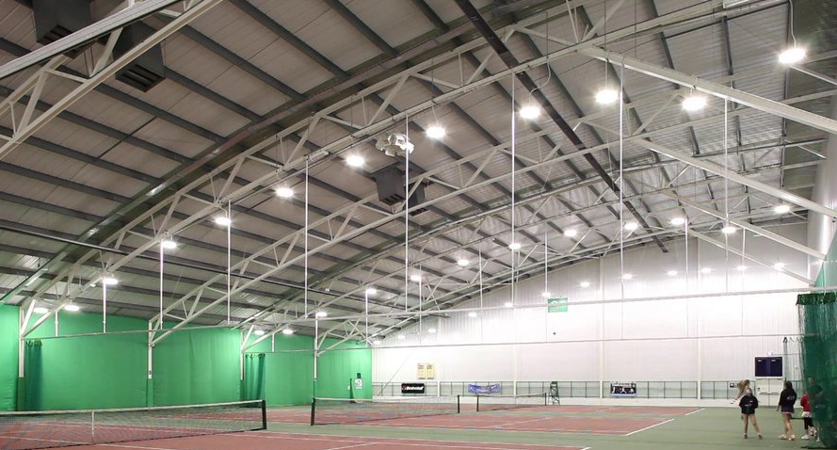
Electrical Material

Slide 15
Electrical Material
Example 1. NECA MLU
325 feet of 3 ½" GRC is being installed in a 5" concrete slab.
Determine the total labor.
Determine the total material cost.

Slide 16
Electrical Material
Example 1.
325 feet of 3 ½" GRC is being installed in a 5" concrete slab.
Determine the total labor.
Determine the total material cost.

Slide 17
Electrical Material
Example 1.
325 feet of 3 ½" GRC is being installed in a 5" concrete slab.
Determine the total labor.
Determine the total material cost.

Slide 18
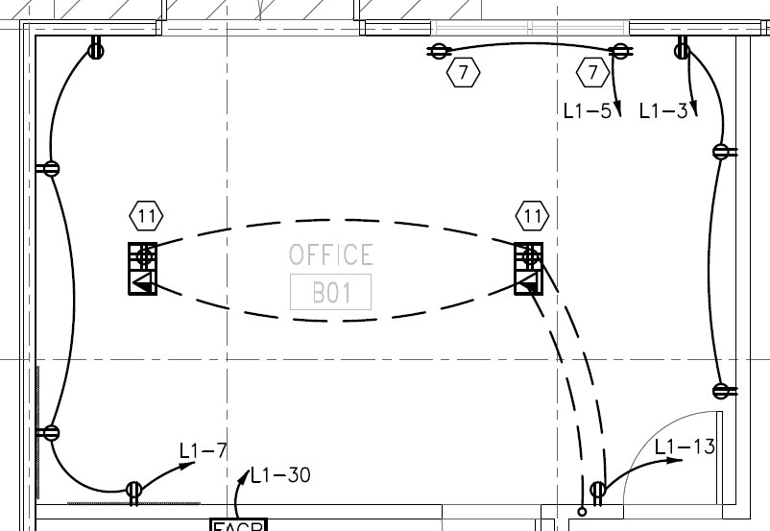
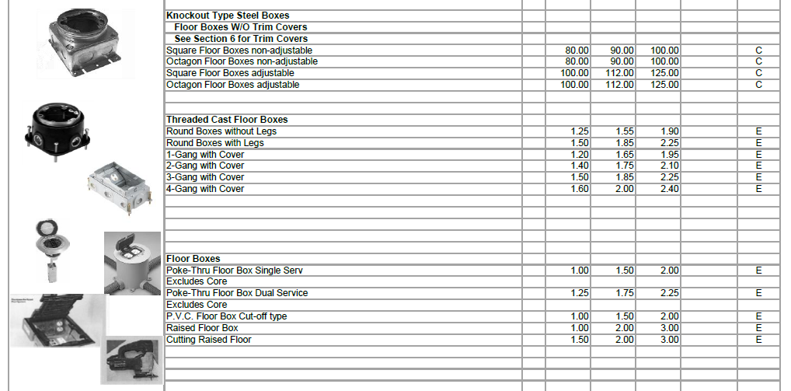
Electrical Material
Example 2.

Slide 19
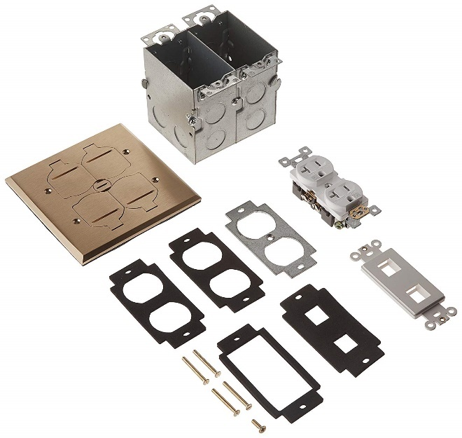
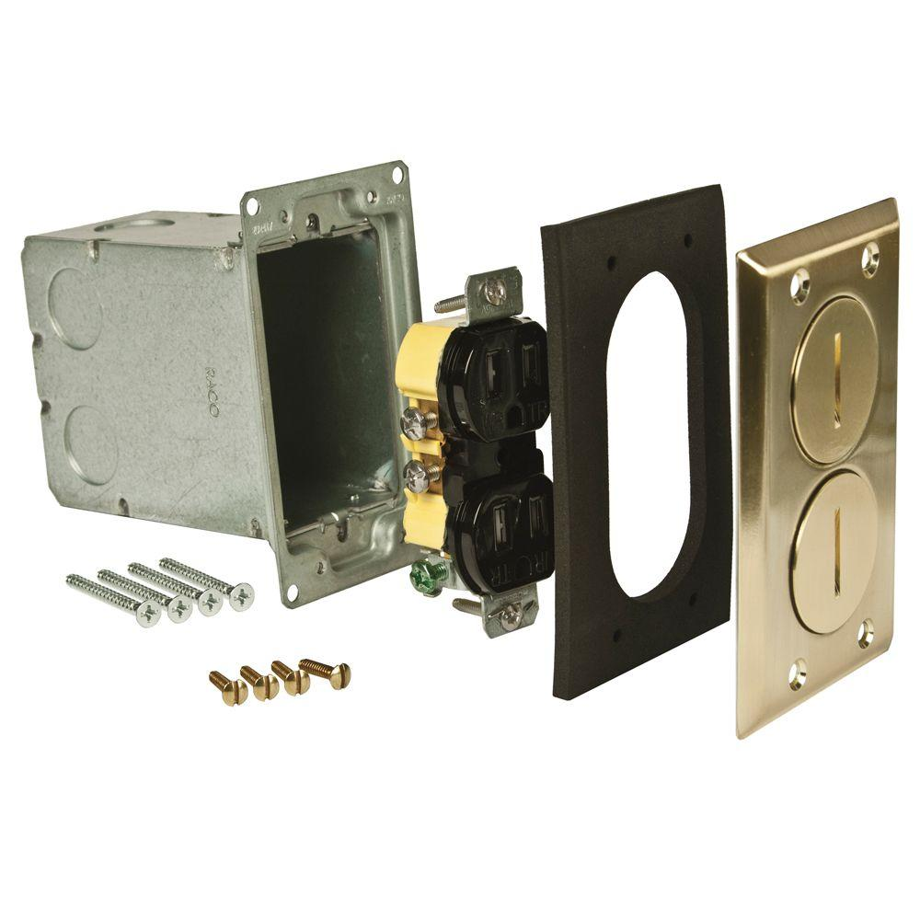
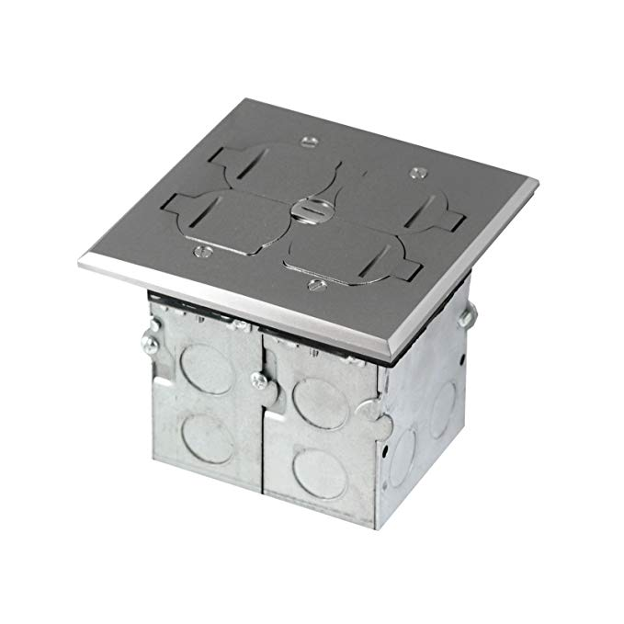
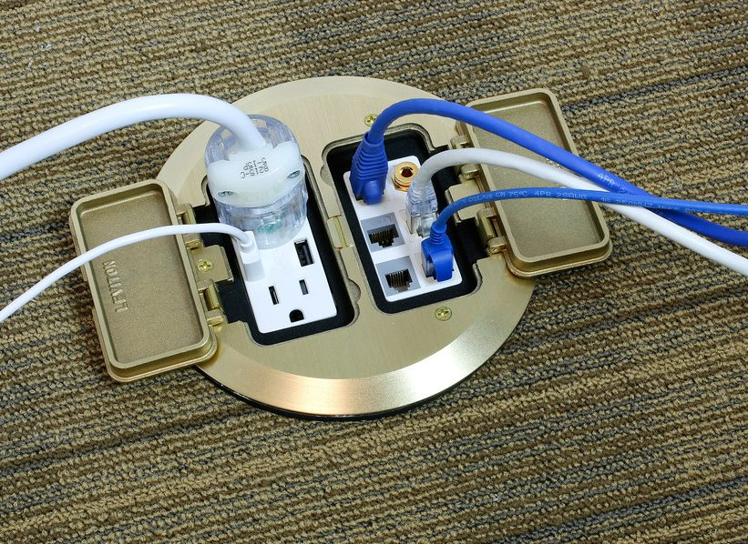
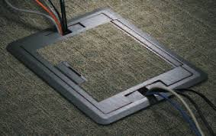
Electrical Material
Floor Boxes

Slide 20
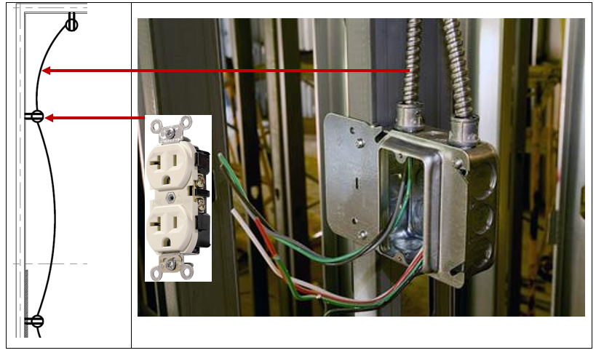
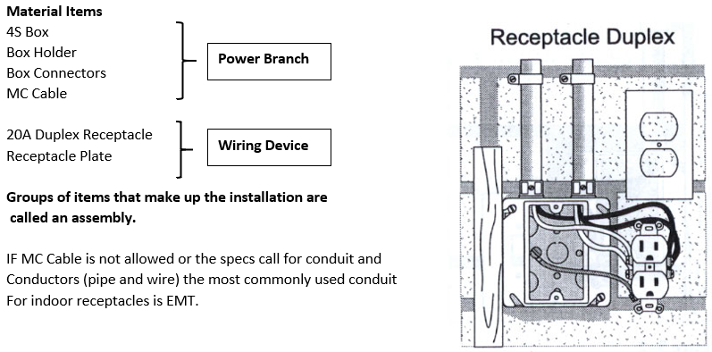
Electrical Material
Branch Wiring
Branch wiring refers to the conduit and conductors or cable that runs power to each device (receptacles, switches, floor boxes).
Electrical drawings indicate the branch using either solid or dashed lines. Often the lines are left off the drawings and it is up to the electrical estimator to sketch the branch onto the drawing.
Most commercial buildings have:
Power Branch
Lighting Branch
Fire Alarm Branch

Slide 21
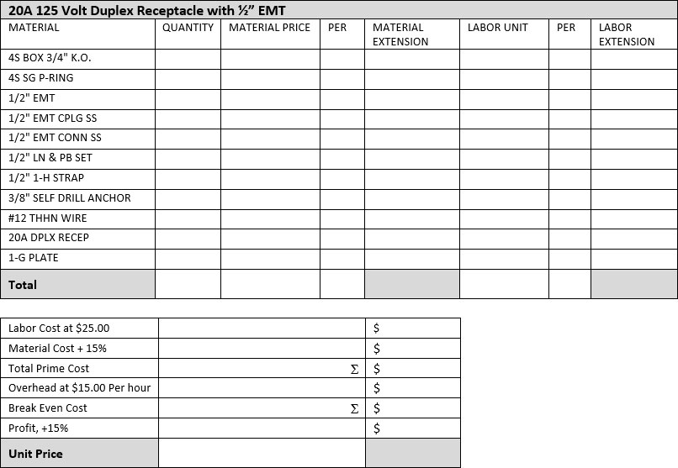
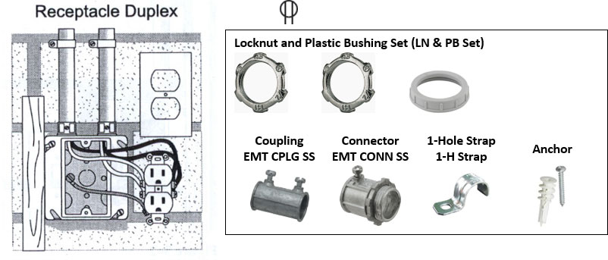
Electrical Material
Example 3. 20A Duplex Receptacle

Slide 22
Electrical Material
Example 3. 20A Duplex Receptacle

Slide 23
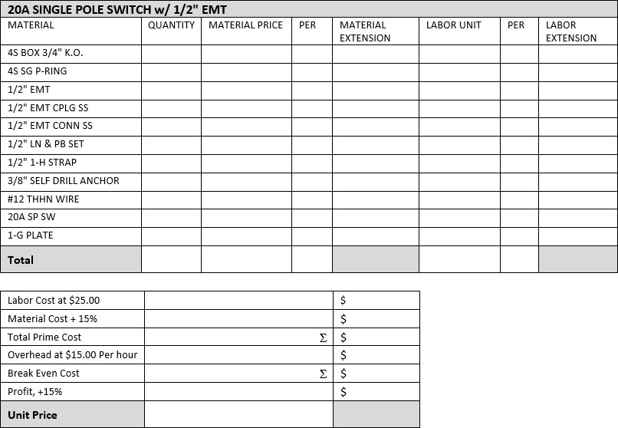
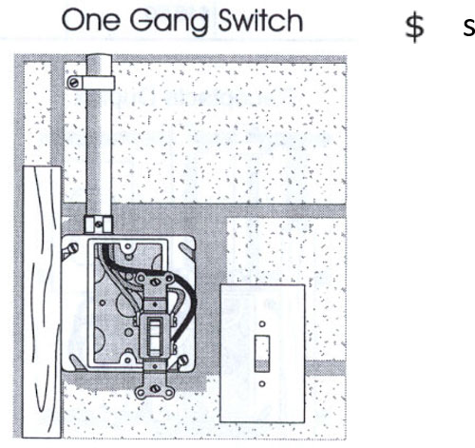
Electrical Material
Example 4. 20A Single Pole Switch

Slide 24
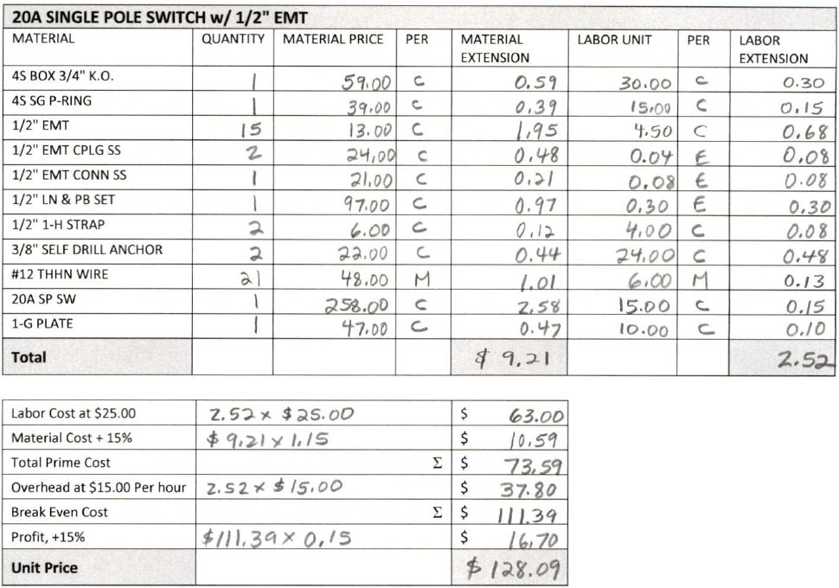
Electrical Material
Example 4. 20A Single Pole Switch

Slide 25
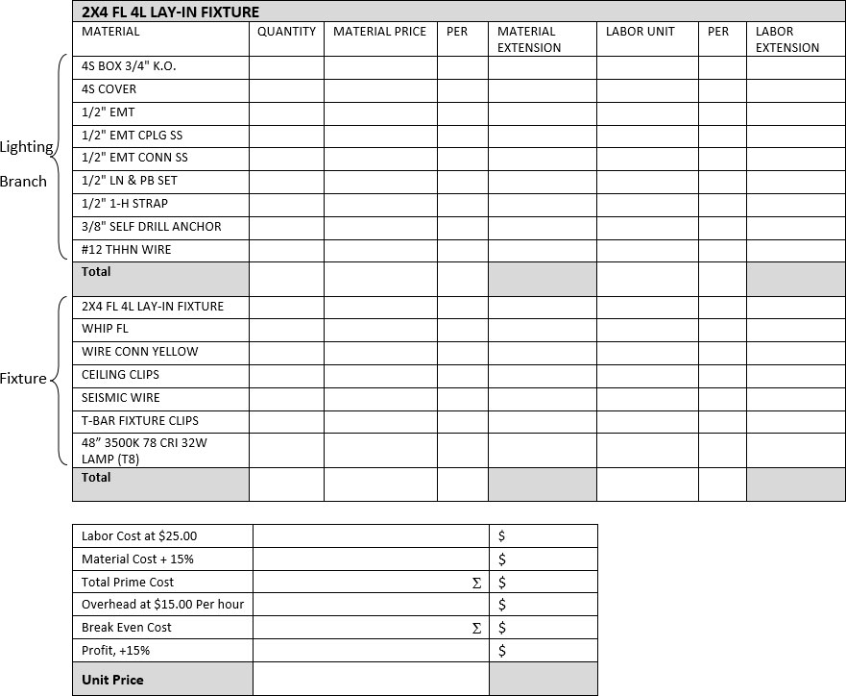
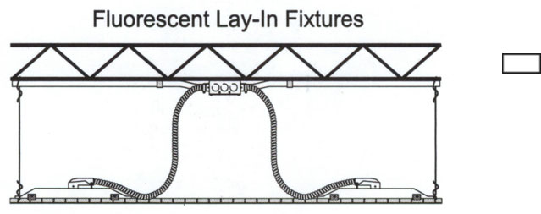
Electrical Material
Example 5. 2x4 FL 4L Lay-In Fixture

Slide 26
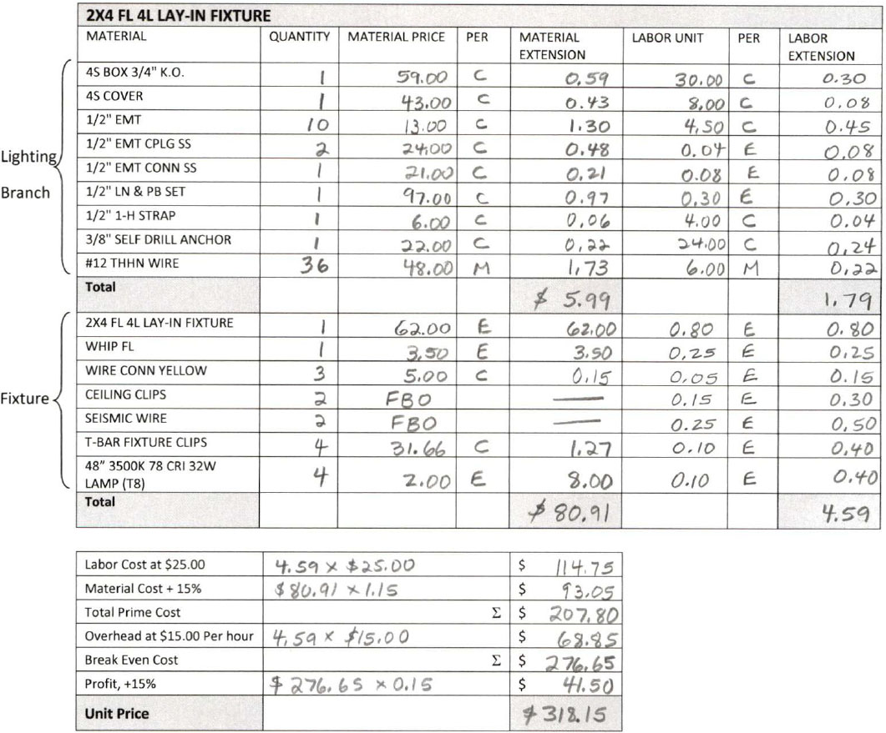
Electrical Material
Example 5. 2x4 FL 4L Lay-In Fixture

