Slide 1
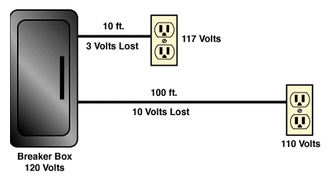
Voltage Drop

Slide 2
Voltage Drop
Electrical Calculations
Most building electrical calculations solve for current or voltage drop.
► Current sets conductor size.
► Excess voltage drop may require an increase in conductor size.

Slide 3
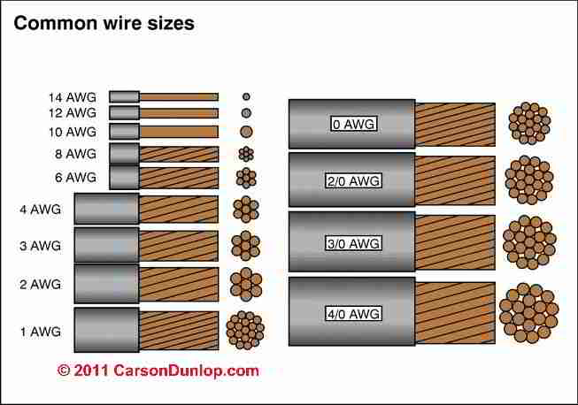
Voltage Drop
AWG Conductor Sizes
THHN Wire stands for - Thermoplastic High Heat-resistant Nylon coated.
THHN is UL listed with a rated 90 degrees Celsius in dry locations or 75 degrees Celsius in wet applications with a THWN rating.

Slide 4
Voltage Drop
Excessive Voltage Drop
Excessive voltage drop in a circuit can cause:
► Lights to flicker or burn dimly
► Heaters to heat poorly
► Motors to run hotter than normal and burn out
This condition causes the load to work harder with less voltage pushing the current.

Slide 5
Voltage Drop
National Electrical Code (NEC)
The National Electrical Code recommends limiting the voltage drop from the breaker box to the farthest outlet for power, heating, or lighting to 3 percent of the circuit voltage.
This is done by selecting the right size of wire.

Slide 6
Voltage Drop
National Electrical Code (NEC)
Two Primary Electrical Design Concerns
► Current Required
► Voltage Drop

Slide 7
Voltage Drop
National Electrical Code (NEC)
Two Primary Electrical Design Concerns
► Current Required
► Voltage Drop

Slide 8
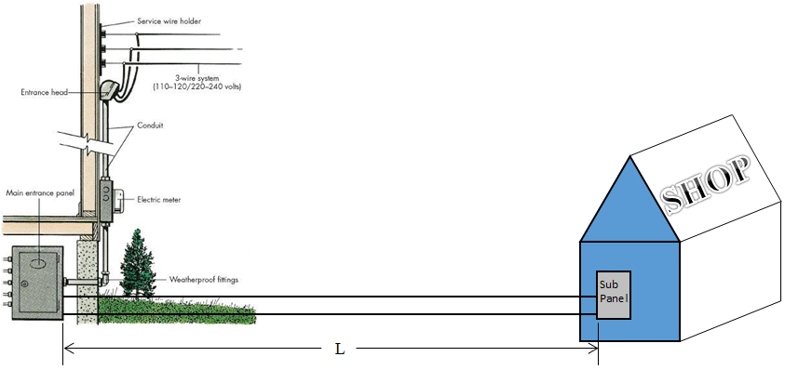
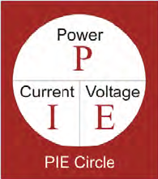
Voltage Drop
E_{s}
I_{T}
15 kW
120/240V
1φ
Total connected load for all the lights and equipment in the shop is 15 kW.
1 kW = 1,000 Watts

Slide 9
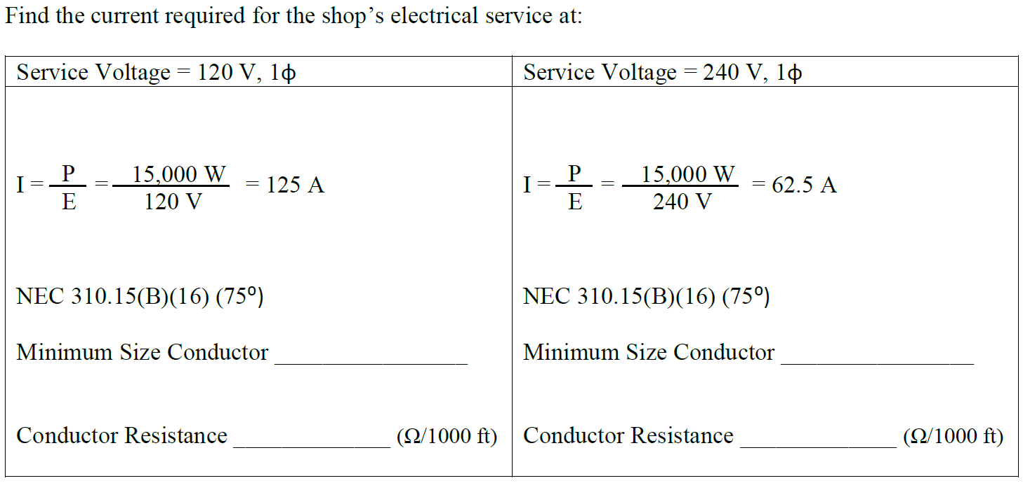
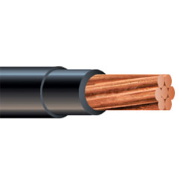
Voltage Drop
#1 AWG
#6 AWG
0.154
0.491
Table 310.15(B)(16)
Table 8

Slide 10
Voltage Drop
R_{Line}
120 V
1φ
R_{Line}
There is a Voltage Drop (VD) due to the Conductor Resistance

Slide 11
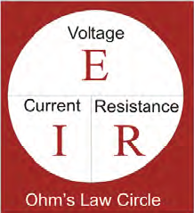
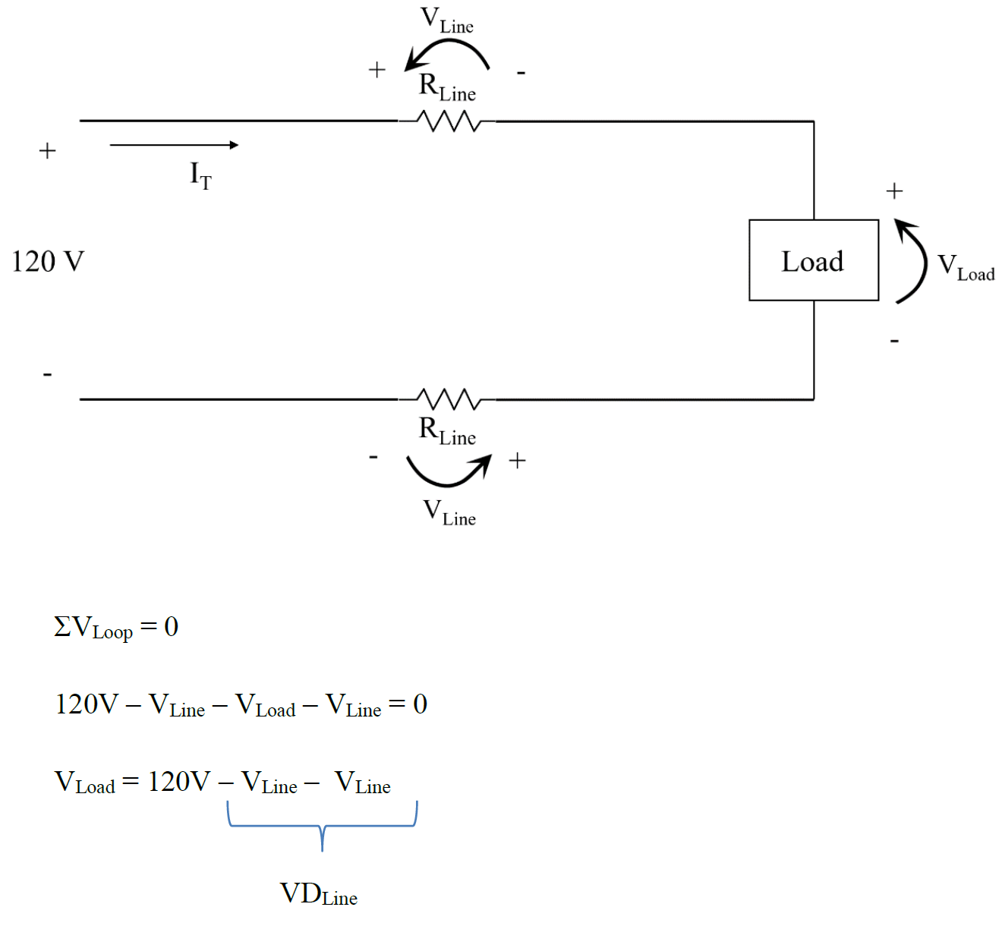
Voltage Drop
Kirchoff’s Voltage Law

Slide 12
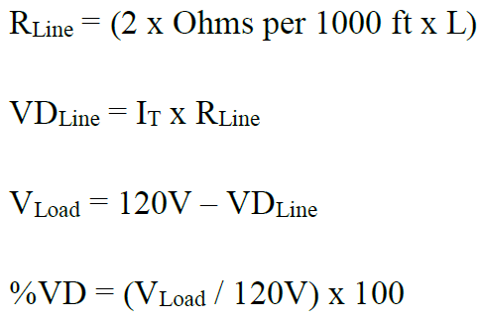
Voltage Drop
Case 1: 120 V, 125 A, #1 – Load Power 15kW
Supply Voltage = 120 V
Load Power = 15 kW
Supply Current = 125 A
Minimum Conductor Size = #1
R_{Line} = (2 x 0.154 Ω x L) / 1000
Length (ft) | R_{Line} (Ω) | VD_{Line} (V) | V_{load} (V) | % VD
90 | 0.02772 | 3.465 | 117 | 2.89
120 | 0.03696 | 4.62 | 115 | 3.85
150 | 0.0462 | 5.775 | 114 | 4.81
230 | 0.07084 | 8.855 | 111 | 7.38

Slide 13
Voltage Drop
Case 2: 120 V, 125 A, #1/0 – Load Power 15kW
Supply Voltage = 120 V
Load Power = 15 kW
Supply Current = 125 A
Minimum Conductor Size = #1 #1/0
R_{Line} = (2 x 0.122 Ω x L) / 1000
Length (ft) | R_{Line} (Ω) | VD_{Line} (V) | V_{Load} (V) | % VD
90 | 0.02196 | 2.745 | 117 | 2.29
120 | 0.02928 | 3.66 | 116 | 3.05
150 | 0.0366 | 4.575 | 115 | 3.81
230 | 0.05612 | 7.015 | 113 | 5.85

Slide 14
Voltage Drop
Case 1: 120 V, 125 A , #1 – Load Power 15kW
Length (ft) | R_{Line} (Ω) | VD_{Line} (V) | V_{Load} (V) | % VD
90 | 0.02772 | 3.465 | 117 | 2.89
120 | 0.03696 | 4.62 | 115 | 3.85
150 | 0.0462 | 5.775 | 114 | 4.81
230 | 0.07084 | 8.855 | 111 | 7.38
Case 2: 120 V, 125 A, #1/0 – Load Power 15kW
Length (ft) | R_{Line} (Ω) | VD_{Line} (V) | V_{Load} (V) | % VD
90 | 0.02196 | 2.745 | 117 | 2.29
120 | 0.02928 | 3.66 | 116 | 3.05
150 | 0.0366 | 4.575 | 115 | 3.81
230 | 0.05612 | 7.015 | 113 | 5.85

Slide 15
Voltage Drop
Case 3: 240 V, 62.5 A, #6 – Load Power 15kW
Supply Voltage = 240 V
Load Power = 15 kW
Supply Current = 62.5 A
Minimum Conductor Size = #6
R_{Line} = (2 x 0.491 Ω x L) / 1000
Length (ft) | R_{Line} (Ω) | VD_{Line} (V) | V_{Load} (V) | % VD
90 | 0.08838 | 5.52375 | 234 | 2.30
120 | 0.11784 | 7.365 | 233 | 3.07
150 | 0.1473 | 9.20625 | 231 | 3.84
230 | 0.22586 | 14.11625 | 226 | 5.88

Slide 16
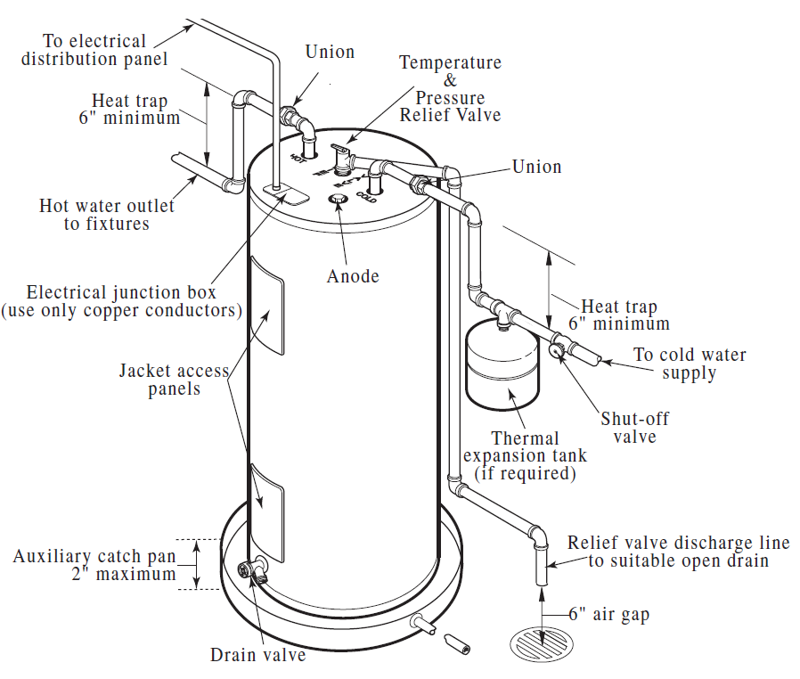
Voltage Drop
Example #2
A residential electric water heater is rated at 4.5 kW and operates at 208V (single phase wiring).
Determine the recommended Over Current Protection (OCP) (Circuit Breaker amperage rating)
Determine the copper wire size AWG based on NEC.

Slide 17
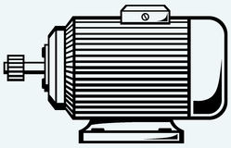
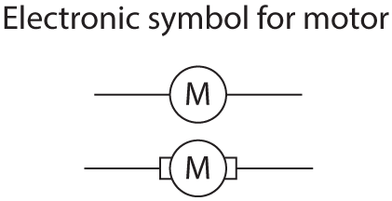
Voltage Drop
Example #3
A current of 4 amps is flowing in a conductor that has a resistance of 2Ω per 1,000 feet. Find the voltage drop if the distance from the source to the load is 1,000 feet.
+
Source
-
4 amps

Slide 18
Voltage Drop
Example #3
A current of 4 amps is flowing in a conductor that has a resistance of 2Ω per 1,000 feet. Find the voltage drop if the distance from the source to the load is 1,000 feet.
R_{Line}
= 2 Ω
+
Source
-
4 amps
R_{Line}
= 2 Ω
Supply Current = 4 A R_{Line} = 4 Ω VD = 4 A x 4 Ω = 16 V

Slide 19
Voltage Drop
Example #4
An extension power cord made of CU #12 THWN is powering a lamp 300 feet from the source. The lamp resistance is 72 Ω and the source voltage is 120 V. Find the voltage drop across the lamp.
120 V
I
R_{lamp} = 72 Ω
19

Slide 20
Voltage Drop
Example #4
An extension power cord made of CU #12 THWN is powering a lamp 300 feet from the source. The lamp resistance is 72 Ω and the source voltage is 120 V. Find the voltage drop across the lamp.
R_{line} = 1.98 Ω
120 V
I
R_{lamp} = 72 Ω
R_{line} = 1.98 Ω
R_{Line} = (2 x 1.98 Ω x L) / 1000 = (2 x 1.98 Ω x 300 ft) / 1000 = 1.188 Ω
I = 120 V / 73.188 Ω = 1.64 A
E_{lamp} = 1.64 A x 72 Ω = 118 V
20

