Slide 1
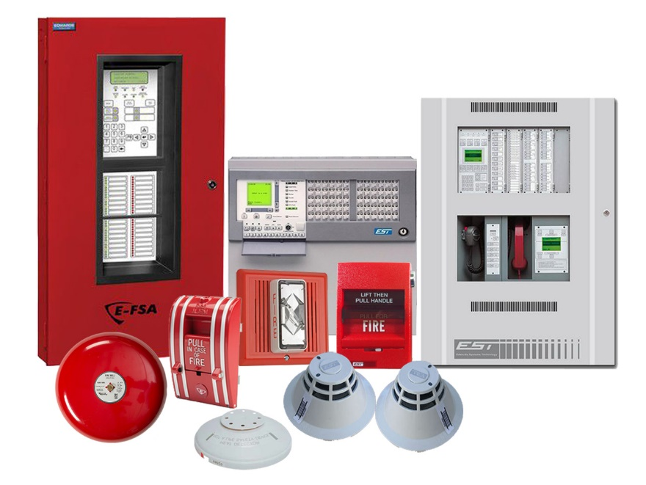
Commercial Building Electrical Systems – Low Voltage Systems

Slide 2
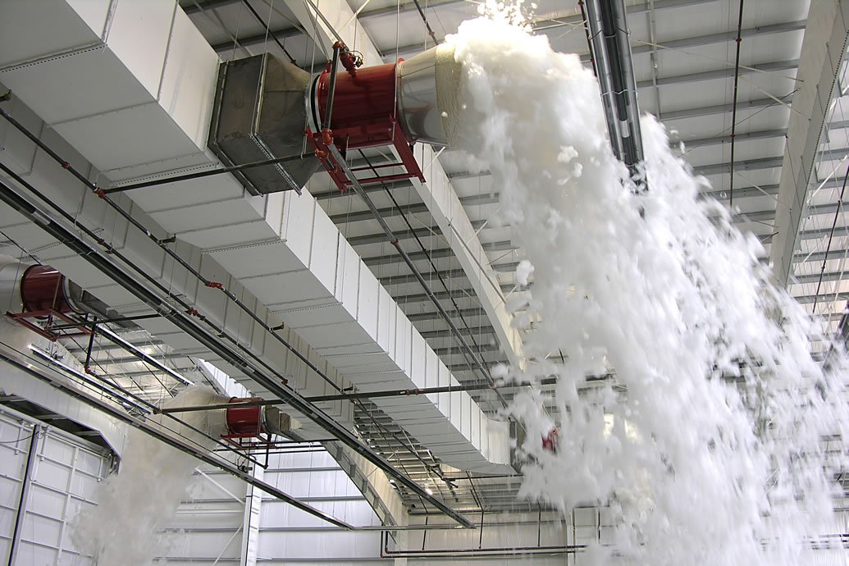

Commercial Building Electrical Systems – Low Voltage Systems

Slide 3
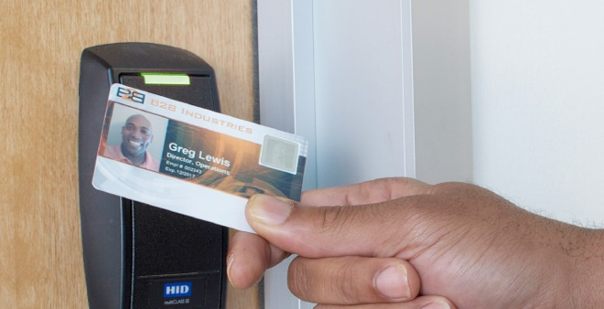
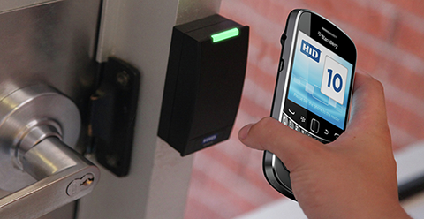

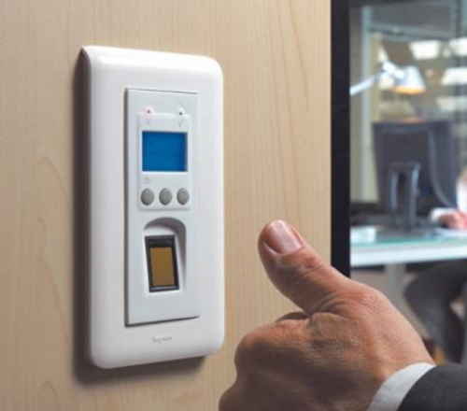
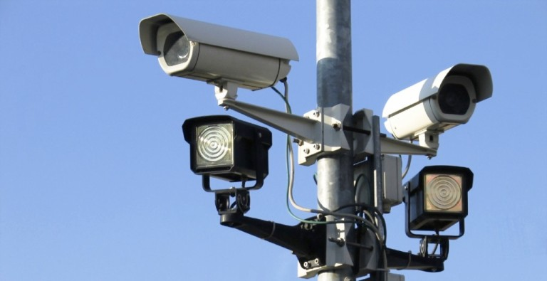
Commercial Building Electrical Systems – Low Voltage Systems

Slide 4
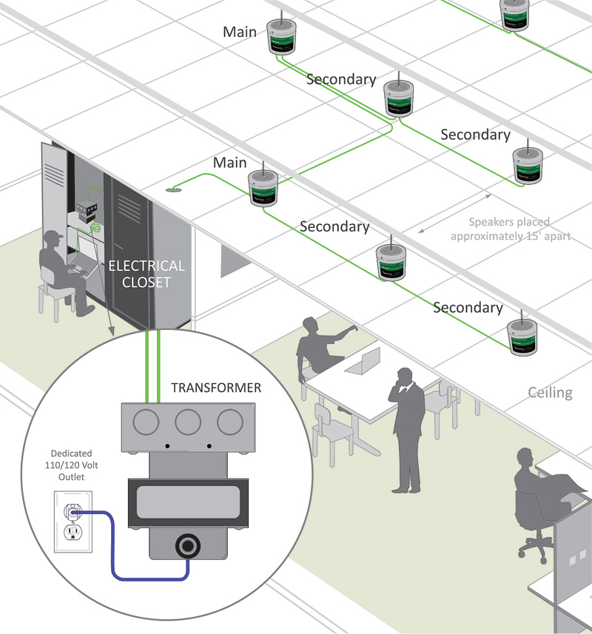
Commercial Building Electrical Systems – Low Voltage Systems

Slide 5
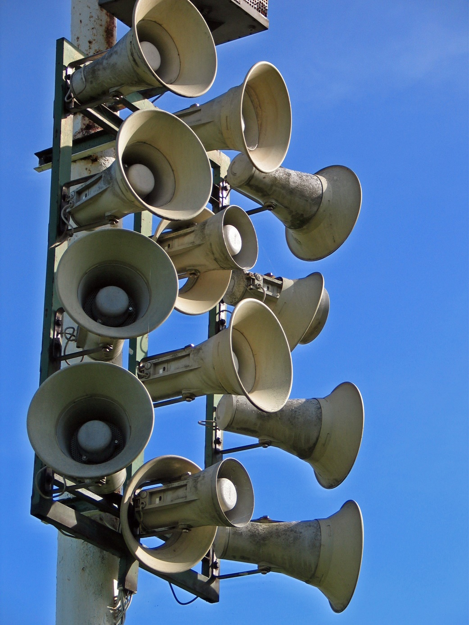
Commercial Building Electrical Systems – Low Voltage Systems

Slide 6
Commercial Building Electrical Systems – Low Voltage Systems

Slide 7
Commercial Building Electrical Systems – Low Voltage Systems

Slide 8
Commercial Building Electrical Systems – Low Voltage Systems

Slide 9
Commercial Building Electrical Systems – Low Voltage Systems

Slide 10
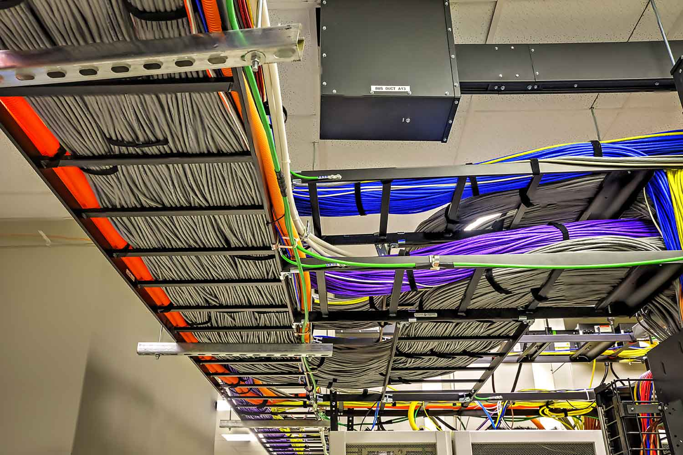
Commercial Building Electrical Systems – Low Voltage Systems

