Slide 1
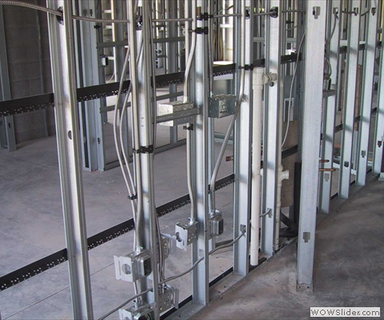
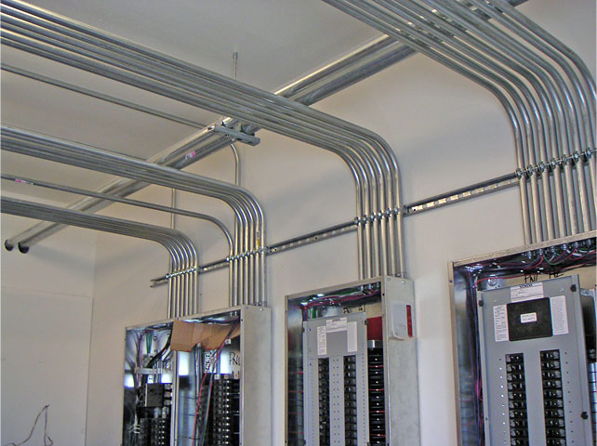
Commercial Building Electrical Systems - Power

Slide 2
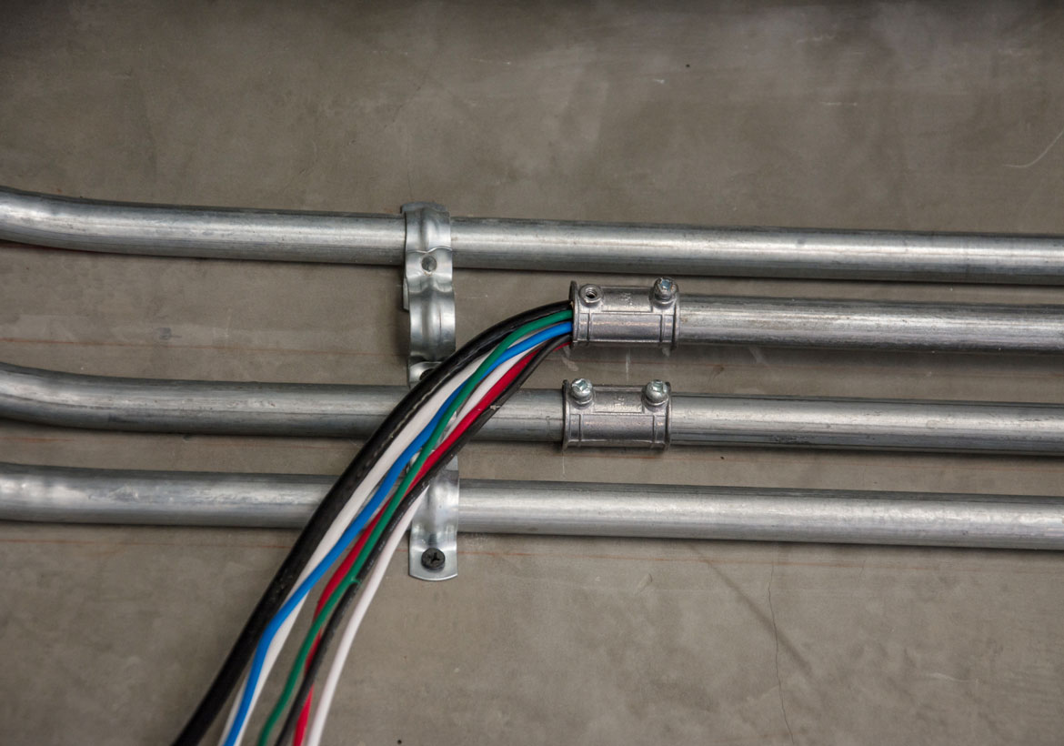
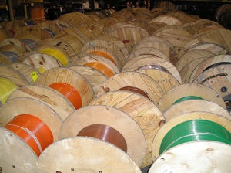
Commercial Building Electrical Systems - Power
Building Wire and Cable
Most commonly known as branch circuit wiring
Supplies electrical current to all external uses of power in a building or dwelling

Slide 3
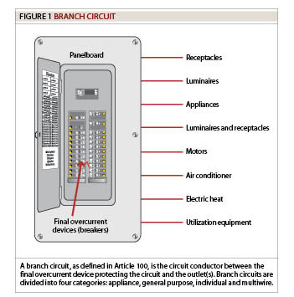
Commercial Building Electrical Systems - Power

Slide 4
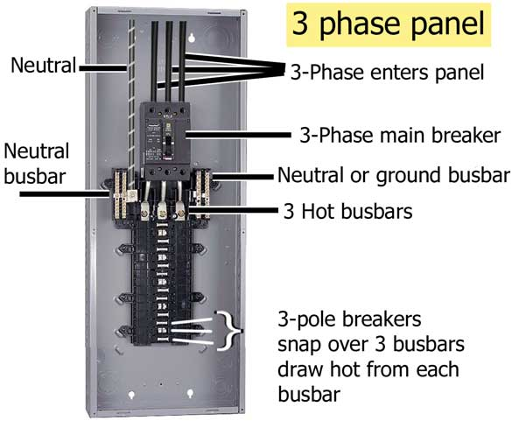
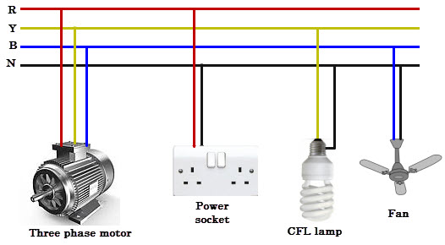
Commercial Building Electrical Systems - Power

Slide 5
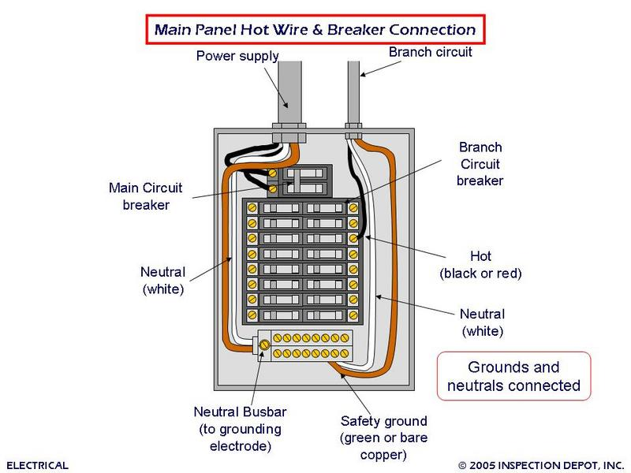
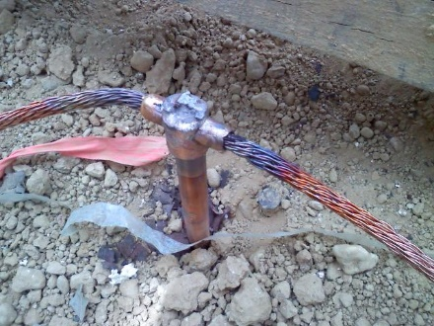
Commercial Building Electrical Systems - Power

Slide 6
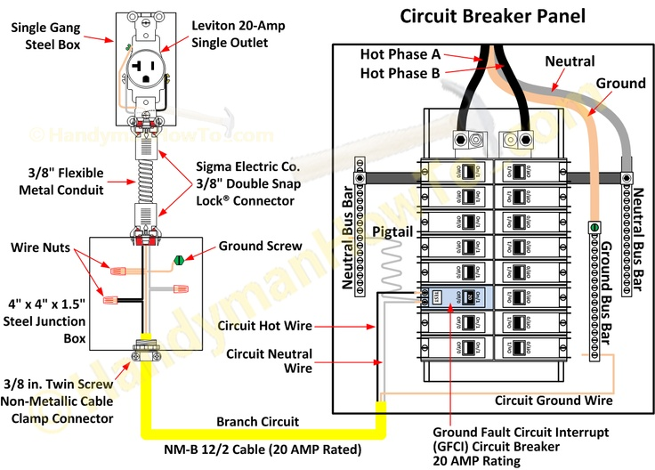
Commercial Building Electrical Systems - Power

Slide 7
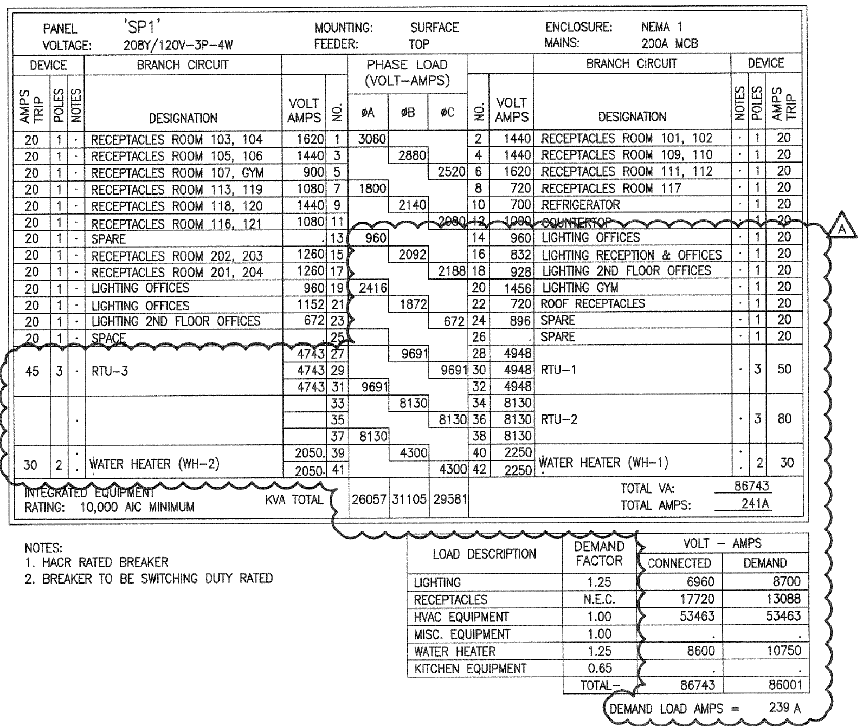
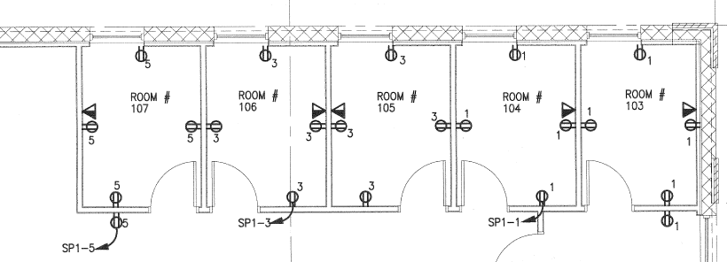
Commercial Building Electrical Systems - Power

Slide 8
Commercial Building Electrical Systems - Power
Electrical Homerun
An electrical homerun is a wiring run that connects directly to a building's electrical panel (source).
It is usually shown on a plan using an arrow with the panel name and circuit number(s) it connects to.

Slide 9
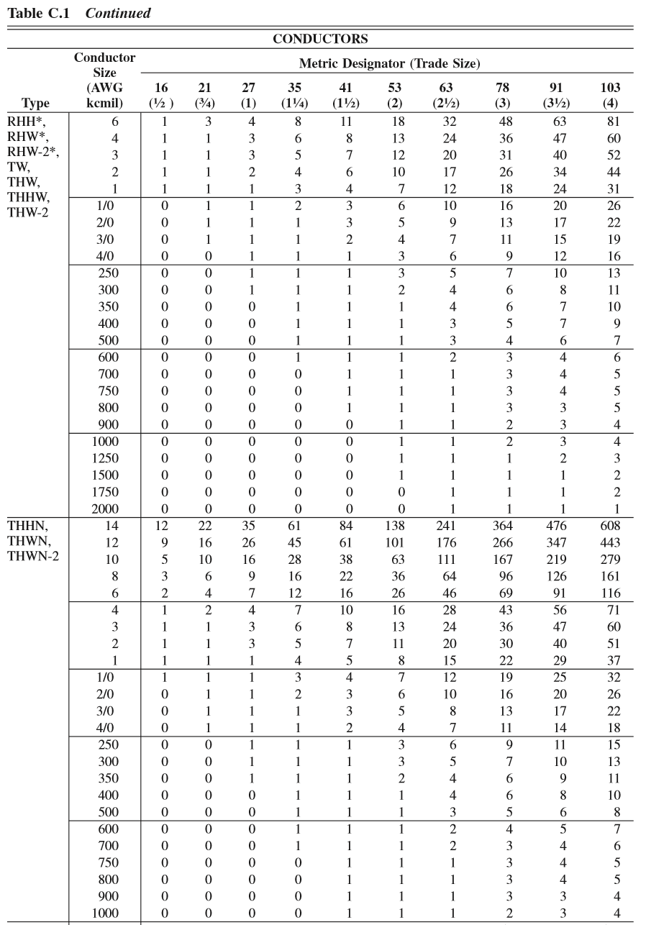
Commercial Building Electrical Systems - Power
Raceway Fill

Slide 10
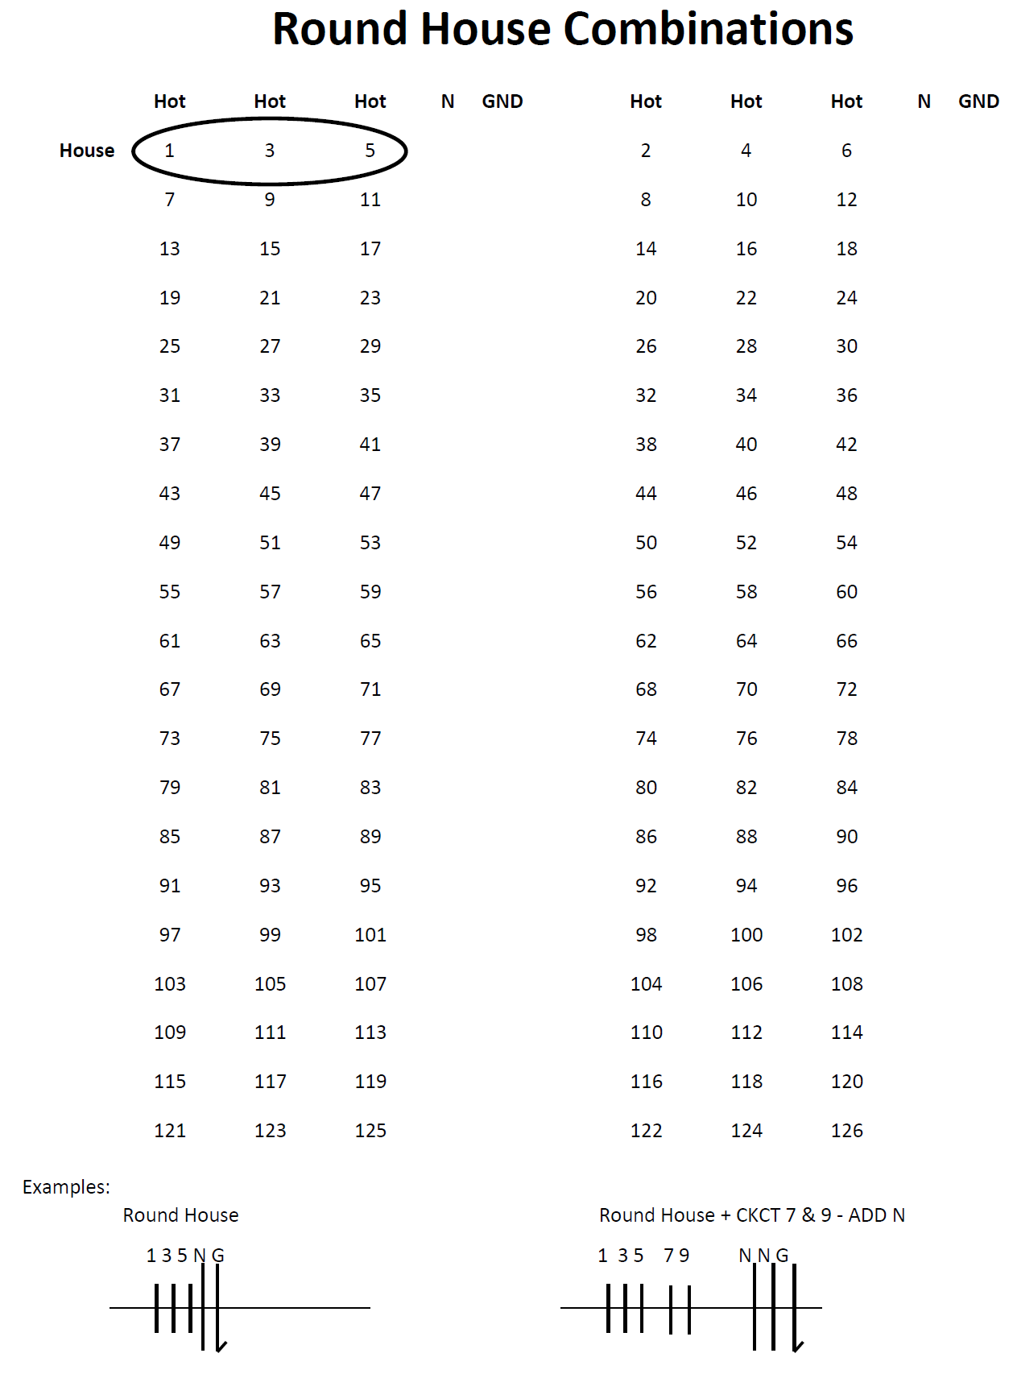

Slide 11
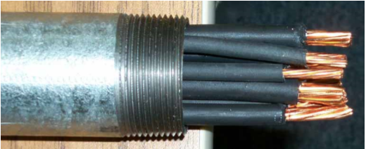
Commercial Building Electrical Systems - Power
Branch Power
5
3
3
1
1
1 3
1 3
1
1
SP1- 1, 3, 5

Slide 12
Commercial Building Electrical Systems - Power
Branch Lighting

